Slide 1

Well-being throughout training
What’s the problem?
What’s the science?
What can we do?
Notes:
Trigger warning – look after yourself. Leave if you need to.

Slide 2

Notes:
How are you coming into today
How do you want to feel by the end of the day?
What will get you from the 1st to the 2nd

Slide 3
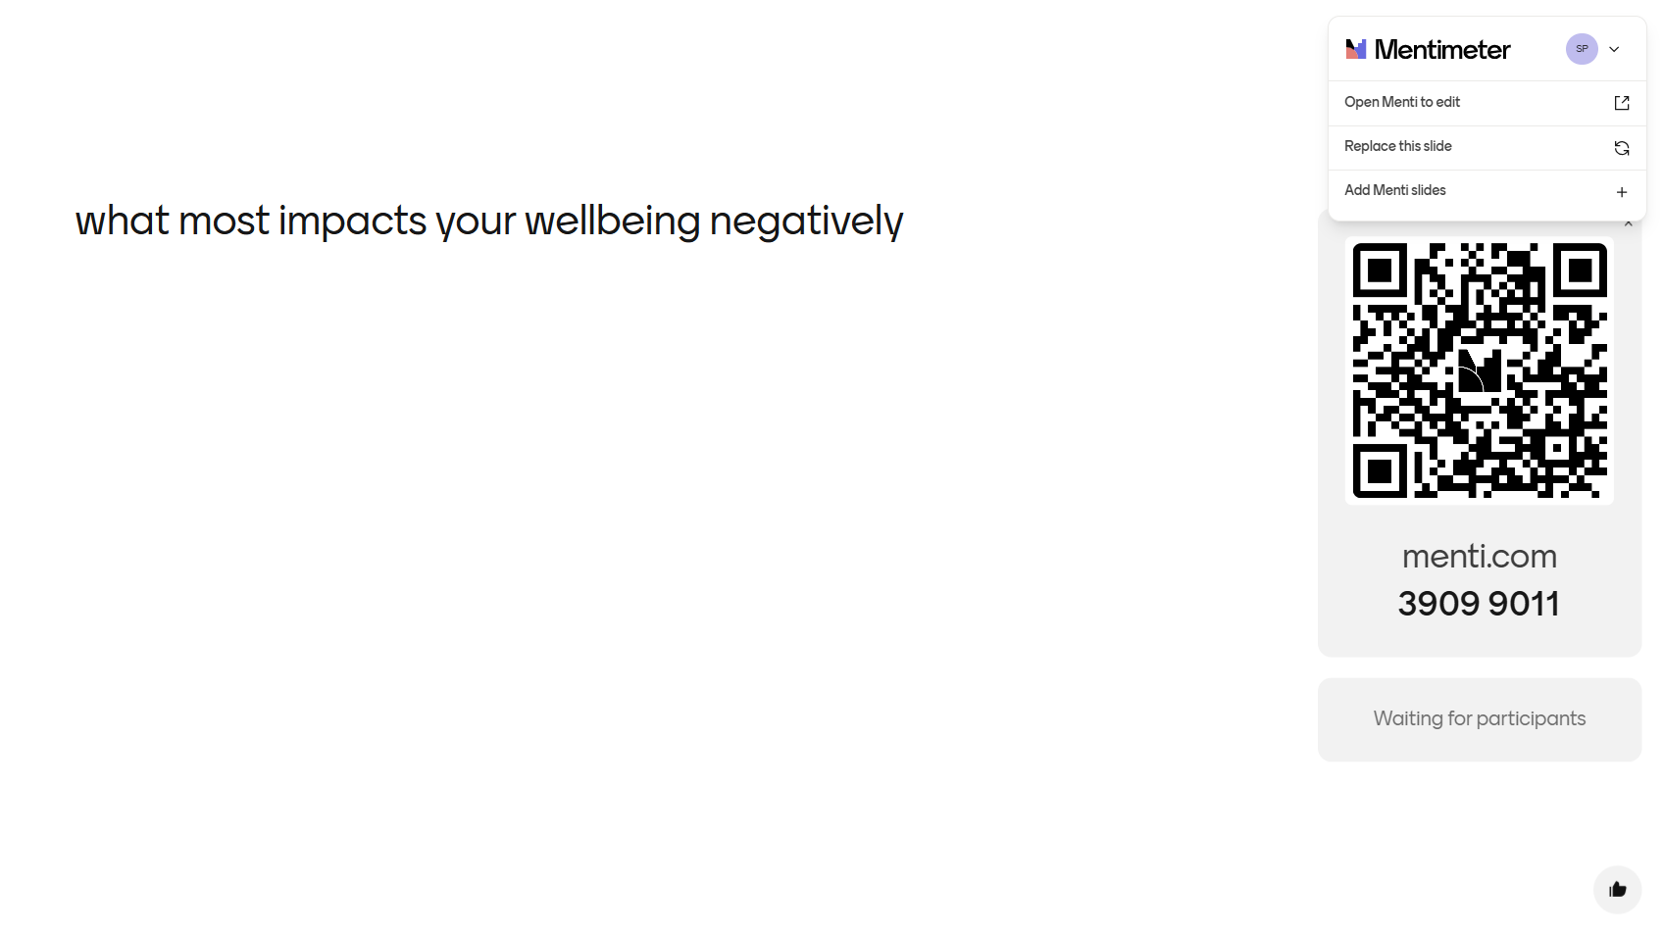
what most impacts your wellbeing negatively

Slide 4
What’s the problem?
Bullying
Racism
Workload
Staffing
Overwhelm
Compassion fatigue
Moral injury
Trauma
Relentless scrutiny/ targets/ WPBA
Portfolio
Family pressures
Cultural pressures
Worry about complaints
We could go on!

Slide 5
Worries about complaints:
GMC statistics (2022)
8,893 Drs referred annually, out of 357,198 Drs on the register (about 2.5%)
75% concerns raised by public
At initial triage:
851 were investigated further, (about 10%) and 300 were dealt with at RO/ employer level
7,725 were closed ie, 86% closed on triage or initial assessment
169 were erased/ suspended and 40 had conditions/ warning/ undertakings
Notes:
Growth mindset
Feedback is a professional opinion – it’s not personal. Look for the treasure

Slide 6

The Mental health crisis in doctors and the consequences
33% feel burnt-out
29% have depression
24% anxiety
10% suicidal ideation
1 doctor dies by suicide every 3 weeks in the UK

Slide 7
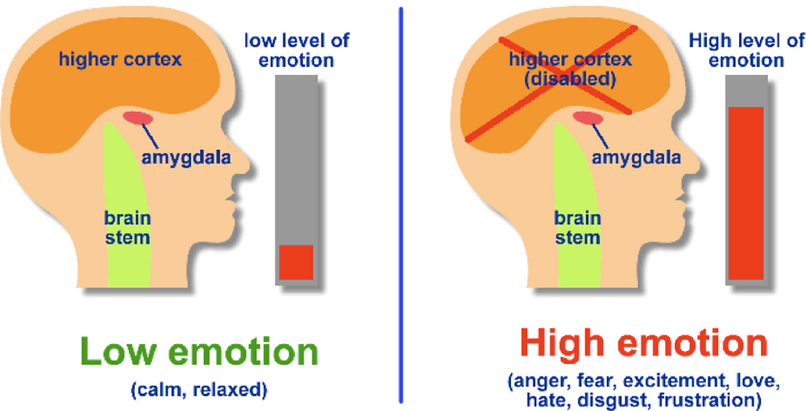
What’s The science?
Amygdala hijack

Slide 8
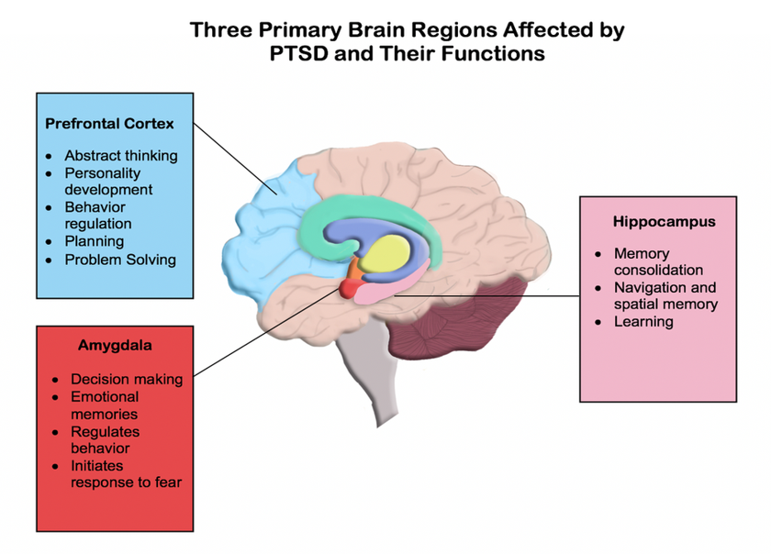

Slide 9
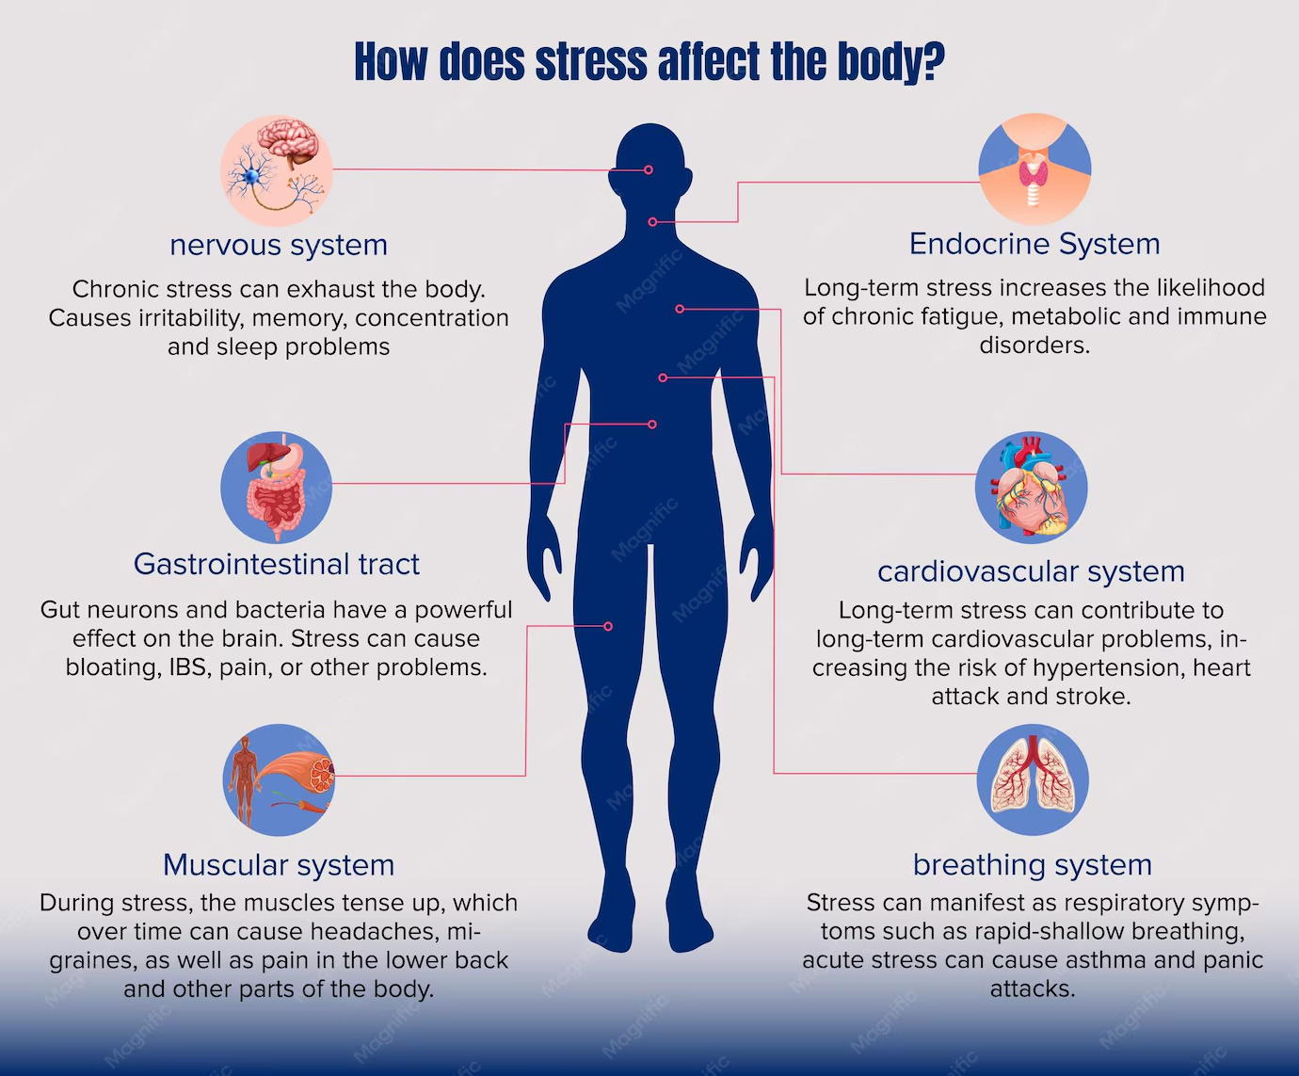

Slide 10
Sleep deprivation alone causes:
An undermined immune function
Issues with memory retention
Worse emotional resilience
Impaired ability to perform
Impaired ability to process trauma

Slide 11
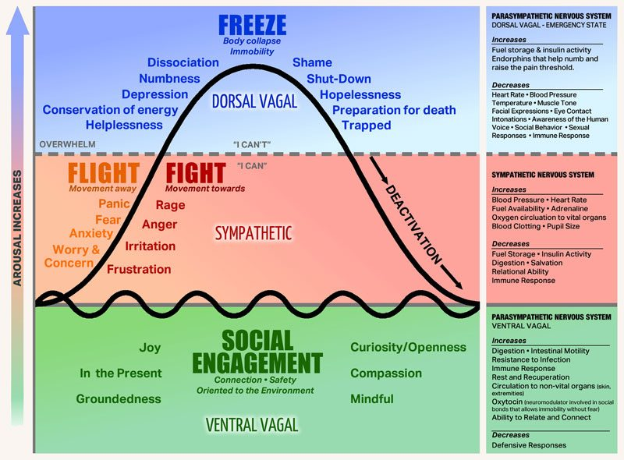
Polyvagal
theory
Triggers
What moves you
up or down?
Glimmers

Slide 12
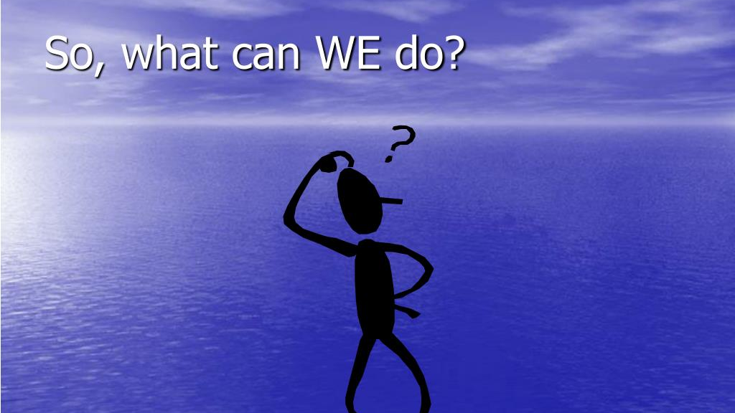
Notes:
In pairs/threes again, what are their methods for helping cope

Slide 13

Understand the issues

Slide 14
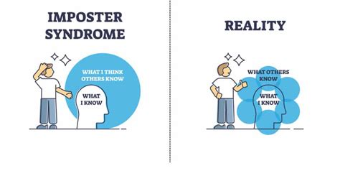

Slide 15
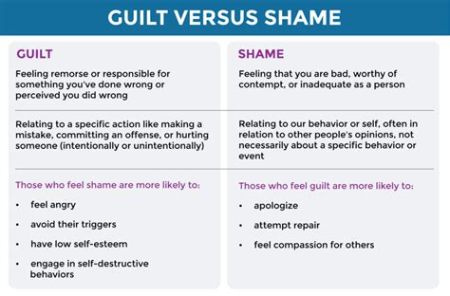

Slide 16
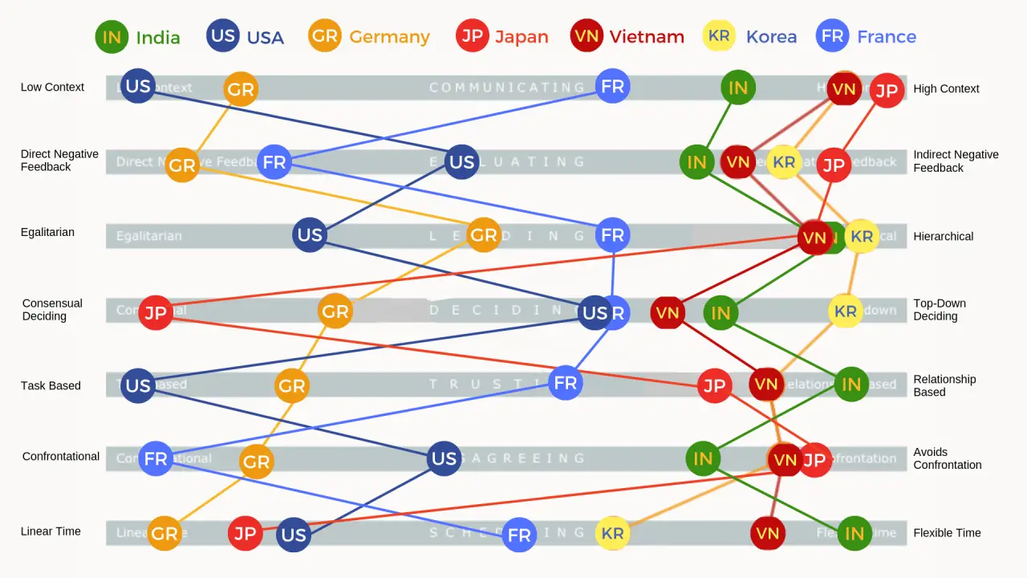
Understand Cultural influences
(Ref: Erin Meyers work)

Slide 17
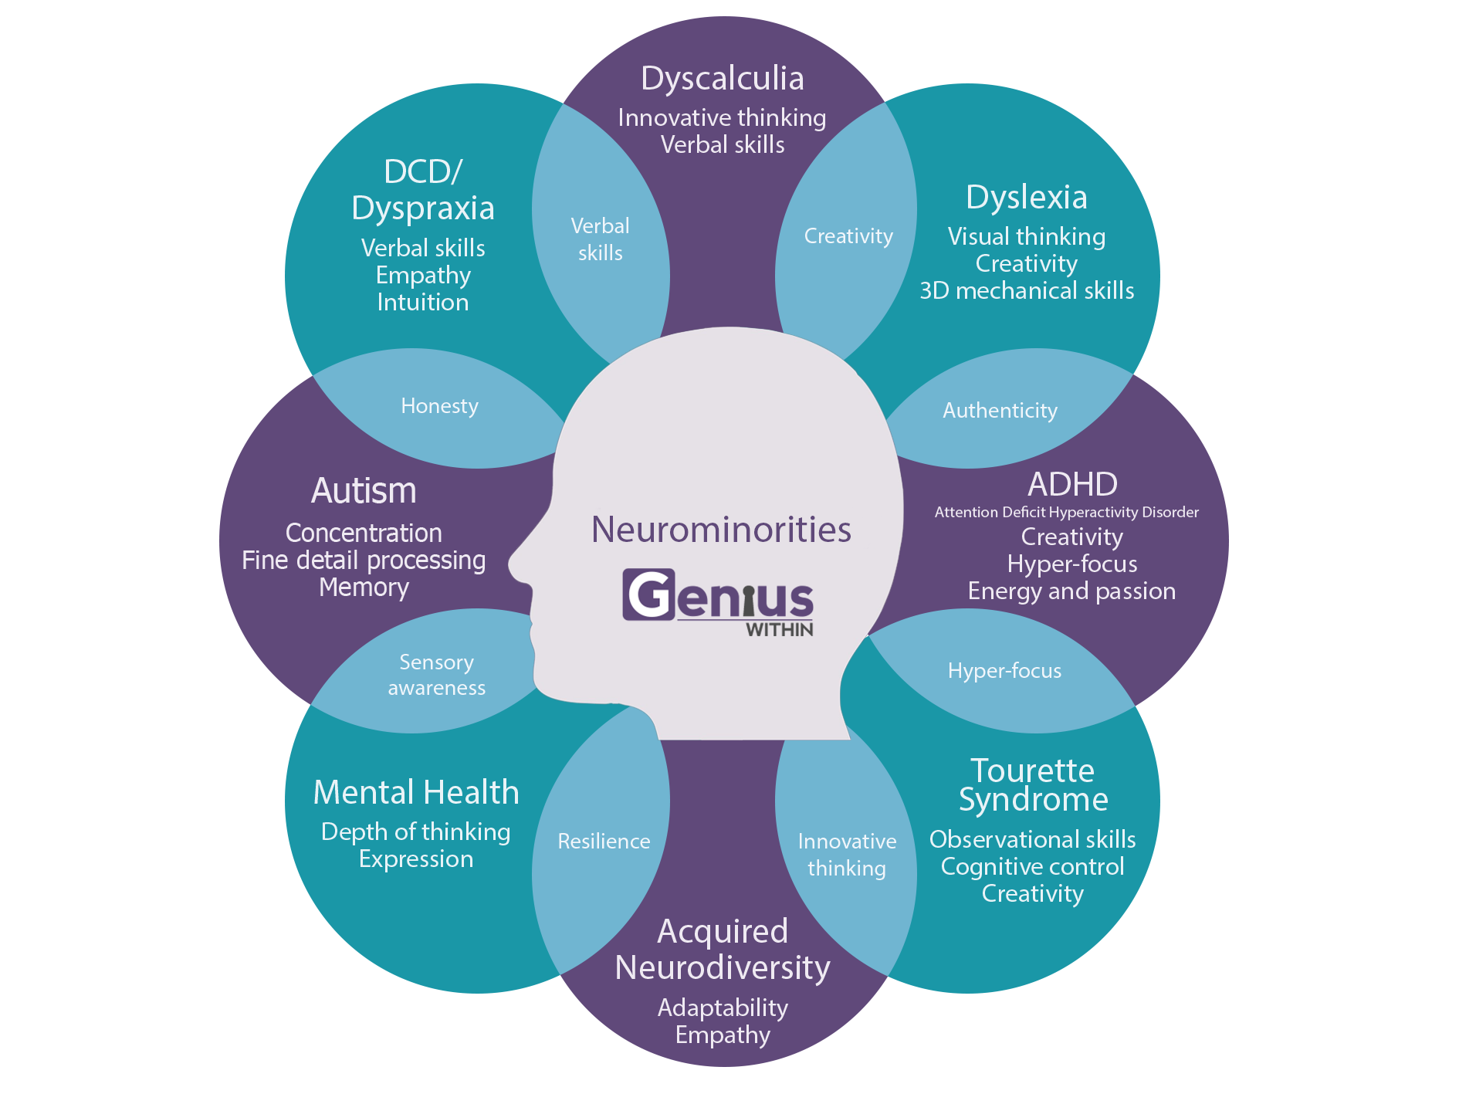
understand differences
in how brains work

Slide 18
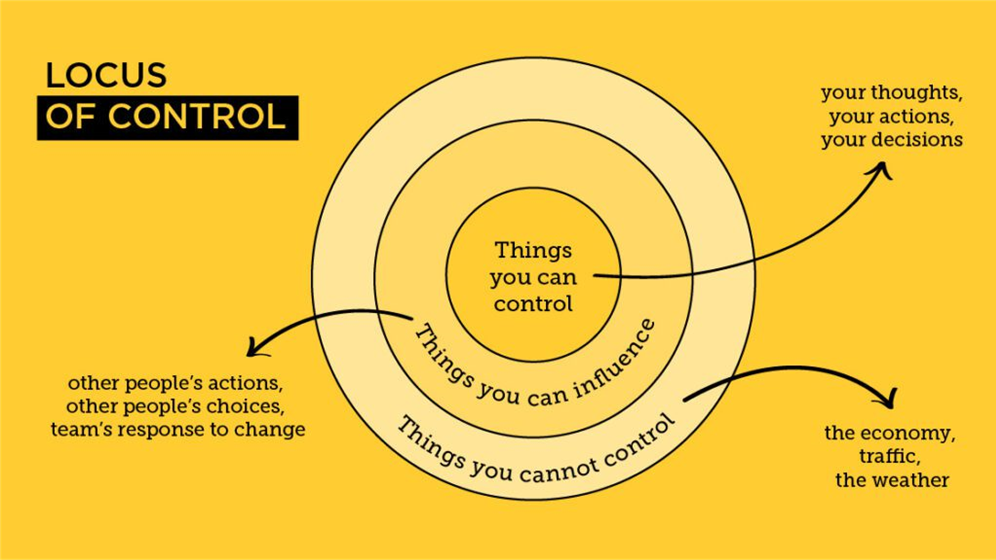
Understanding your zone of power
Notes:
Remember, hurt people hurt people. Don’t take things personally

Slide 19

“Lack of planning on your part does not constitute a crisis on mine” – step back, look at the whole situation: what’s my responsibility here?

Slide 20
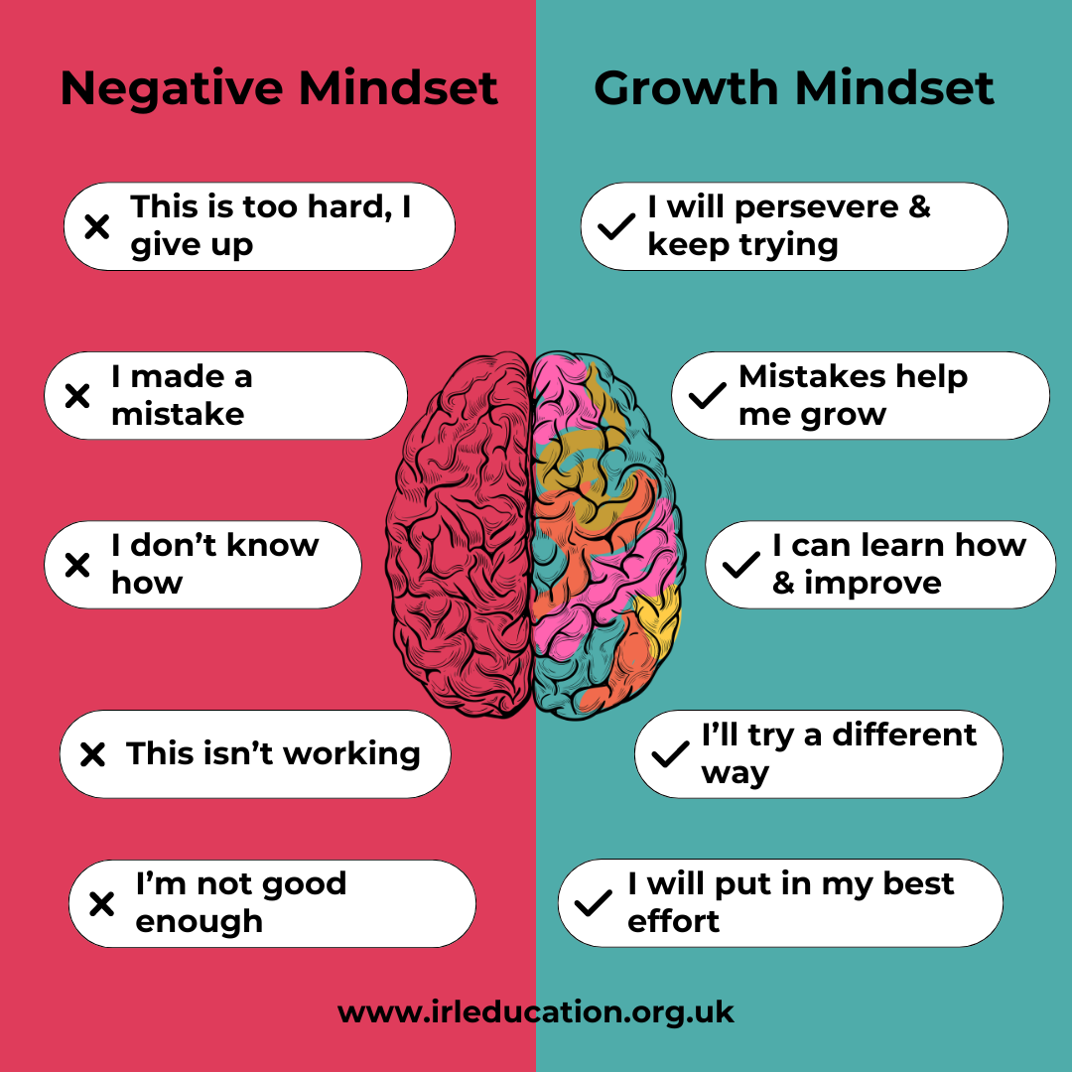

Slide 21
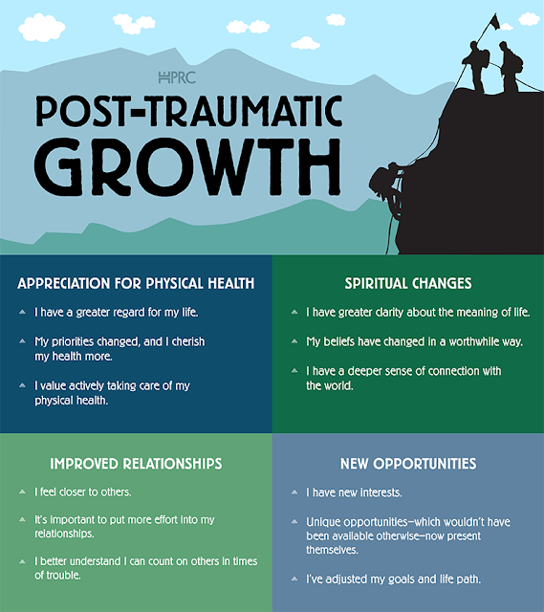

Slide 22
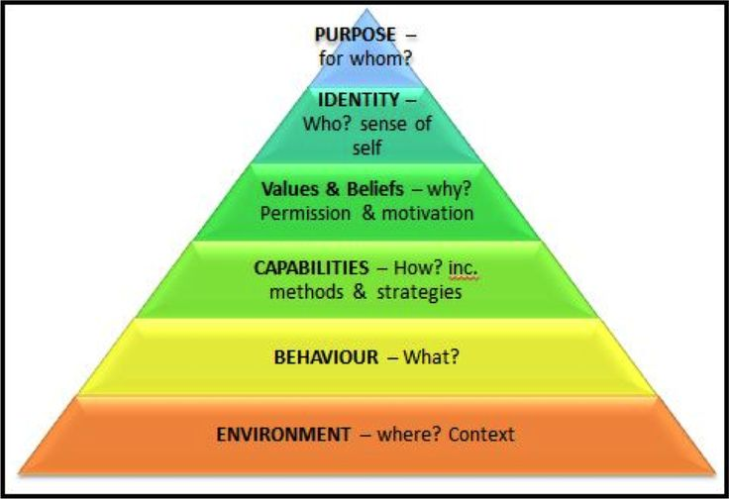
Have tools to tackle the issues
Notes:
Talk through and get them to work through an issue in pairs

Slide 23

Use tools and techniques to help

Slide 24
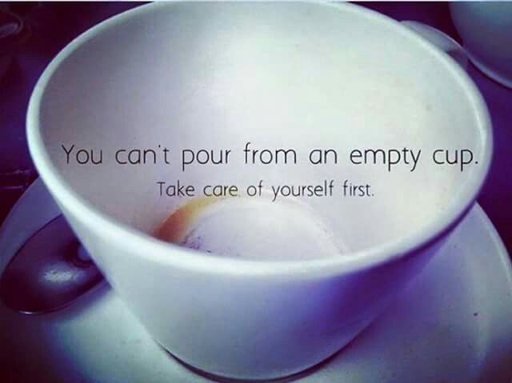

but you also can’t hear if you’re overflowing with your own wisdom
Notes:
Your well being is non-negotiable. “ give from your bucket, not from your well!”

Slide 25

what most impacts your wellbeing positively

Slide 26
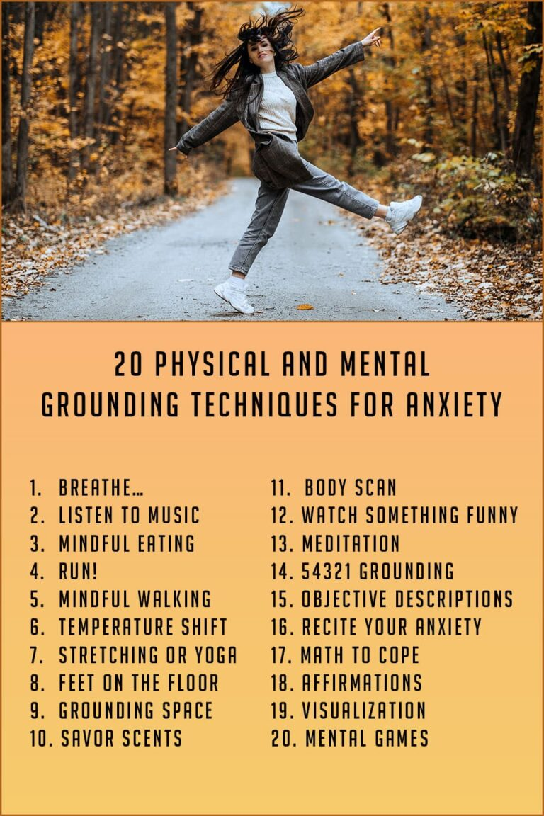
Suggestions to help:

Slide 27
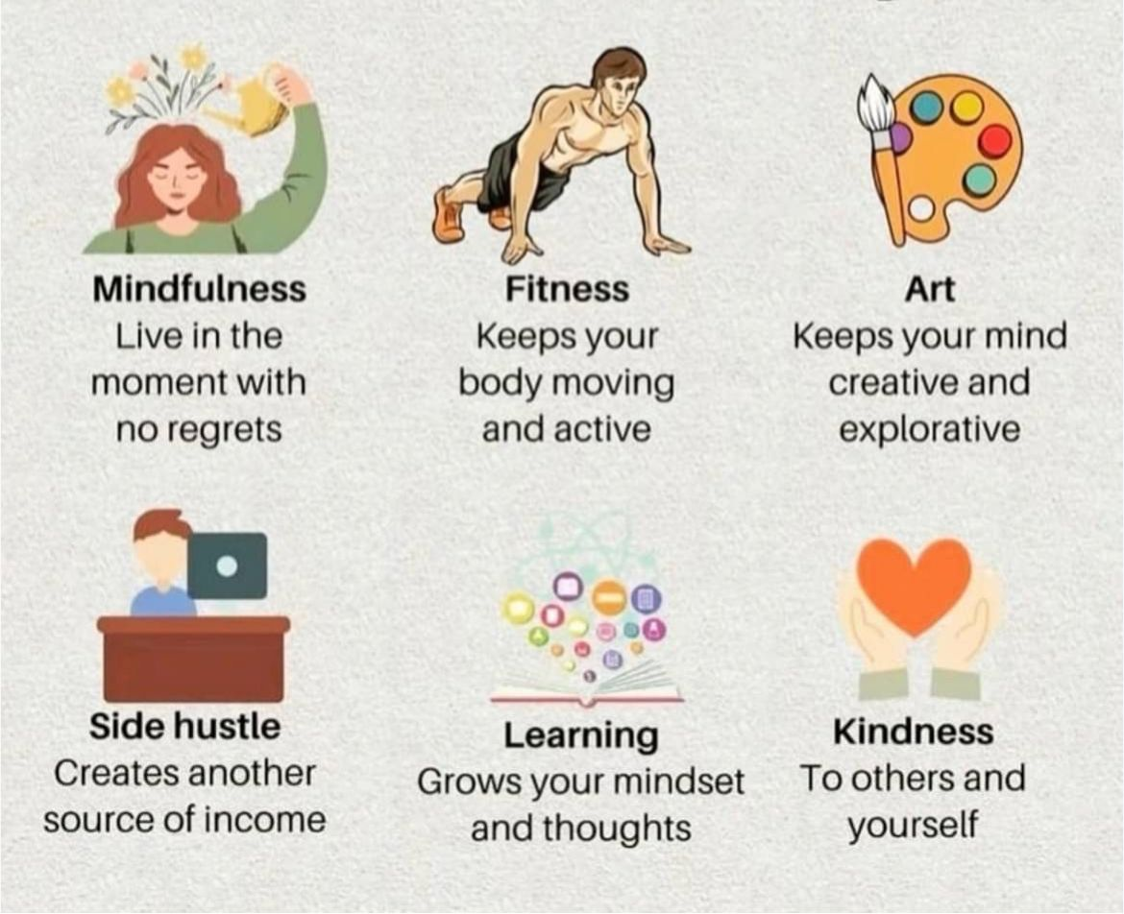
Hobbies

Slide 28
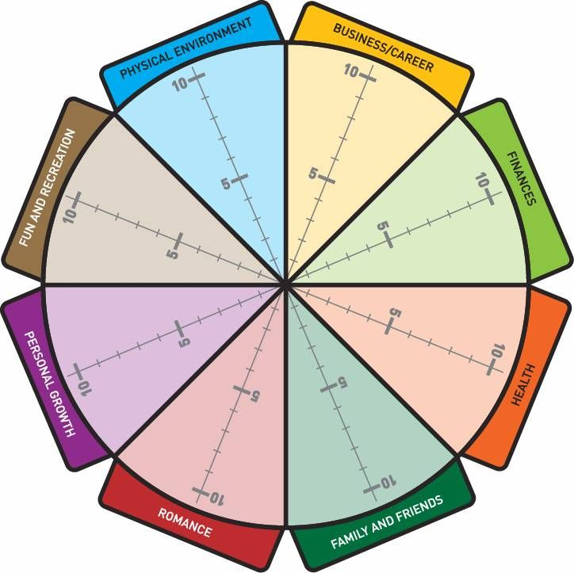
Know where you are:
Notes:
10mins to do and then discuss with partner/ three

Slide 29
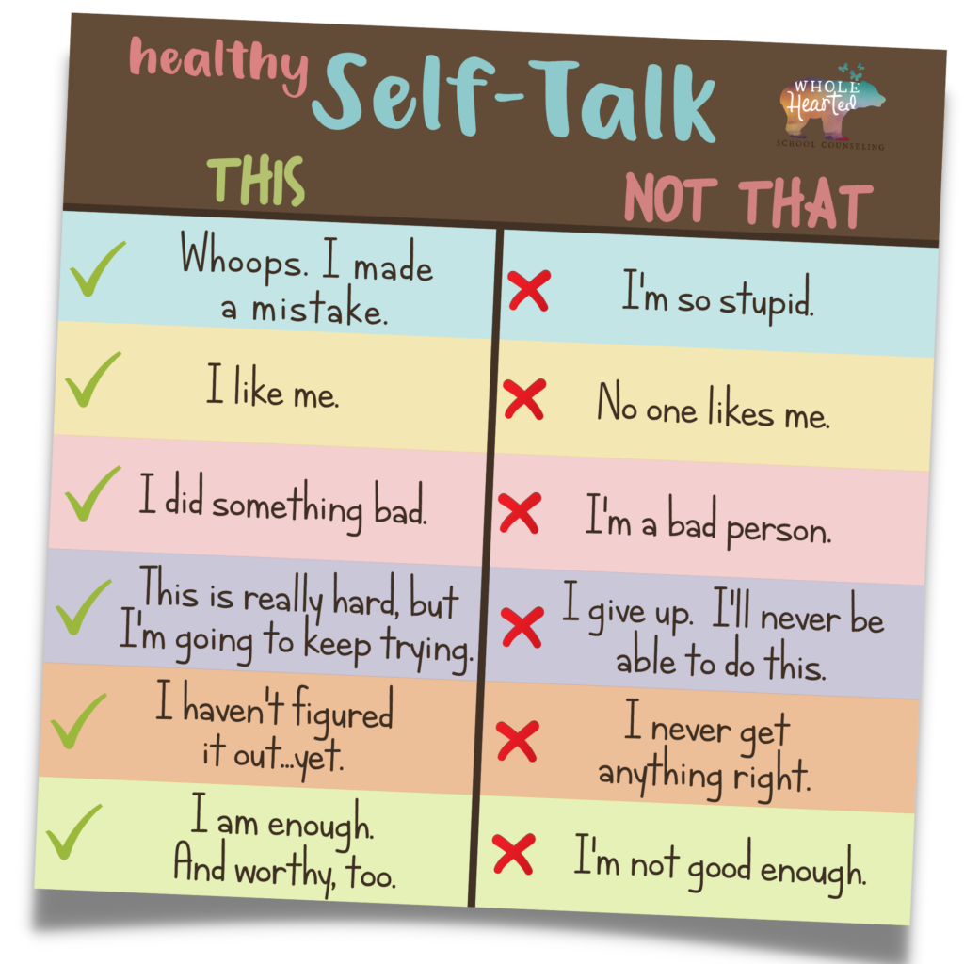
The language we talk to ourselves with matters
Eg, “you have failed this attempt at this exam”
Vs
“you are a failure”

Slide 30
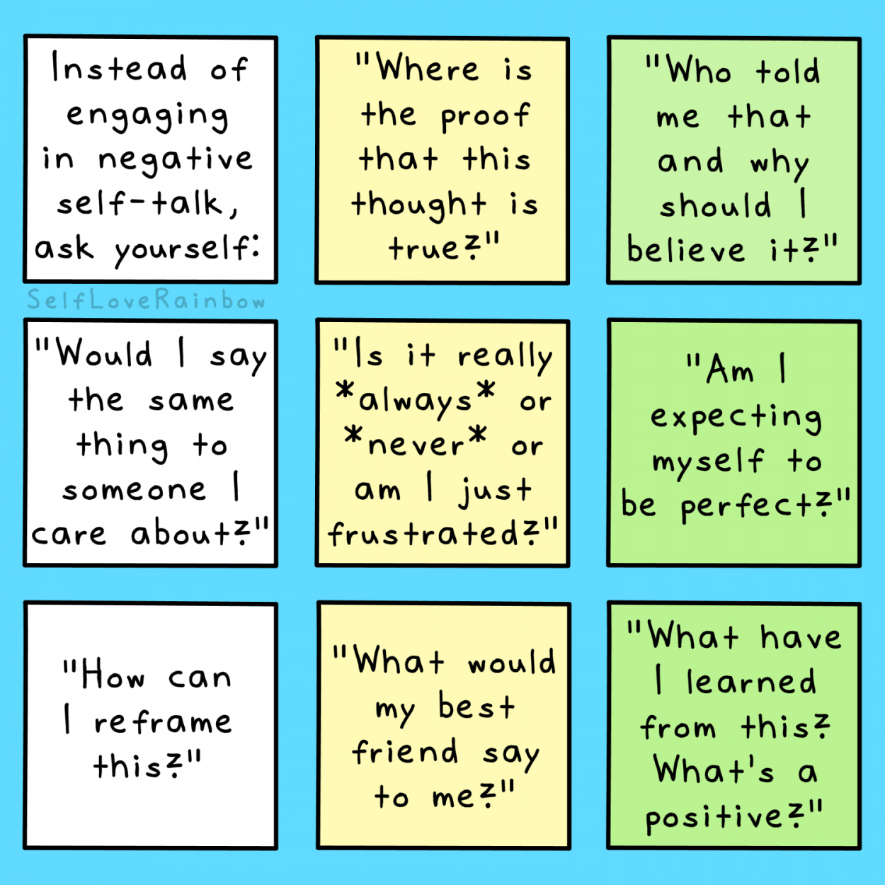

Slide 31


Slide 32


Slide 33
Coaching questions to ask yourself
I am at my best when ……
I enjoy my work when ……
I enjoy interacting with people when …..
My energy is filled up when ……
My energy is depleted when …….
If I was on my death bed, what would really matter is ……

Slide 34
Gratitude / 3 good things
What were 3 things that went well today and what was my role in bringing that about?
What am I grateful for today?

Slide 35
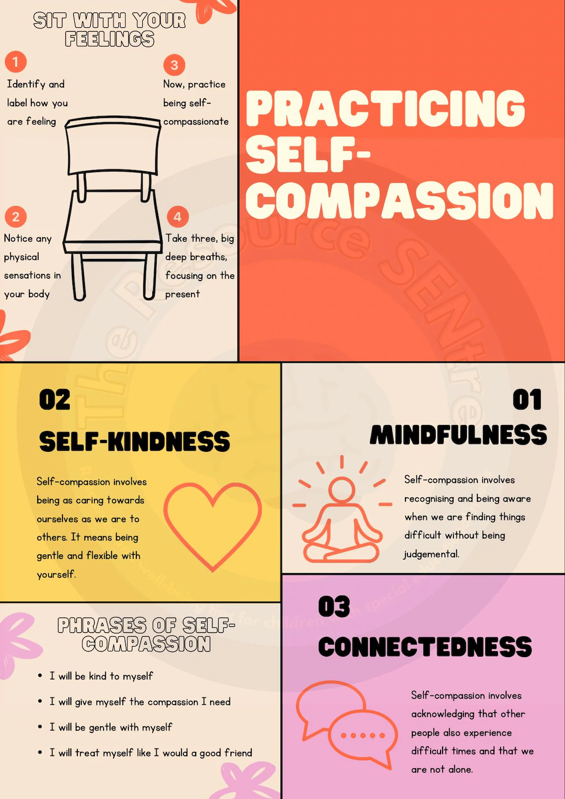

Slide 36

Tiny experiments

Slide 37


Slide 38
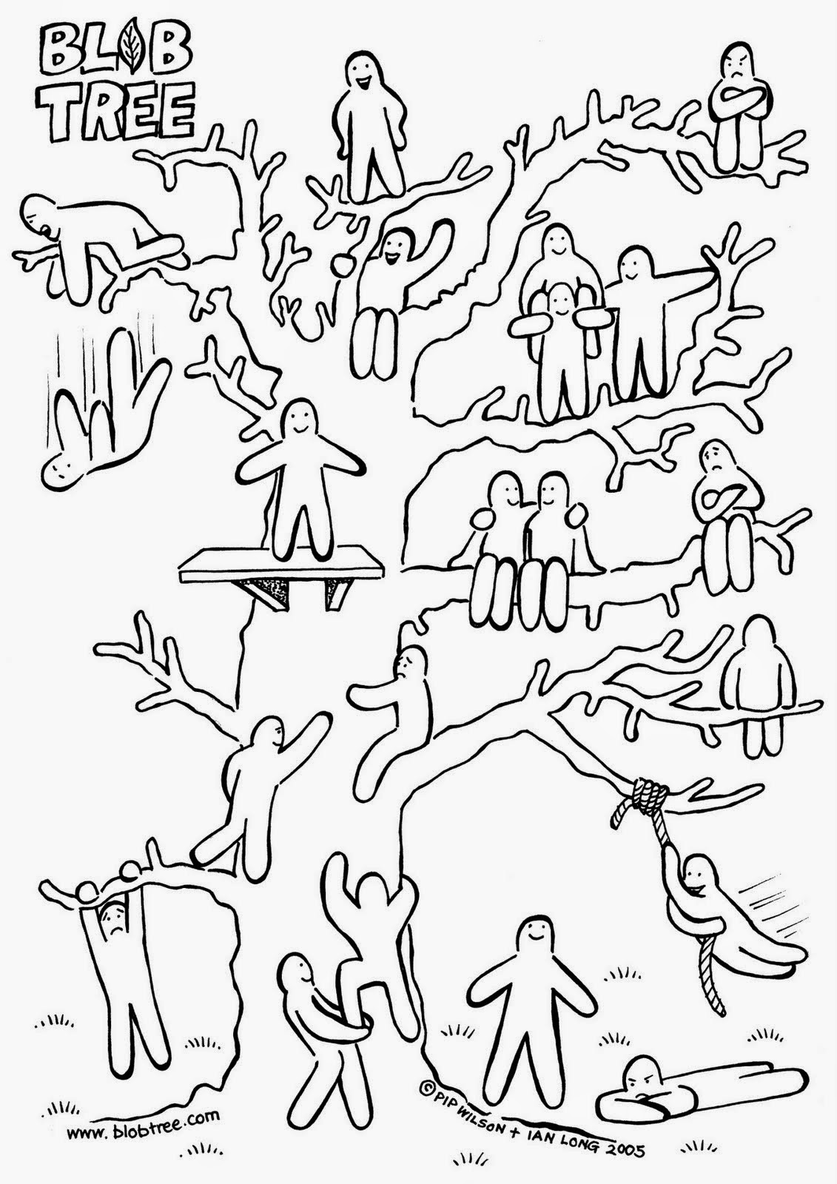
Know yourself
How do you feel now?
How do you want to feel?

Slide 39

Thank you for attending

Slide 40
Resources
PSW - https://wessex.hee.nhs.uk/wellbeing-and-support/psw/
BMA’s 24/7 confidential counselling - https://www.bma.org.uk/advice-and-support/your-wellbeing/wellbeing-support-services/counselling-and-peer-support-services
NHS practitioner health - https://www.practitionerhealth.nhs.uk/
Samaritans - https://www.samaritans.org/
Drs in distress - https://doctors-in-distress.org.uk/
You Ok Doc - https://youokaydoc.org.uk/
You are not a frog podcast - https://youarenotafrog.com/

Slide 41
More resources
Women’s aid - https://www.womensaid.org.uk/
Men’s aid - https://www.mensmindsmatter.org/
Financial support - https://rmbf.org/, https://doctorshelp.org.uk/, https://www.dsn.org.uk/financial-support-for-doctors
Sick doctors trust - http://sick-doctors-trust.co.uk/
The employing Trust help – freedom to speak up guardian, OH
Access to work - https://www.gov.uk/access-to-work
https://www.mymichigan.org/quality-safety/3-good-things/

Slide 42
And more
https://www.bma.org.uk/advice-and-support/equality-and-diversity-guidance/discrimination-guidance/managing-discrimination-from-patients-and-their-guardians-and-relatives/steps-for-any-worker
www.thehappymd.com – one minute stress busters
https://www.thecalmzone.net/
Books like: The Chimp Paradox by Steve Peters
The stress solution by Rangan Chatterjee
Why has nobody told me this before by Julie Smith

Slide 43
support
https://wessexlmcs.podbean.com/e/technostress/ - Exploring the hidden impact of digital technology on healthcare professionals and practical ways to reduce digital overload.
Coping with Imposter Syndrome https://www.podbean.com/media/share/pb-fwd78-145f933?utm_campaign=admin_episode&utm_source=episode_share_pb&utm_medium=dlink - John Perry, a counsellor and coach, provides tips for coping with Imposter Syndrome.
How We Can Cope with Ongoing Stress https://www.podbean.com/media/share/pb-amk8y-113e8fd?utm_campaign=w_share_ep&utm_source=w_share_pb&utm_medium=dlink - practical ways to manage ongoing stress, build resilience, and support psychological wellbeing.

Slide 44
References:
chrome-extension://efaidnbmnnnibpcajpcglclefindmkaj/https://www.gmc-uk.org/-/media/gmc-site/about/how-we-work/annual-report-2022/fitness-to-practise-annual-statistics-report-2022.pdf

