Slide 1
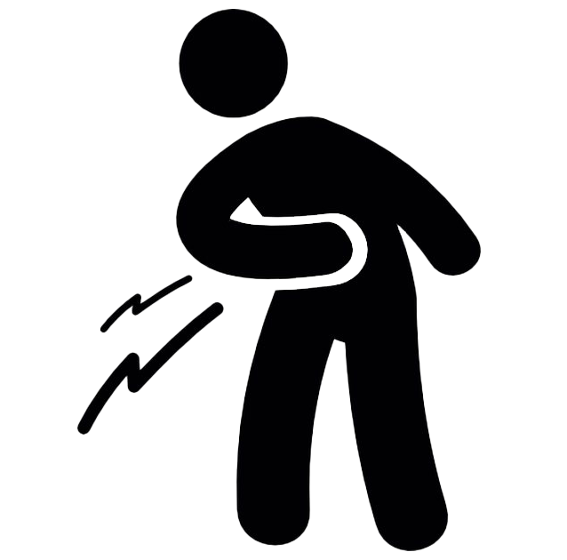
Pain: prescribing, pitfalls and potential
Dr Sam Powell
This Photo by Unknown Author is licensed under CC BY-NC
Notes:
What we’re going to cover
Why relevant to them? – who saw a pt with pain this week?
How – with some exercises and exploring the topics
Why do I care?
Trigger warning

Slide 2
agenda
9.30 Pain – definitions
9.45 Case discussion – escalating meds?
10.00 Nociceptive pain
10.15 Prescribing options – what to bear in mind
10.30 Pitfalls of prescribing
10.55 Neuropathic pain
11.00 ish Comfort break
11.30 Neuroplastic pain
11.45 Potentials for treatment
12.00 De-prescribing conversations
12.15 Q&A
Notes:
What we’re going to cover

Slide 3
IASP definition of pain:
‘An unpleasant sensory and emotional experience associated with, or resembling that associated with, actual or potential tissue damage’.
Nociceptive
Neuropathic
Neuroplastic
Can be acute (short term) or chronic (usually more than 3 months)
Notes:
IASP = International Association for the Study of Pain

Slide 4
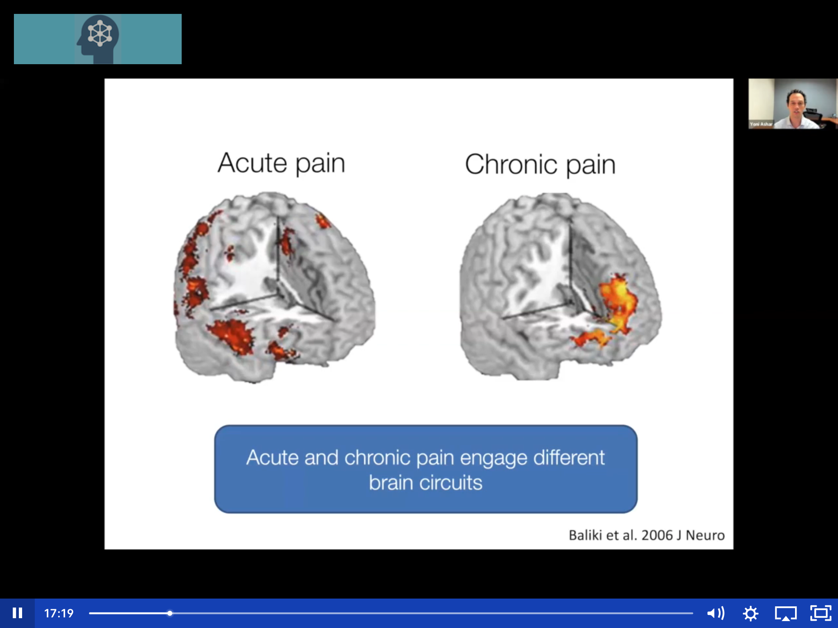
Notes:
And then there’s the diff between acute and chronic.
Acute pain and chronic pain light up different areas of an fMRI. Shows that pain is complex, distributed across multiple locations in the brain.
Acute lights up: thalamus, poste and ante insula and somatosensory cortex, anterior cingulate cortex, nucleus accumbens – 44 areas of the brain light up in total (Tor Wager’s research)
Chronic lights up: medial prefrontal cortex and amygdala – involved in processing memories, emotional regulation and our sense of meaning.

Slide 5
Nociceptive pain Case discussion:
69 yr old gentleman waiting for a total hip replacement
X-ray shows “bone on bone” and orthopaedics have listed for surgery –who knows how long to wait
Is currently taking paracetamol very occasionally
What do you do as his pain progresses while he’s waiting?
What analgesics and what other things do you mention to help?
Notes:
Let’s start with nociceptive
In 2-3s for 5mins
Get ideas from room

Slide 6
National guidance
Osteoarthritis NG226
Pharmacological management of osteoarthritis:
Topical NSAIDs
Oral NSAIDs (if topical ineffective or unsuitable, consider risk)

Slide 7
National guidance
Osteoarthritis NG226
Pharmacological management of osteoarthritis:
Paracetamol
Weak opioids - UNLESS infrequently and short term and other treatments ineffective, contraindicated or not tolerated
Strong opioids
Glucosamine

Slide 8
National guidance
Low back pain and sciatica NG59
Pharmacological management of low back pain:
NSAIDs
Consider weak opioids (with or without paracetamol) for managing acute low back pain only if an NSAID is contraindicated, not tolerated or has been ineffective
Notes:
Other examples where there is some guidance

Slide 9
National guidance
Low back pain and sciatica NG59
Pharmacological management of low back pain:
Paracetamol alone
Opioids
Gabapentin/pregabalin
Antidepressants (SSRI/SSNI/TCA)

Slide 10
National guidance
Chronic Primary Pain NG193
Pharmacological management of chronic primary pain:
Consider an antidepressant
“If an antidepressant is offered to manage chronic primary pain, explain that this is because these medicines may help with quality of life, pain, sleep and psychological distress, even in the absence of a diagnosis of depression”.
Notes:
But what about other types of pain

Slide 11
National guidance
Chronic Primary Pain NG193
Pharmacological management of chronic primary pain:
Paracetamol
NSAIDS
Opioids
Antiepileptic drugs
Benzodiazepines
Antipsychotics
Corticosteroid injections
Local anaesthetics
Ketamine

Slide 12

NICE Guidance NG193
Notes:
Overview | Chronic pain (primary and secondary) in over 16s: assessment of all chronic pain and management of chronic primary pain | Guidance | NICE

Slide 13

Guidance
App - Pain Management section available on Eolas

Slide 14

Best practice when considering prescribing opioids
Consider whether the medication is appropriate for the diagnosis and in line with NICE guidelines
Do not prescribe opioids for:
persistent low back pain
sciatica
osteoarthritis
headaches
fibromyalgia
Notes:
Who has got pts on high dose morphine for pain that they feel is concerning?
and we often find pts come back for more.
We find that escalating doses are necessary to achieve the same analgesic effect
And we know that adding more and more opioids has little therapeutic effect
And there is an evident cost to individuals and to society

Slide 15

Opioids Aware - Key Message
Very good for acute pain and for pain at the end of life but there is little evidence that they are helpful for chronic pain.
Pharmacological management of chronic non-cancer pain is associated with minimal benefits, and potential harm, when compared to effective biopsychosocial (+spiritual) interventions.
Notes:
Opioids Aware | Faculty of Pain Medicine (fpm.ac.uk)
Opioids Aware – Public Health England/Faculty of Pain Medicine, contributions from NICE, CQC, RPSGB, RCGP…
A small proportion of people may obtain good pain relief with opioids in the long term if the dose can be kept low and especially if use is intermittent (however it is difficult to identify these people at the point of initiation).

Slide 16
Opioids Aware
The risk of harm increases substantially at doses above an oral morphine equivalent of 120mg/day, but there is no increased benefit.
If a patient is using opioids but is still in pain, the opioids are not effective and should be discontinued, even if no other treatment is available.
Chronic pain is very complex and if patients have refractory and disabling symptoms, particularly if on high opioid doses, a very detailed assessment of the many emotional influences on their pain is essential.
Notes:
Opioids Aware | Faculty of Pain Medicine (fpm.ac.uk)
Opioids Aware – Public Health England/Faculty of Pain Medicine, contributions from NICE, CQC, RPSGB, RCGP…

Slide 17
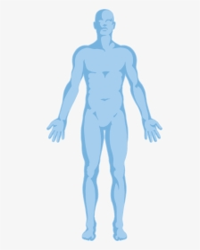
Problems with opioids
Respiratory
Decreased central
respiratory drive
Decreased respiratory rate
Decreased tidal volume
Respiratory depression
Irregular respiratory pauses
Sleep apnoea
Cardiovascular
Bradycardia
Hypotension
Increased risk of MI
Gastrointestinal
Constipation
Nausea
Dry mouth
Musculoskeletal
Osteoporosis
Falls and fractures
Notes:
Respiratory – leads to ineffective ventilation in susceptible individuals
FALLS (1.38 relative risk of any fracture)

Slide 18
Problems with opioids
Central nervous system
Neurotoxicity
Hyperalgesia
Confusion
Drowsiness
Cognitive impairment
Mood changes
Emotional detachment
Endocrine
Reduction in GRH Reduction in testosterone
Adrenal suppression
Sexual Dysfunction
Loss of libido
Depression and fatigue
Notes:
Tolerance – pain reduced in 1 in 10 (My Live Well with Pain in association with North Tyneside CCG)
Addiction – 8-12% (Opioids Aware)
Over 90 days duration associate with overdose and dependence

Slide 19
Problems with opioids
Other
Sleep problems
Sweating
Urine retention
Plus:
Tolerance
Dependence
Addiction
Misuse
Immune System
Suppress immune response
Notes:
Tolerance – pain reduced in 1 in 10 (My Live Well with Pain in association with North Tyneside CCG)
Addiction – 8-12% (Opioids Aware)
Over 90 days duration associate with overdose and dependence
Misuse (up to 37%)

Slide 20
Opioid related harm
For every 62 people with chronic pain prescribed opioids for longer than 90 days,
1 in 10 suffer moderate harm.
And one will die
who would not have if the chronic pain had been managed with biopsychosocial interventions alone
(Gomes et al, 2011), (Häuser et al, 2020).
Notes:
NHS England » National medicines optimisation opportunities 2024/25
https://www.england.nhs.uk/long-read/national-medicines-optimisation-opportunities-2023-24/#15-chronic-non-cancer-pain-management-without-opioids

Slide 21
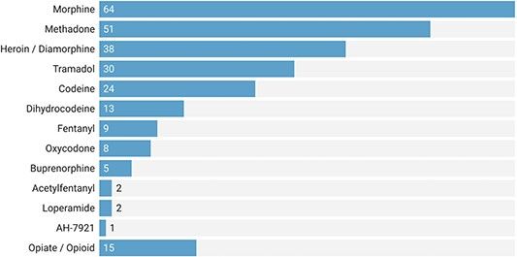

Fig. 2 Rates of opioid drugs reported in 219 Prevent Future Death (PFD) reports published between July 2013 and ...
Notes:
Fig. 2 Rates of opioid drugs reported in 219 Prevent Future Death (PFD) reports published between July 2013 and February 2022 in England and Wales. Some PFDs reported multiple opioids and others did not specify the type of opioid involved (i.e. the opiate/opioid category).
Unless provided in the caption above, the following copyright applies to the content of this slide: © The Author(s) 2023. Published by Oxford University Press on behalf of Faculty of Public Health. All rights reserved. For permissions, please e-mail: journals.permissions@oup.comThis is an Open Access article distributed under the terms of the Creative Commons Attribution License (https://creativecommons.org/licenses/by/4.0/), which permits unrestricted reuse, distribution, and reproduction in any medium, provided the original work is properly cited.
Preventable deaths involving opioids in England and Wales, 2013-2022: a systematic case series of coroners' reports – PubMed
Dernie F, France HS, Thomas ET, Bilip M, DeVito NJ, Ferner RE, Cox AR, Heneghan C, Aronson JK, Richards GC. Preventable deaths involving opioids in England and Wales, 2013-2022: a systematic case series of coroners' reports. J Public Health (Oxf). 2023 Nov 29;45(4):e656-e663. doi: 10.1093/pubmed/fdad147. PMID: 37605451; PMCID: PMC10687604.

Slide 22
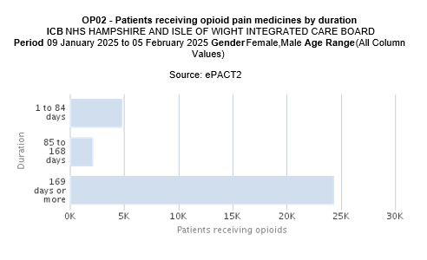
Data shows:
Potentially
428
preventable deaths
4,837
2,136
24,372
Notes:
From ePACT 2 dashboard – can look at your PCN or practice level data on this dashboard

Slide 23
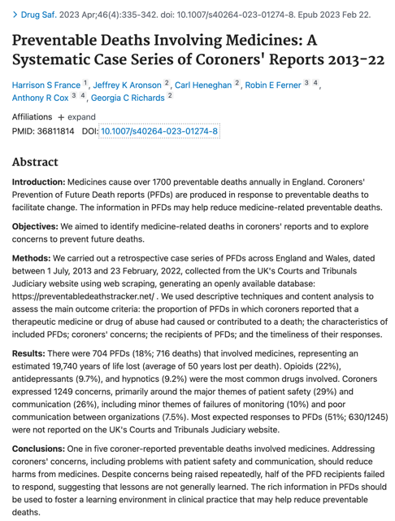
Preventable Deaths Involving Medicines:
A Systematic Case Series of Coroners' Reports 2013-22
Opioids (22%), antidepressants (9.7%), and
hypnotics (9.2%) were the most common drugs involved.
One in five coroner-reported deaths involved medicines.
Notes:
Preventable Deaths Involving Medicines: A Systematic Case Series of Coroners' Reports 2013-22 – PubMed
https://pubmed.ncbi.nlm.nih.gov/36811814/#:~:text=Results%3A%20There%20were%20704%20PFDs,the%20most%20common%20drugs%20involved.
France HS, Aronson JK, Heneghan C, Ferner RE, Cox AR, Richards GC. Preventable Deaths Involving Medicines: A Systematic Case Series of Coroners' Reports 2013-22. Drug Saf. 2023 Apr;46(4):335-342. doi: 10.1007/s40264-023-01274-8. Epub 2023 Feb 22. PMID: 36811814.

Slide 24
A Coroner’s concerns:
No treatment strategy for the opioid or a plan to stop.
No practice policy for prescribing opioids.
No policy for long term prescribing of opioids (over 3 months).
No process to flag the 3-month stage of prescribing.
No policy for co-prescribing of opioids and benzodiazepines.
Notes:
https://www.judiciary.uk/wp-content/uploads/2024/06/Louise-Jones-Prevention-of-future-deaths-report-2024-0322_Published.pdf

Slide 25
Best practice when considering prescribing opioids
A good initial consultation gives the patient the best chance of positive outcomes
Notes:
A good initial consultation gives the patient the best chance of positive outcomes –
Take a good hx, listen carefully and look into the full biopsychosocial context
Manage expectations and establish ground rules from the start
Good management of prescribing reduces chance of medicine related harm and other issues further down the line

Slide 26
Best practice when considering prescribing opioids
Consider cautions and risk factors of prescribing opioids.
  Co-morbidities and risk factors (e.g. elderly, impaired renal/liver function, COPD, epilepsy).
  Risk factors for dependence/addiction disorder.
  Drug interactions
    Risk of serotonin syndrome when tramadol is prescribed with an SSRI.
    CNS depressants - cumulative.
  Risk of respiratory failure, coma and death when opioids are prescribed with benzodiazepines or gabapentin/pregabalin.
Notes:
Underlying psychological distress or diagnosed psychiatric illness (current or past)
Those with a history of alcohol or drug dependence who may or may not be willing to engage in further assessment or treatment.
Domestic or sexual abuse
Gabapentin (Neurontin): risk of severe respiratory depression - GOV.UK (www.gov.uk)
Benzodiazepines and opioids: reminder of risk of potentially fatal respiratory depression - GOV.UK (www.gov.uk)

Slide 27
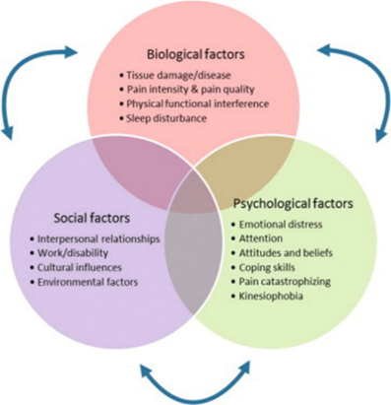
Best practice when considering prescribing opioids
Consider the individual and the influences on their pain.
Notes:
Pain is a complex biopsychosocial phenomenon.
In addition to physiological investigations, assess emotional state and social circumstances, past and present.
Refer patient to physiotherapy or to psychological therapies if appropriate and make use of social prescribing initiatives.
And are we now allowed to mention spiritual impact?

Slide 28
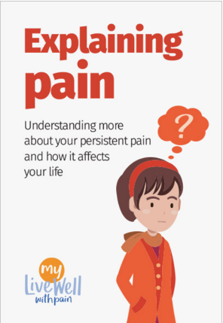
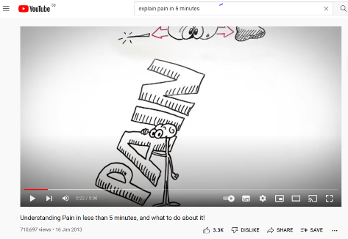
Best practice when considering prescribing opioids
Manage expectations
Notes:
https://livewellwithpain.co.uk/wp-content/uploads/2022/09/explaining-pain.pdf
https://www.youtube.com/watch?v=C_3phB93rvI

Slide 29


Best practice when considering prescribing opioids
Clinical Records.
Remember to record:
rationale for prescribing
information given to patients
agreed goals of treatment
arrangements for review

Slide 30
Best practice when considering prescribing opioids
Start with a plan to stop.
Notes:
This is now stated in all opioid summary of product characteristics
Southampton Practice Policy for Prescribing Opioids
Explain the arrangements for review and circumstances under which the treatment will be discontinued.
One prescriber should be responsible for prescribing opioids for the patient where possible.
Issue prescriptions as ‘acute’ and only put onto repeat if functional goals are clearly met.
For some patients, a written ‘Patient Agreement’ may be useful.
We will discuss de-prescribing later once we’ve got some other ideas of how to help – we can’t take away if we haven’t given replacement options

Slide 31
Neuropathic pain: National guidance
Neuropathic pain There are separate CKS topics on Diabetes - type 2 (covering painful diabetic neuropathy), Palliative cancer care - pain, Post-herpetic neuralgia, Sciatica (lumbar radiculopathy), Shingles and Trigeminal neuralgia.
Pharmacological management of neuropathic pain:
Tricyclic antidepressants
Duloxetine
Gabapentin
Pregabalin
Capsaicin cream
Notes:
Again we have some guidance to help us

Slide 32
National guidance
Pharmacological management of neuropathic pain:
Paracetamol
Opioids - UNLESS infrequently and short term and other treatments ineffective, contraindicated or not tolerated
NSAIDs
Notes:
But the stuff we’ll cover after coffee will all help all these patients and the NP ones too

Slide 33
Deprescribing conversations
Notes:
Don’t force pts to come off their pain meds til they’re feeling better.
Fear increases pain and if they think we’re going to stop their meds, it won’t help.
Let’s help, then stop the meds.

Slide 34

Tapering opioids
The dose of drug can be tapered by 10% weekly or two weekly
Notes:
Use as a rough rule of thumb
One size does not fit all!
Your big chance to do true shared decision making!

Slide 35
Tapering opioids
Modified Release preparations e.g. morphine, oxycodone:
Decrease by 10% every 1-2 weeks (may be more practical reduce every 28 days)
Slower tapering may be more effective for patients who are anxious or psychologically dependent – use smaller reductions (5%) on increase the interval between reductions.
Faster tapering may be indicated for patients experiencing adverse effects or displaying aberrant drug taking or drug seeking behaviours.

Slide 36
Tapering opioids
Immediate release or PRN doses:
Keep the frequency the same (e.g. four times a day) and reduce the dose each week or agreed interval
Or maintain the dose and decrease the frequency each agreed interval
Or reduce the number of tablets (or volume of liquid) at agreed intervals

Slide 37
Tapering opioids
Fentanyl patches (micrograms/hour)
Required Dose | What to prescribe
100 | 100
87 | 75 + 12
75 | 75
62 | 50 + 12
50 | 50
37 | 25 + 12
25 | 25
12 | 12
0 | STOP
Notes:
Not suitable for chronic non-cancer pain
Amber on formulary locally
Because increments are bigger, I would normally go slower (i.e reduce every 8 weeks) asmore likely to get withdrawal symptoms

Slide 38
Tapering opioids
Buprenorphine patches (micrograms/hour)
Required Dose | What to prescribe | Frequency of change
70 | 70 | Twice a week
52.5 | 52.5 | Twice a week
40 | 2 x 20 | Every 7 days
35 | 20 + 15 | Every 7 days
30 | 20 + 10 | Every 7 days
25 | 20 + 5 | Every 7 days
20 | 20 | Every 7 days
15 | 15 | Every 7 days
10 | 10 | Every 7 days
5 | 5 | Every 7 days
0 | STOP | Every 7 days

Slide 39
What to expect (withdrawal symptoms)
Opioid withdrawal is unpleasant, but not dangerous.
Increased pain (same pain or general joint and muscle aches).
  This should settle within a few days.
  Make a plan to deal with this, for example distraction, activity, stretching, mindfulness, heat.
Other withdrawal symptoms can be flu-like, for example, sweats, chills and headache. Diarrhoea, fatigue, anxiety and sleep disturbance can also occur.
Notes:
What should I expect? You may experience increased pain to start with. This might be the same pain you are being treated for or might be general joint and muscle aches. This is a withdrawal symptom and should settle within a few days. Make a plan to deal with this, for example distraction, activity, stretching, mindfulness, heat. Other withdrawal symptoms can be flu-like, for example, sweats, chills and headache. Diarrhoea, fatigue, anxiety and sleep disturbance can also occur.

Slide 40
What to expect (withdrawal symptoms)
Anxiety and depression often worsen during an opioid reduction as emotions that may have been suppressed start to emerge. Be prepared to manage this if necessary.
Notes:
What should I expect? You may experience increased pain to start with. This might be the same pain you are being treated for or might be general joint and muscle aches. This is a withdrawal symptom and should settle within a few days. Make a plan to deal with this, for example distraction, activity, stretching, mindfulness, heat. Other withdrawal symptoms can be flu-like, for example, sweats, chills and headache. Diarrhoea, fatigue, anxiety and sleep disturbance can also occur.

Slide 41
What if the patient isn’t keen?
Don’t worry!
Give patient chance to take the information in.
Use NICE and Wessex Opioid Resources.
Notes:
Overview | Medicines associated with dependence or withdrawal symptoms: safe prescribing and withdrawal management for adults | Guidance | NICE

Slide 42
Case discussion
What would you do next?
40 yr old female pt.
Background hx of mental health issues, obesity, persistent leg pain for 5 yrs.
Originally pain started after a fall, but it has persisted and no abnormality now seen on x-ray/CT/ MRI scans. Has been fully Ix by ortho and sent back to GP as nil further they can do.
Current meds: oramorph, gabapentin, amitrip, zopiclone, co-codamol, ibuprofen, quetiapine, diazepam
Pt attends wanting more analgesia as still in pain.
Notes:
Do word cloud 1st then groups to discuss

Slide 43
some neuroscience about neuroplasticity
Notes:
Does emotional state affect physical pain?
Stress, for example, can manipulate pain in both directions. In extreme cases it can very temporarily cause analgesia which is a reduced pain response. If you're in an acutely stressful situation and you've suffered an injury, the stress can produce temporary analgesia so you might not realise how injured you are until it starts to hurt a bit later. You’re running across a field and twist your ankle – whether you feel that depends on what you’re running from!
It's also entirely possible that chronic stress can exacerbate pain.
the shared neuroanatomy contributes to the reciprocal relationship between pain and emotional state. For example, the regions of the brain implicated in anxiety and depression are also responsible for the processing of pain. Negative emotions are signalled in the same regions of the brain as the unpleasant nature of pain - particularly the anterior cingulate and prefrontal cortices. But other brain regions like the amygdala and locus coeruleus, which are important for processing emotions, also regulate our pain sensitivity.
When someone has chronic pain - a pain that doesn't resolve - that takes a big toll on their emotional wellbeing. In these circumstances people can develop anxiety, depression, and insomnia. We know that when chronic pain and mood disorders co-exist, this can exacerbate the experience of both conditions and part of this may stem from a shared neurobiology.

Slide 44
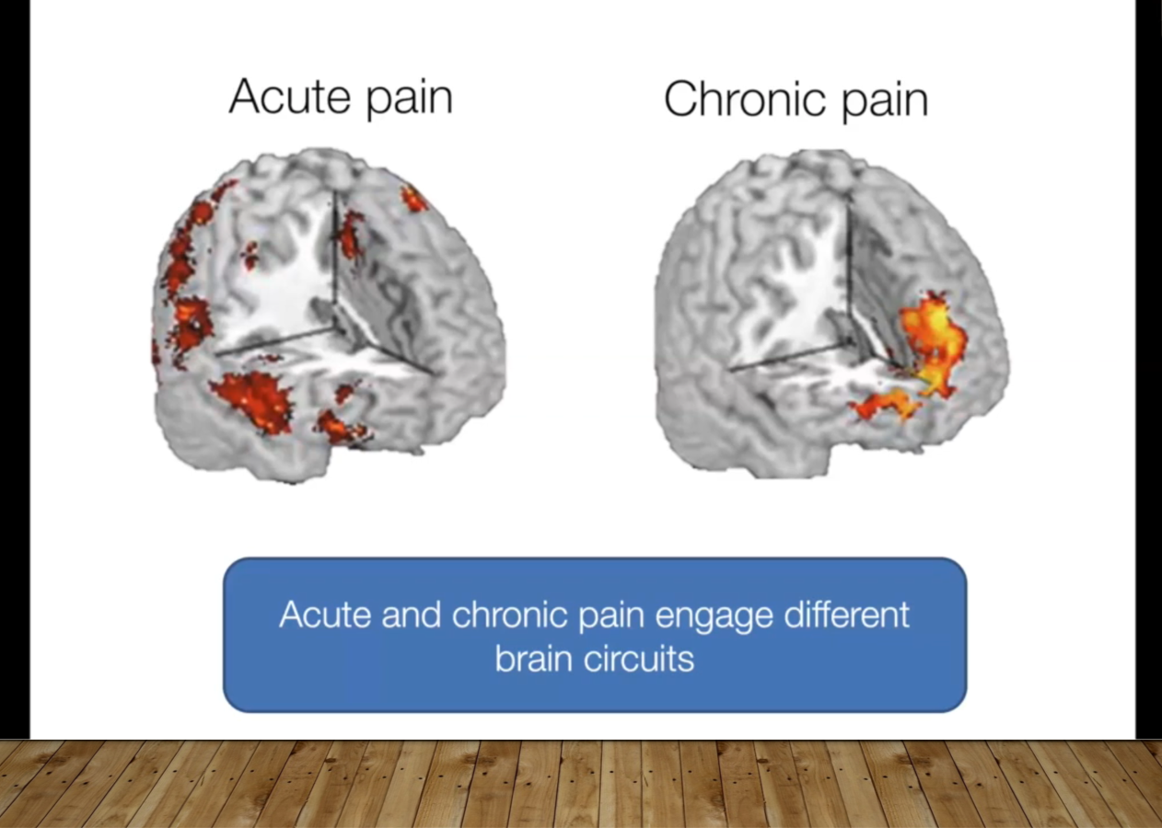
Notes:
They’ve found we get central sensitisation – the brain becomes over-sensitive to any sensation and labels it pain in these situations.
https://www.ncbi.nlm.nih.gov/pmc/articles/PMC5289824/
Injuries nearly always heal, so the issue is the neural circuits the brain set up at the time that haven’t settled down. The brain circuits change over time from acute picture to chronic. Think about the amputee pt feeling the pain in their foot, which is in the lab/ incinerator. We call this neuroplastic pain. We need to be using this label much, much more.
Symptoms are a message from the brain, so we have to find out why and what to do about it.
The pain is the solution the brain produced to protect us from something it decided was dangerous (Ranjan’s podcast)
Our job is to find out whether this is what’s going on for our pts. Are they suffering from neuroplastic pain?

Slide 45
The brain cannot tell the difference between emotional and physical pain!
Notes:
Rejection lights up the same areas of the brain as pain

Slide 46
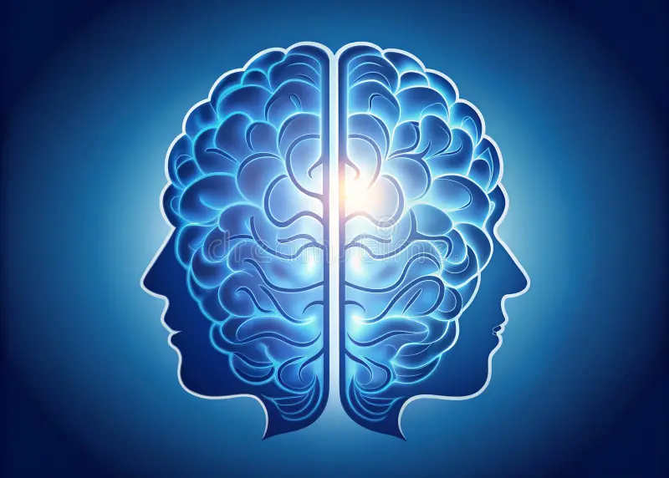
It’s not binary!
There’s something seriously wrong that no-one has found yet
It’s all in your head and not real
Notes:
It’s not a choice between these beliefs

Slide 47
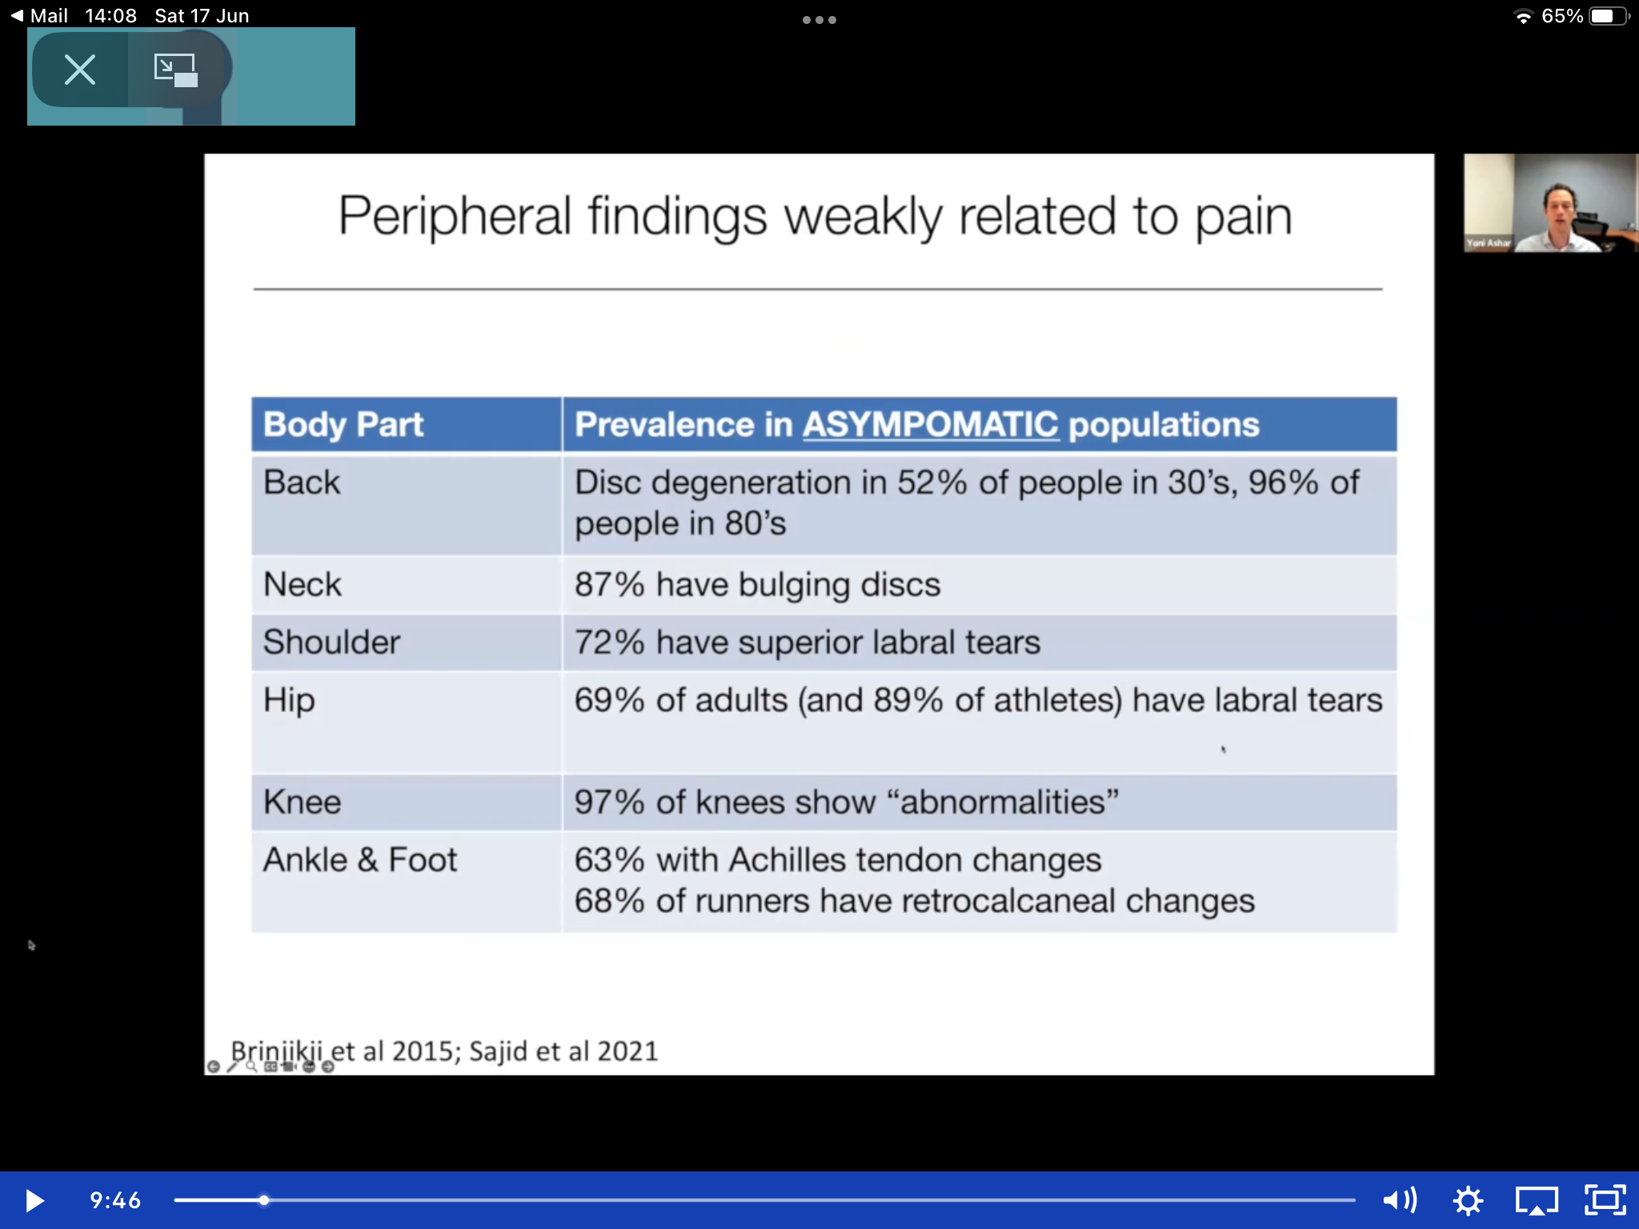
Notes:
You can find bulging discs in 96% of 80 yr old pts with no neck or back pain. (RC’s podcast)
Abnormal findings in 97% of knees that are pain free.
30% of women with persistent pelvic pain had abnorm found, but so did 30% of women with no pelvic pain.
Brain induced conditions: Anxiety and depression – 99%
Fibromyalgia – 99%
IBS- 99%
Headaches – 95%

Slide 48
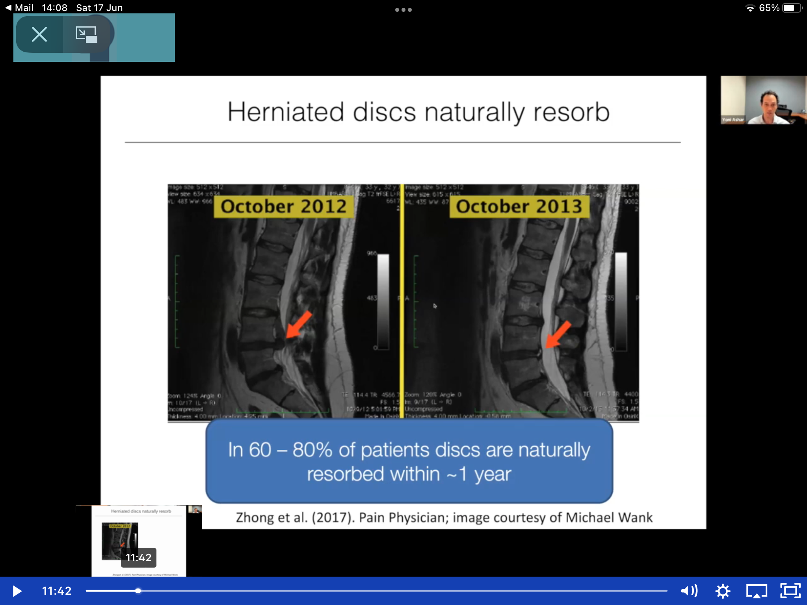
Notes:
And the natural resolution of these herniations, is resolution.
Researchers are starting to think the findings on tests are likely to be incidental, like internal wrinkles.
Think about the many peripheral surgeries that respond just as well to sham procedures – think the knee arthroscopy trial. https://pubmed.ncbi.nlm.nih.gov/24369076/ - partial meniscectomy no better than sham.
We are wrong to say the finding on MRI causes the pain. We need to stop treating the MRI, and treat the pt. It’s like saying having wrinkles causes headaches. Or that because the cock crows in the morning when the sun rises, the cock makes the sun rise.

Slide 49
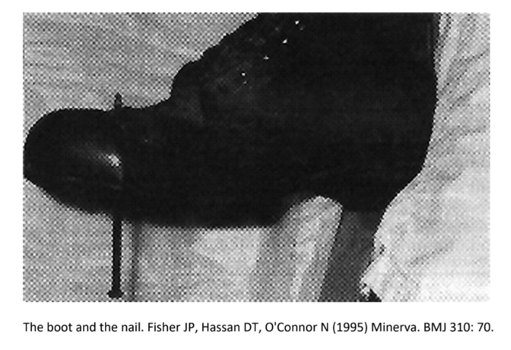
A tale of two nails:
Nail one
Notes:
The issue is, sympt are often caused by the brain.
So, let’s look at what might be going on with NP pain.
Let me tell the story of 2 nails:
This building work constructor. Jumped and landed on a nail. Saw it coming through his boot and assumed it had gone through his foot. Was taken to hospital, screaming in fear and pain, unresponsive to morphine, til they took his boot off – no trauma. The nail had gone between the toes.
https://www.psychologytoday.com/us/blog/pain-explained/201911/tale-two-nails

Slide 50
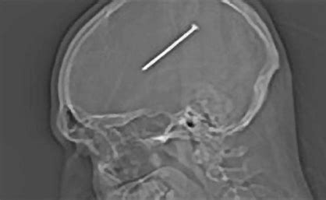
Nail two
Notes:
Whereas this pt had no pain at all for 12 yrs. The nail was only found yrs later when he presented to ED about something else.
The point is that pain is not an accurate indicator of tissue damage. We all know pts with huge amounts of pain and nil we can find to explain it.
Again, let’s define pain “Pain is an unpleasant sensory and emotional experience associated with, or resembling that associated with, actual or potential tissue damage. Pain is always a personal experience that is influenced to varying degrees by biological, psychological and social factors.“ https://europeanpainfederation.eu/what-is-pain/
You can experience terrible pain in the complete absence of bodily harm (nail 1), and little pain in the presence of significant damage (nail 2). Think about the pain you’d feel from a broken ankle if you were on a ski slope versus if you were being chased by the most frightening thing you can think of.
Just because something hurts does not necessarily mean your body is in danger of harm. “Hurt” and “harm” are not the same. It can help our pts to realise that the brain can make mistakes about these things.
Pain is never purely biological, due exclusively to issues like tissue damage and anatomical dysfunction. It is also emotional, social and cognitive, constantly influenced by thoughts, perceptions, emotions, and context (Bushnell et al, 2013; Gatchel et al, 2007).
Your prior beliefs and predictions matter.
Pain is your brain’s best guesstimate as to whether you need protection from danger. The brain has a model of how much pain it expects and monitors the incoming signals which it then tries to interpret – but it can be wrong. (Moseley & Butler, 2015 https://pubmed.ncbi.nlm.nih.gov/26051220/).
And emotional pain is processed the same as physical pain. We know that mental distress creates physical sympt.
We experience social (like heart break) and physical pain in the same parts of the brain – we know this from fMRI studies (Ranjan Chatterjee’s podcast, Prof Irene Tracey youtube: https://youtu.be/3MRBlixsQRw?si=GQHxhV_CpVy03wzL)
Whether we have symptoms, and whether those are persistent symptoms doesn’t depend on the physical finding at the site we feel the pain from, it depends on the brain. Ovid said “when the mind is ill at ease, the body suffers” around the time of Augustus (43BC- 17/18AD)

Slide 51
I cnduo’t bvleiee taht I culod aulaclty uesdtannrd waht I was rdnaieg. Unisg the icndeblire pweor of the hmuan mnid, aocdcrnig to rseecrah at Cmabrigde Uinervtisy, it dseno’t mttaer in waht oderr the lterets in a wrod are, the olny irpoamtnt tihng is taht the frsit and lsat ltteer be in the rhgit pclae. The rset can be a taotl mses and you can sitll raed it whoutit a pboerlm. Tihs is bucseae the huamn mnid deos not raed ervey ltteer by istlef, but the wrod as a wlohe. Aaznmig, huh? Yaeh and I awlyas tghhuot slelinpg was ipmorantt! See if yuor fdreins can raed tihs too.
Notes:
The brain’s job is to predict if we are safe or in danger
Avoidance tells the brain the thing is dangerous and activates the fear response
Shouting at a frightened child won’t help it stop being frightened
When we say we’re fine and we’re not, we’re avoiding and maybe increasing the threat in our own systems
Evolutionary system here. Not blame, understanding and compassion

Slide 52
We see what we our brain tells us, not what’s there
Rotating mask video = https://youtu.be/sKa0eaKsdA0?si=qdm9x25bGT5Vsfdu
Notes:
We actually don’t see with our eyes, we see with our brains- we see what we expect to see, not what’s there. Predictive brain.
Interestingly, this illusion doesn’t work on schizophrenics!
If you wear a prism, with the images of the world coming in upside down, the brain will adapt in 2/7 – (Rangjan Chatterjee’s podcast)

Slide 53
Rubber arm illusion = https://youtu.be/xdxlT68ygt8?si=Cy1pwgaNGFU1Pmbe
Notes:
So what? Watch this!
They did an experiment where they simulated a car crash and 10% of the people involved got whiplash – there was no actual neck movement!
All of this causes morbidity but not mortality

Slide 54
What makes pain worse?
Doctors!
Fear, anxiety and depression
Introspection
Anticipation
Expectations
Unhelpful beliefs
Rumination
Loss of trust
Loss of hope
Personality traits
ACEs
Notes:
We can ask things like “do you have less sympt when you feel safe/relaxed? “
What makes the pain worse? Or better? Getting the pt to be curious about their sympt in a non-fearful way. Somatic tracking.
Think of the Start back questions – these are really important for picking out the type of pts who might need this sort of approach – if they believe moving makes the pain worse, we might need to be thinking about helping them to change those beliefs. Moving won’t make neuroplastic pain worse. Believing it does will.

Slide 55
Stress inducing personality traits
People pleasing
Hypervigilant
Perfectionist
Low self esteem
Excessive self-criticism
Excessive hard work
Notes:
There’s this thing called a stress inducing personality trait. I think this might relate to a lot of GPs!!!
Especially those heading to burn out.
These traits are a nociceptive stress which leads to inflammation in the body.
And we are starting to learn about the link between inflammation and most diseases – they are starting to see slightly raised CRP, eg in IHD https://pubmed.ncbi.nlm.nih.gov/18823504/
Think how the skin reacts to stress – we see the stress physically outside- eg ex husband’s seb derm

Slide 56
Asking about ACE:
Would you let a child you love have your childhood?
Notes:
Our communication skills are essential around this topic. Be kind and compassionate.
And ACE are a massive factor in this. Be selective who you do this with! Could open a can of worms!!!!
Even the little things you remember that you wouldn’t let a child you love experience will influence the brain’s pain centres and make them hypersensitive and more likely to have chronic pain.
2/3 of adults have ACE but not all go on to develop anxiety/ depression/ pain. But there is a significant relationship between the 2.
ACE strongly relate to issues in later life in a dose response relationship. (https://www.sciencedirect.com/science/article/pii/S2772609623000187?fbclid=IwAR0ht8yxUnBA04GIBDLnh_PGT0NSipMg9fOpCYXZpri9B2YyLWw8t7PII_A&inf_contact_key=24b137f361923915d56712e478d0f088680f8914173f9191b1c0223e68310bb1)
This maters. Spinal surgery success with person with 0 ACE = 95%
With 3-5 ACE = 15%. Maybe we should use it as a screening tool prior to surgery!!
But you won’t find something physical to “fix” as this is linked to neural circuits in the brain.

Slide 57
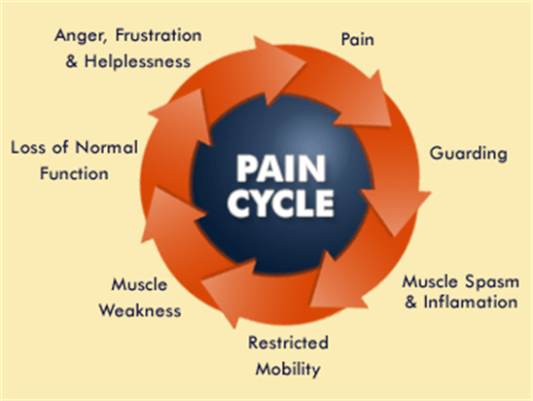
The pain cycle
Notes:
Pts can get into vicious cycles – it gets worse and worse, we see them come back with more/ new sympt, or for stronger analgesia, eg my chap with back pain at present.
And, as the brain gets sensitised, so the pain spreads, and suddenly, even light touch can cause pain, (think of your fibromyalgia pts). And they’re worrying there’s really something wrong, so they get even more anxious and guard those muscles/ areas, or stop moving, etc.
It’s like a false alarm on a car – so sensitive a leaf dropping on it sets off the alarm. And the alarm noises are exactly the same, whether there really is a car thief or not.
or like a fire alarm. They sound the same, fire or no fire. Same as persistent pain when no physical cause found, it feels the exact same as if there’s some structural damage (and sometimes there is structural damage to an area). But the brain decides how much pain we’re in, and we can help pts change this vicious cycle.

Slide 58
Leads to Impaired neural circuits
STRESS
SNS overstimulation leads to:
PAIN, FATIGUE, HEADACHES
PNS overstimulation leads to:
BRAIN FOG, DIZZINESS, TINNITUS, VIS DISTURBANCES, NEAD
ANS overstimulation leads to:
IBS, BLADDER SYMPT, MIGRAINE
Notes:
All of these lead to nociceptive stress which if prolonged, leads to physiological responses in the body, which if prolonged, leads to sympt, which if prolonged lead to illnesses.
These are hard wired, neural circuits in the brain, automatic and not conscious. Pts are not to blame, and they’re not trying to deceive us.
Our nervous system is triggered, and unlike animals on the savannah that calm immediately after an attack, we don’t. We reminisce, we ponder, we talk about it, we replay the memory of hurt over and over. And that is what, over time, leads to symptoms.
And remember, emotional injury triggers the same bits of the brain as physical pain. The brain can’t tell the difference.
ALL PAIN IS REAL

Slide 59
Assessing for neuroplastic symptoms:
1) rule out structural disease
Pain originated without injury (though not always)
Symptoms are inconsistent or anatomically impossible
Symptoms affecting different systems
Symptoms are spreading or move
Lack of a physical diagnosis of structural issue
Notes:
When diagnosing these issues, there’s 2 steps:
Step 1 is rule out structural disease (eg, is the sympt there all of the time, no matter what, red flag sympt, something treatable – we must do our jobs first, but be alert for these issues)

Slide 60
The “FIT” criteria – Howard Schubiner
Functional
Inconsistent
Triggered

Slide 61
Assessing for neuroplastic symptoms:
2) rule in neuroplastic disease
Symmetical symptom, eg both feet, both wrist,
Delayed onset pain
ACE
Personality traits
Triggered by stress
Triggered by things that have nothing to do with the body (smells, days of the week, weather,
Notes:
Step 2 is rule in neural circuit disease (eg, the sympt doesn’t fit neurology / anatomy rules, it might be functional. If it’s inconsistent, triggered or demonstrable, eg asking someone to imagine bending over brings on their back pain when they’ve not even moved, consider it.
F = functional
I= inconsistent
T = triggered
The most important thing from the pt’s perspective is that we listen properly and understand the impact on their function. Take is seriously. It is ruining their lives. Gaslighting adds to that pain.
Don’t tell them nothing is wrong, explain neuropathic pain, or functional symptoms and reassure them you believe them. These symptoms are real and produced by the brain. And we can give hope. Things can improve.

Slide 62
Pain is the brain’s danger signal

Slide 63
Overwhelm
Negative thoughts
Symptoms
Notes:
I find this structure incredibly useful in many presentations

Slide 64
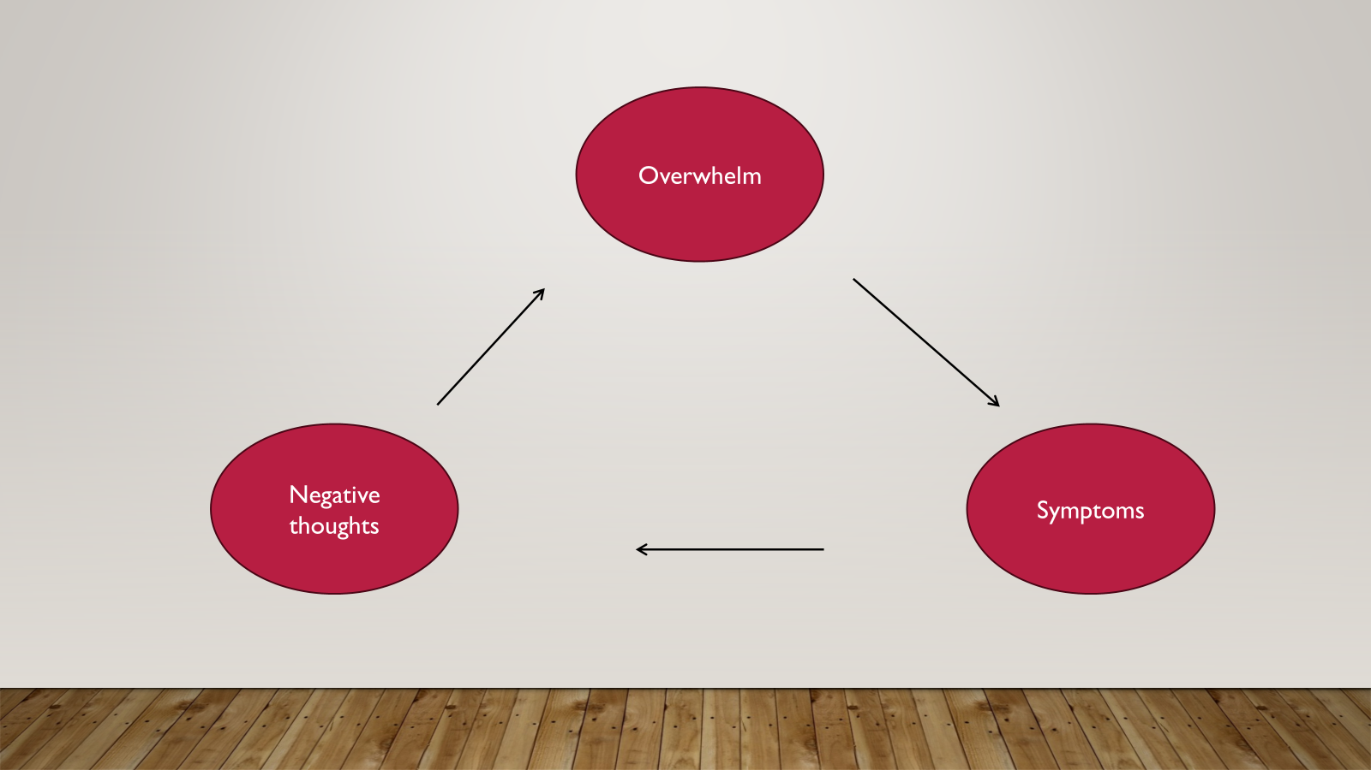
Predisposing factors
Precipitating factors =
The sensitising event
The way out
Danger signals from the nervous system
The mechanism
The 7 Fs
Fix
Fight
Focus on
Feel forlorn
Frustration
Fight
Figure it out
Signs from the body
Perpetuating
Notes:
The predisposing factors are those ACE, personality factors, things we’ve just talked about
The ppt might be infection or accident but it attacked an already primed system
For example, the severity of post infectious syndrome isn’t predicted by the severity of the illness but by the pre-existing distress of the person attacked
And the pts’ experience of illness matters – have they been dismissed, isolated, feeling frightened, having conflicting theories of causes thrown at them and feeling unsupported and confused?
So relevant for us as Drs as this all happens to us too.

Slide 65
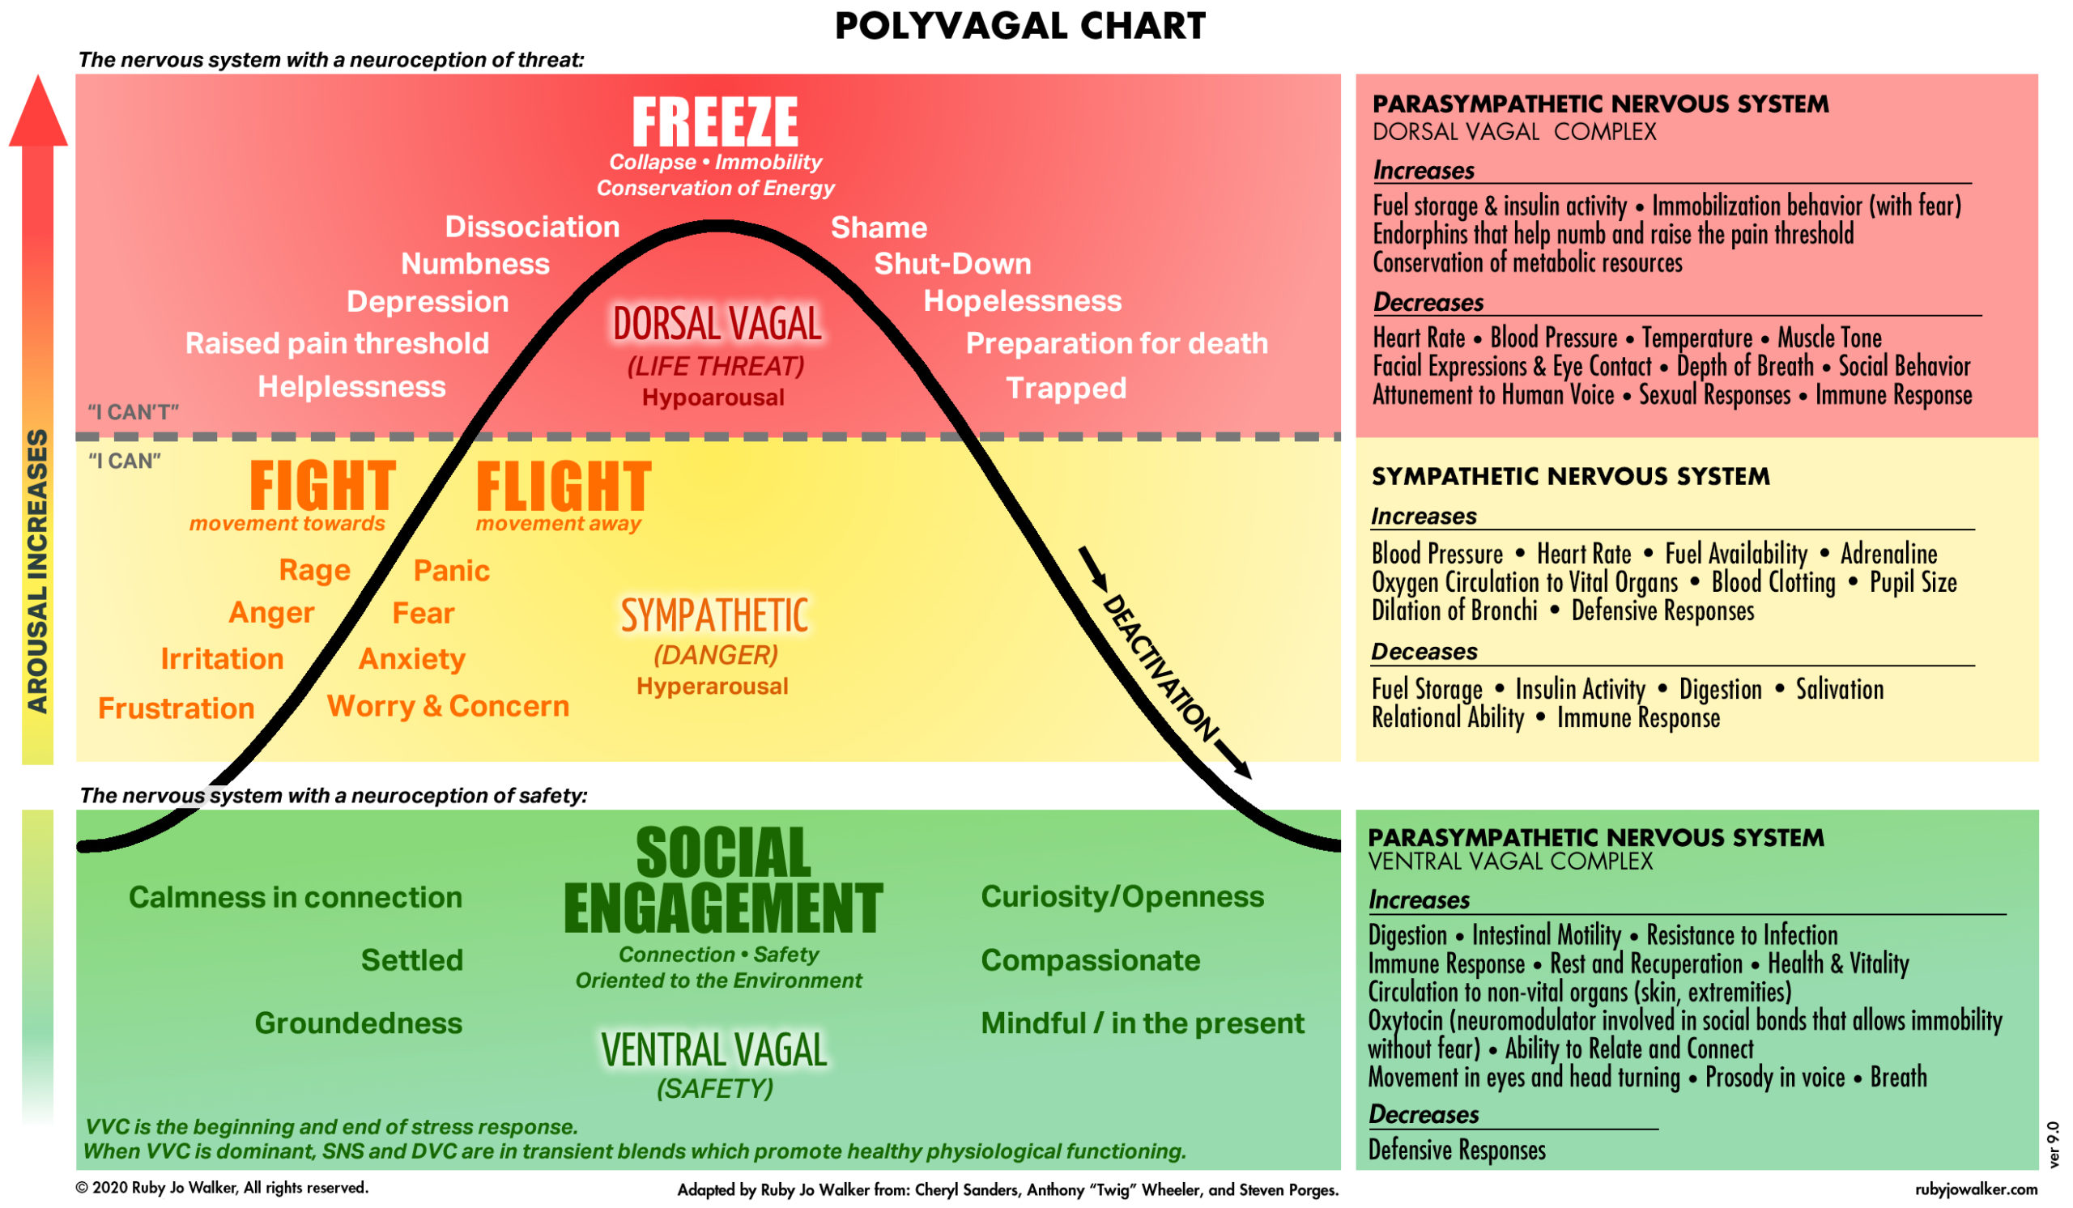
Notes:
The mechanism for how this all works

Slide 66
Mechanisms in the body
ANS overload and dysregulation
Mitochondrial depletion
Microbiome dysbiosis
Vagal nerve stimulation
Immune dysregulation and auto-immune issues
Central sensitisation
Cell inflammation
Notes:
Not knowing why is not the same as there being no reason
Not lack of moral fibre
Not unreasonable
Understandable and unifying theory
Excessive introspection
Every cell is eavesdropping on our thoughts
Remember correlation doesn’t mean causation – just because mitrochondrial depletion may be found, doesn’t mean that it’s what caused the issue – just because the rooster crows every morning when the sun rises, doesn’t mean the crowing made the sun rise.
When the brain is in threat mode, it increases pain and decreases energy expenditure, causing fatigue to make you rest, brain fog and aching so that you
Normally when threat is cleared, the immune system should stand down, the NS return to balance and sympt resolve, but we can get these prolonged sympt when that doesn’t happen. We see it so often in these persistent physical sympt.
The driver isn’t the infection or original trigger, it’s what that taught the NS – hypervigilance/ danger/ threat
None of this is the pt’s fault (our fault)

Slide 67
Exercise:
Talk through a patient you’ve spoken to recently where you think this approach might be relevant
How would you approach this conversation?
Notes:
In 2-3s for 5 mins

Slide 68
Potential options for help.
What can we do?
Notes:
Sam

Slide 69
So, what can we do? RUFUS!
Recognition
Understand the brain and how it works
Focus on Function
Understand what helps
Sympathise
Notes:
We need to know this. It’s got to revolutionise how we help people, because if we don’t treat neuroplastic pain well, we’re missing out on helping a huge number of our pts.
NICE says “don’t use drugs”, think psychosocial. Look at how their pain affects their life and how their life affects their pain.
BUT only do this with people who are ready. Be careful !!! and I’m still learning and not always getting it right.
Recognise what they’re describing, and when we’ve excluded something that could be treated traditionally (they’ve been to every specialist and want more referrals). When we’re in the right place to do this, recognise what’s going on.
The Dr listening can make a huge difference. We need to take time to hear their stories. Don’t rush. Do a thorough hx. Bring them back. Have them write it down for you and bring it. It matters.
And when you explain, there’s nothing worse than a Dr looking you in the eye and saying, “there’s nothing wrong”, so be careful. Use words like “Impaired neural circuits” or FND or neuroplastic pain. These are terms that can help. Don’t gaslight!
I’ve noticed they often want a second opinion – but if we’re going to refer, we need to contract with them prior to it, so that if the specialist agrees (eg it’s FND), we move on to helping them live with or get beyond seeking answers. “we’ve done all the tests we need to do”.
“I can’t explain it all, but what can we help you achieve?”
Understand
Pts need to receive an explanation that makes sense to them but we live in a society that doesn’t allow our thoughts to affect our bodies. But they do.
We can help them see the link between those traumas and their current sympt. I often ask, what happened in the yr or so before it first started. Reveals sig events many times.
If pts don’t believe, it can help to ask “do you really think that how you feel has no effect on your symptoms? “
Function
Persistent pain is a long-term condition.
We don’t have to cure them.
It’s about helping pts live with it.
How they improve their life and health despite it
Help pts to reattribute pain from the periphery (“it’s my leg”) to central (my brain is trying to help me feel safe and not feel scary/ hard feelings), to reduce their fear of it.
Address non pain threats – e.g., stress, self-criticism, living in flight/ fight mode.
Understand what helps. Coming up
Sympathise
This might be hard for us to explain and for pts to accept.
They need to feel safe and that we care.
Be gentle and kind above all.
We can help them by telling them, “It’s not in your head, it’s in your brain!”
It’s hard wired into us by biology – we need to be clear saying this to pts, “it’s not your fault “

Slide 70
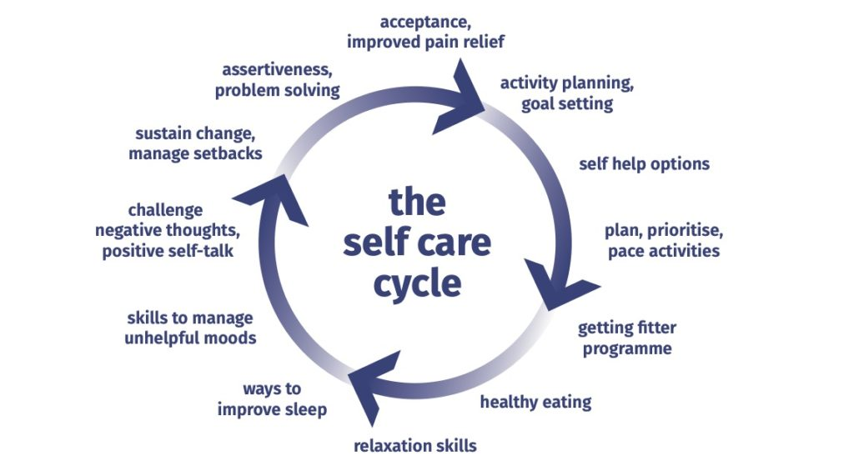
Virtuous circle
Notes:
Let’s get them into a virtuous circle of recovery.

Slide 71
What Helps: MINDSET
Medications
Interventions
Neuroscience
Diet
Sleep
Exercise and relaxation
Therapy of mind and body
Notes:
Meds we talked about earlier
Interventions is things like pain clinic or operations
Neuroscience is explaining the cycle we’ve just talked through
Now we can focus on the 4 pillars.
The whole body and mind are interconnected.
When listening to pts, think:
Does this person need to be rid of something – eg a toxin, an allergy, an infection, a stress, a person in their life?
Or do they have an unmet need that’s required to improve their function, eg food, nutrients, social experiences, stress reduction,
What do they think they can change?
Agree goals with them and safety net them.
To activate behaviour change – we need to
Make it easy – like “1 click” on Amazon.
Stick it to an existing habit, eg brushing teeth.
Reward changes
Design your environment to help.
Don’t use motivation as a driver for change – it’s not repetition that makes a habit stick, it’s reward.
A changed diet improved depression – paper by Jacka – 32 % remission - reduce empty carbs, reduce highly processed food, reduce refined starches
Increase the diversity of the diet.
Don’t force pts to come off their pain meds til they’re feeling better.
Fear increases pain and if they think we’re going to stop their meds, it won’t help.
Let’s help, then stop the meds.
Meet people where they’re at with kindness and empathy. The secret of care is caring for the pt. Help the pt feel safe and heard. And then the magic happens
Sleep – so important for pain relief
Movement – often people have stopped and we want them to start doing something, even though it might hurt
Relaxation – how many of us take time to relax – why not?
Therapy of mind and somatic body work

Slide 72
“The problem is not in your head, but the solution is not in your body”
Nicole Sachs

Slide 73
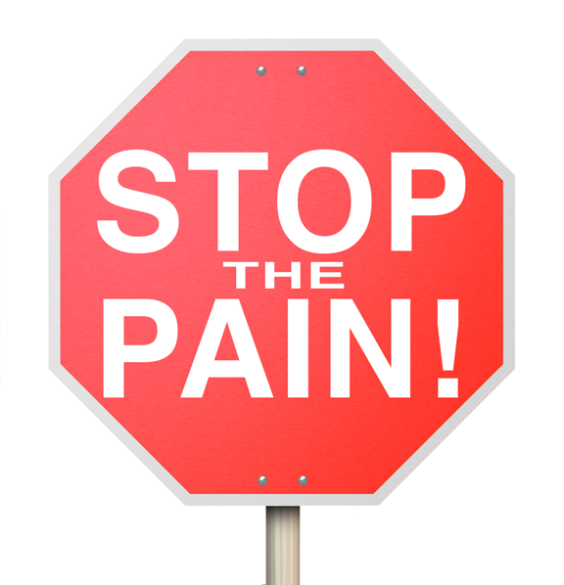

What pt’s want vs what we can do
versus

Slide 74
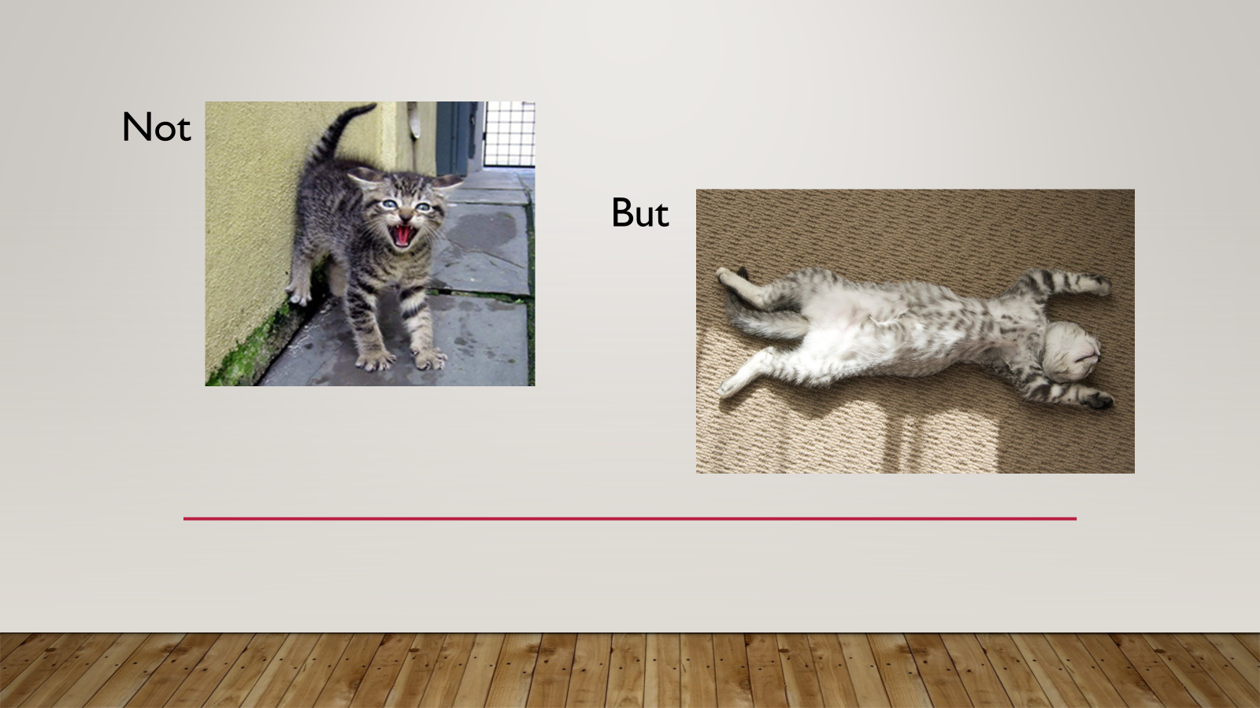
Notes:
Us compassionately listening makes a huge difference
Creating this type of safety in our clinical rooms
Create agency for them – what can they make choices about
Our kindness and compassion matters
Our communication skills
“maybe there is something else your body is trying to tell you”
“maybe some of what has happened to you in your life up until now has an impact on your experience of your symptoms”

Slide 75

Responding to the pain signal
Decrease fear and alarm
Increase curiosity
Not pushing through
Doing what genuinely feels doable

Slide 76
Help them to
Stop the 7 F’s
Trying to fix it
Fight it
Being focused on it
Frustrated by it
Trying to figure it out
Feeling forlorn about it
Fearing it
Notes:
If we can calm the alarm, we can help
CBT and other counselling/ coaching approaches have their uses

Slide 77
What works: the Free stuff
Balanced breathing
Expressive journalling
Grounding
Mindfulness
Punching the pillows
Yoga
Boxing
Dancing
Humming
Singing
Notes:
Pts need to experience an intervention that they expect will help the problem.
Do we want the alternative to understanding this? Which would mean telling pts they will suffer for their whole lives, or do we want to give them hope that it can be better?
We can’t change the bad thing that happened, but we can help them find peace about it. This is neuroscience (Ranjan)
They need to gain skills and knowledge that allow them to gain control and mastery over the problem.
If we empower them, they can recover. Our brains are plastic, and we can learn new pathways, away from the old pain ones.
It’s not for us to fix them, it’s for us to help them acknowledge unresolved emotions and increase their awareness of their bodies.
Mindfulness – living in the present moment, not being anxious about the future or depressed about the past. What about right now? Reassure the brain, “right now you’re safe”.
Balanced breathing – balances the sympathetic and parasympathetic NS – 6 sec in, 6 sec out.
Grounding is about getting the person to feel safe where they are. Constant reminders they are safe now (make sure they are!)
Expressive journalling is probably the easiest thing you can tell them to do that makes the biggest difference. Address the emotions
Free write for 15-30 mins daily about stress/ childhood/ emotions and then, importantly, throw it away. You’re creating separation from those events and you.

Slide 78
What works: probably not Free
EMDR
PRT
IFS
ISPDT
EAET
Notes:
EMDR – definitely helps with traumas – it’s disrupting the neural circuits in the brain and that’s how it works.
PRT - Pain reprograming technique. More in a second. This is the course I’m doing now.
IFS – internal family systems – recognising that there are parts of you that are trapped in feeling emotions from the past, and we develop strategies to avoid feeling those feelings. Strategies that might be unhelpful. Therapist needed.
ISPDT – intensive short psychodynamic therapy – again need therapist to work with you on emotions from past.

Slide 79
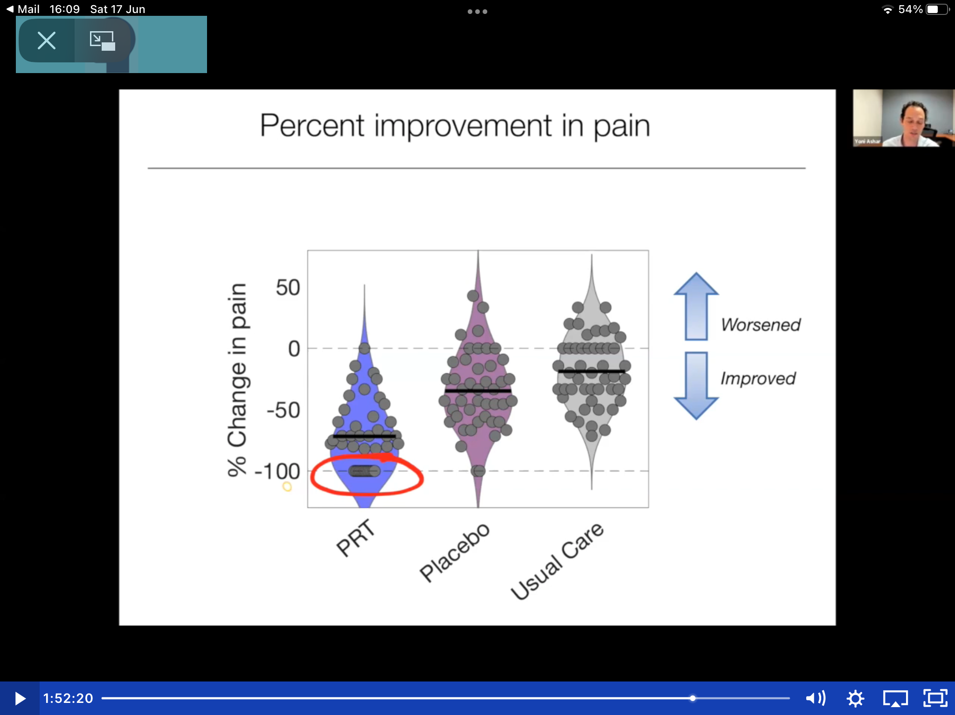
PRT
Notes:
PRT – American based Rx, but more people worldwide getting trained up including me. Website on resources at end.
PRT trial results impressive – 150 pts with no structural back issues but severe back pain for an average of 10 yrs. 50 had usual care, 51 in the placebo arm, 50 had PRT – 9 sessions over 1/12. fMRI brain scans before and after. Outcome was pain intensity. 1 yr follow up and 5 yr being collected now.
In PRT group, no-one got worse, most got better, and 33 were cured (pain free or nearly pain free). In the usual Rx 5/50 were pain free or nearly pain free, and in the placebo arm, 10 were pain free or nearly pain free. Brain imaging showed the changes. They seemed to have helped people recog that emotions were linked to pain. It reduced fearful pain beliefs (think start back scores and doing something about them),
explanation – the pain is a false alarm which has caused central sensitisation but not tissue damage.
Expectations – you can be cured – you can teach the brain that the sensation is safe.
Exposure – somatic tracking and emotional awareness, then do the movement that increased the pain and track that
Engage – increase your physical activity and engage in life.
It’s shifting the belief about the pain that shifts the pain.

Slide 80
More ideas:
TMS wiki recovery program
Podcasts (eg, Tell me about your pain)
Books, websites and films
TED talks
Play, fun and laughter
Social connection
Curable or free-me app

Slide 81
Don’t forget:
Good sleep
Physical activity
Joy, hope and optimism
Sense of control
Positive outlook
Self compassion
Healthy anti-inflammatory diet
Notes:
A changed diet improved depression – paper by Jacka – 32 % remission - reduce empty carbs, reduce highly processed food, reduce refined starches
Increase the diversity of the diet.
Meet people where they’re at with kindness and empathy. The secret of care is caring for the pt. Help the pt feel safe and heard. And then the magic happens

Slide 82
summary
Assess – what type of pain are you dealing with?
Education – is this neuroplastic and does the patient need to learn about that?
    Remember the predictive brain generating the symptoms
    Have the patient decide whether this fits them and what to do now (yes/no/need more info)
Their work:
    Symptom reappraisal – curiosity not fear, know it’s possible to improve and feel better
    Emotional processing – turning down the alarm signals
    Make the necessary changes in life
Your work:
    keep an open mind
    Kindness, compassion and being a good GP

Slide 83
Conclusions
Pain is the brain’s danger signal
There are options for Rx that don’t involve drugs
Most importantly, PLEASE GIVE HOPE
Notes:
4 types of pts -
ready,
angry, (can’t hear it),
emotionally fragile (can’t bear it) and
uneducated (unable to understand it).
Meet people where they’re at.
Get them thinking about this – we’ll exclude physical but have a think about stress/ACE – bring your list next time so we can discuss how it’s relevant
What matters in caring for pts, is CARING for pts. - the relationship matters more than anything else you do in therapeutic relationships.
Most importantly, give hope

Slide 84
resources
https://www.solent.nhs.uk/msk/self-help/ (website for pts)
https://www.sirpa.org/ (website for pts and our training)
https://www.livingproof.org.uk (website for pts)
https://www.tmswiki.org/ppd/The_Tension_Myositis_Syndrome_Wiki (free pain recovery program for pt)
https://www.flippinpain.co.uk/ (website for pts)
Curable app – costs about £50 per year but as Drs, you can sign people up for free trial

Slide 85
Books
Unlearn your pain by Howard Schubiner
The Way out by Alan Gordon
The pain free mindset by Deepak Ravindran
The body keeps the score by Bessel Van Der Kolk
The mindbody prescription by John Sarno

Slide 86
Other resources
https://open.spotify.com/show/2ZbUds4FFscyzIIv2tD1wh?si=09a511f7075c401c
https://youtu.be/Su_RVR6Thvo?si=GPJvX96TIZMhxqXm (Deepak’s your tube channel)
http://www.youtube.com/@RaelanAgle (recovery stories to give hope to pts)
https://www.livingproof.org.uk/professionals (resources for us including our education)

Slide 87
references
https://www.ncbi.nlm.nih.gov/pmc/articles/PMC5289824/
Overview | Chronic pain (primary and secondary) in over 16s: assessment of all chronic pain and management of chronic primary pain | Guidance | NICE
Chronic Pain Prescribing Guidelines (hantsiowhealthandcare.org.uk)
Opioids Aware | Faculty of Pain Medicine (fpm.ac.uk)
NHS England » National medicines optimisation opportunities 2024/25
https://bnf.nice.org.uk/treatment-summaries/neuropathic-pain/
https://livewellwithpain.co.uk/wp-content/uploads/2022/09/explaining-pain.pdf
https://www.england.nhs.uk/long-read/national-medicines-optimisation-opportunities-2023-24/#15-chronic-non-cancer-pain-management-without-opioids

Slide 88
References continued
NHS England » National medicines optimisation opportunities 2024/25
https://www.england.nhs.uk/long-read/national-medicines-optimisation-opportunities-2023-24/#15-chronic-non-cancer-pain-management-without-opioids
About Chronic Pain | Division of Pain Medicine | Stanford Medicine
https://med.stanford.edu/pain/about/chronic-pain.html#:~:text=Every%20person%20experiences%20chronic%20pain,tailor%20therapies%20to%20that%20person.
https://www.judiciary.uk/wp-content/uploads/2024/06/Louise-Jones-Prevention-of-future-deaths-report-2024-0322_Published.pdf
Preventable deaths involving opioids in England and Wales, 2013-2022: a systematic case series of coroners' reports – PubMed

Slide 89
More references
https://www.psychologytoday.com/us/blog/body-sense/201204/emotional-and-physical-pain-activate-similar-brain-regions

