Slide 1
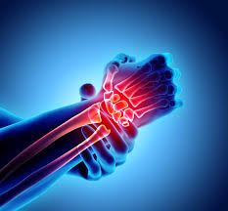
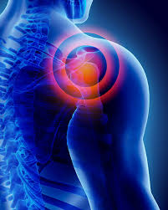
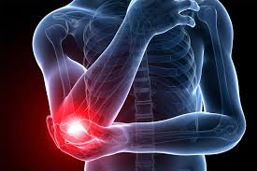
MSK for GP trainees
Upper limb
Will Swain GPSI MSk

Slide 2
‘Whilst I’m here doc, can you take a look at my hand?’
Intro
Why this topic?
Clinicians often lack confidence in MSK hands vs Hips/knees/shoulders
Patients of bring hand issues up unexpectedly
Good to have quick pearls of conservative management

Slide 3

History – usually enough to make the diagnosis
Hand exam
  Look
  Feel
  Move
  Special tests
Investigations, usually not needed in primary care
  X-ray can show OA – useful if it will change management?
  Bloods if considering rheum cause (but won’t rule out)
  US – useful for uncertain soft tissue lump
  NCS – avoid routinely for CTS. Can request if neuro signs and unclear cause

Slide 4
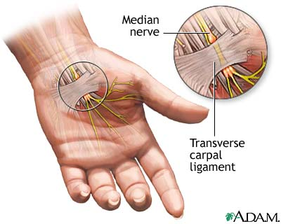
Carpal tunnel syndrome
Idiopathic—most common,
Rheumatoid flare-ups, OA wrist.
Metabolic—pregnancy (common), hypothyroidism (rare), traumatic, Meds e.g. aromatase inhibitors
Vibration.
??Repetitive use
Tingling / P and N / numbness – greater 3.5 digits (patients may report all digits
Sharp pains wrist int hand
Night symptoms
Weakness / wasting in severe cases

Slide 5
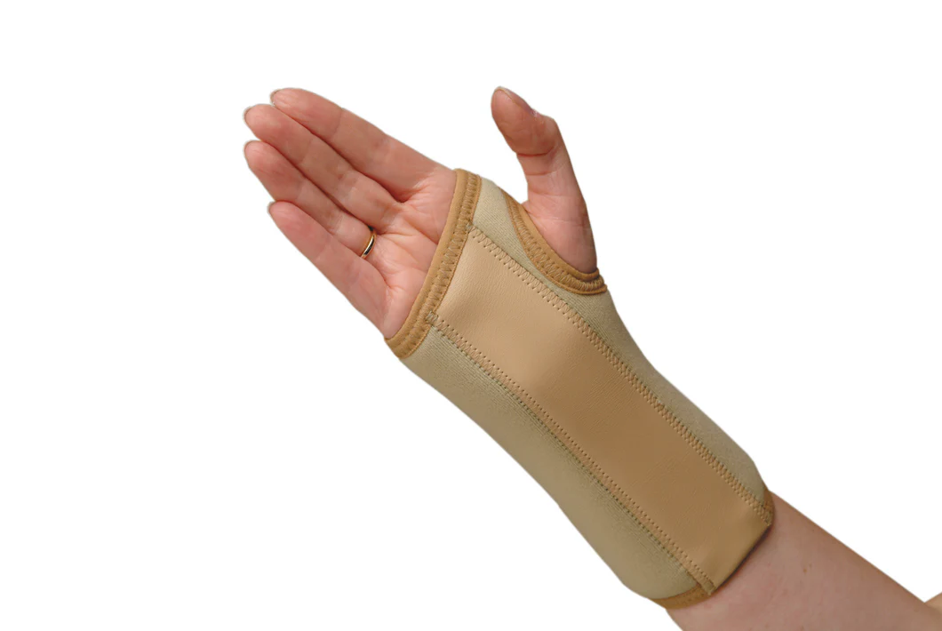
Carpal tunnel syndrome
Management
  Futura splint at night 6 weeks
  Steroid injection
  Surgery
Early urgent surgical ref only if: wasting / objective significant weakness / constant median nerve sensory loss
Surgery Vs steroid injection
  Districts trial – surgery better option
  But injection can reduce the need for surgery
  GIRFT guidelines
Differential diagnoses:
  Cervical radiculopathy
  Degenerative cervical myelopathy
  Diabetic / other peripheral polyneuropathy
  Cubital tunnel syndrome

Slide 6
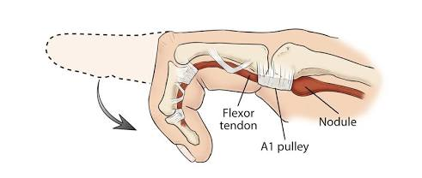
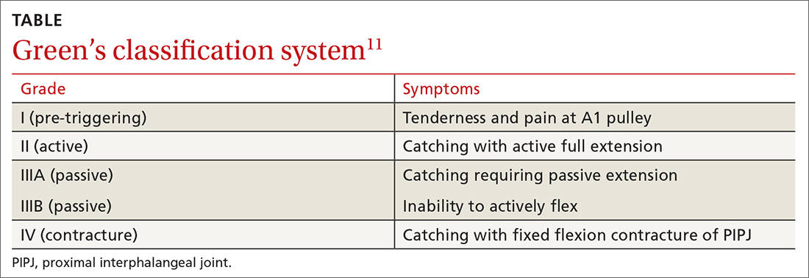
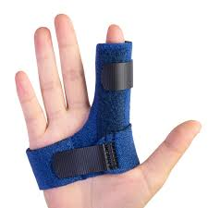
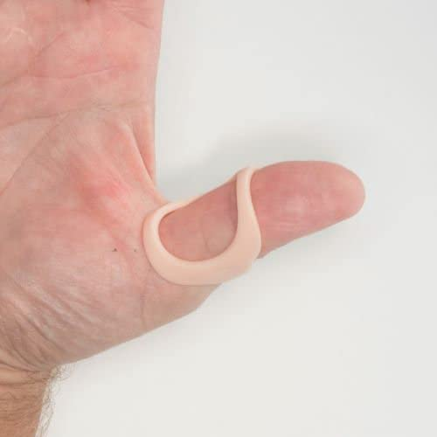
Trigger finger/thumb
Nodular thickening of the flexor tendon, accompanied by stenosis of the (A1) pulley of the tendon sheath at the level of the MCPJ.
More common in diabetes, rheumatoid
Management
  Splint at night 6 weeks
    + topical NSAIDs
  Steroid injection(s)
  Surgical release
Grade 4 – early urgent ortho referral

Slide 7
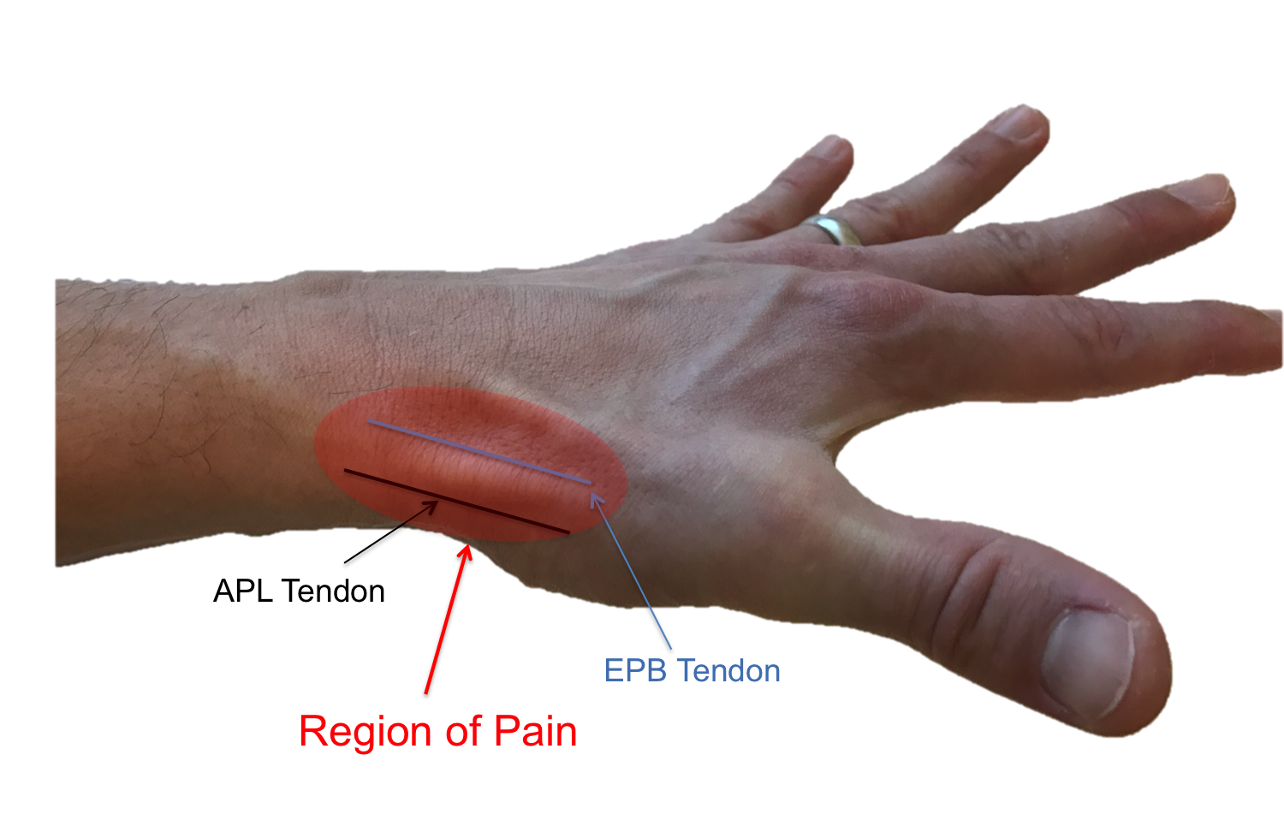
De Quervain’s tenosynovitis
4x more common in women
Often middle aged
Also affects post partum women
Often with visible swelling
Where is the tenderness?
Finkelstein sensitive but not specific
DD: Thumb CMCJ OA, STT OA, intersection syndrome
Management
  Thumb spica 6 weeks
    + topical/oral NSAID
    Activity modification
  Steroid injection (Early if severe symptoms)
  Surgical release

Slide 8
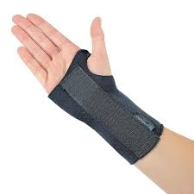

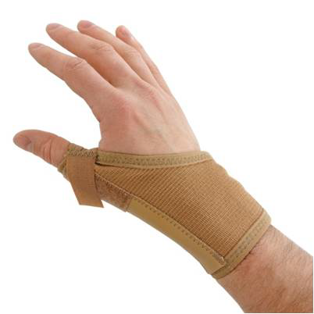
Routine management
Splint > injection > surgery
 | Splint – 6 weeks Conservative | steroid injection(s) | Surgery
CTS* | Splint at night + nerve glides + activity modification | 1 steroid injection | ~30% require
Trigger finger* | Splint at night + topical NSAIDs | 1 – 2 steroid injections | <10% require
De Quervain’s | Splint day and night + activity modification + oral/topical NSAID Consider early injection | 1 – 2 steroid injections | <20% require
*If CTS red flags (wasting / objective weakness / constant median nerve sensory loss) > skip conservative and do early surgical referral
*Trigger finger red flag – grade 4, locked in palm

Slide 9
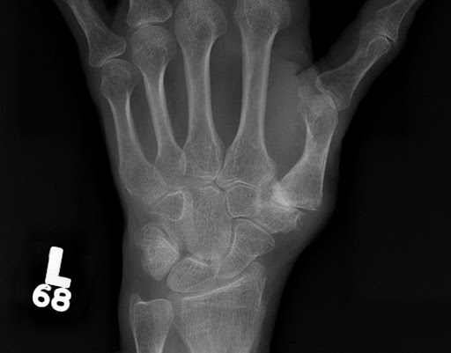
Osteoarthritis
Thumb CMCJ – very common, especially in women
IP joints – bouchards, hebredens
If synovitis (swollen / warm) then consider rheum cause, especially MCPs
Topical NSAIDs, splinting e.g. thumb base, wrist
If isolated joint can consider steroid injections (sometimes lasting benefit) or even surgery if severe/persistent pain
If widespread hand OA –
  try and reassure+++, pain often settles, especially DIPs,
  Biopsychosocial approach to pain
  Consider hand therapy if functional impairment

Slide 10

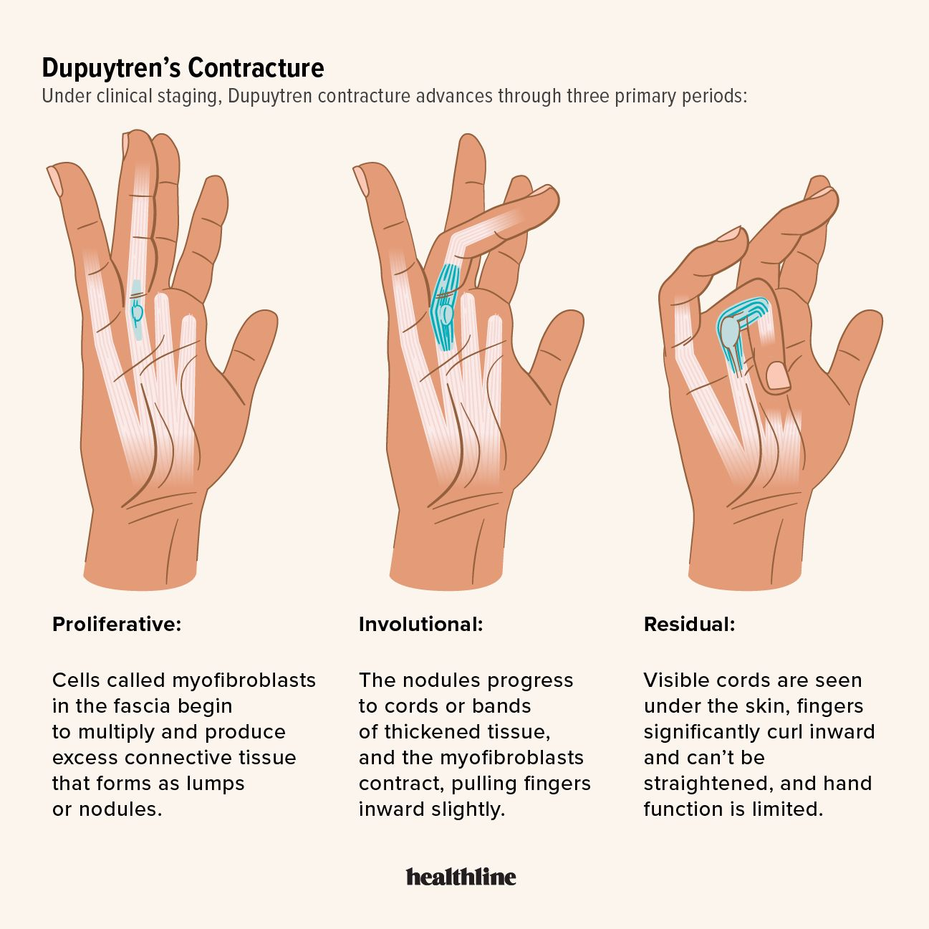
Dupuytren’s disease / contracture
‘Viking disease’
Can also affect feet ‘Ledderhose’
And penis ‘Peyronies’
Reassure, watch and wait
Surgical release if functional impairment and meets criteria:
  MCP contracture > 30deg
  PIP contracture > 20deg
  Severe thumb contracture
Surgery wont stop it returning

Slide 11

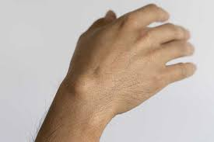
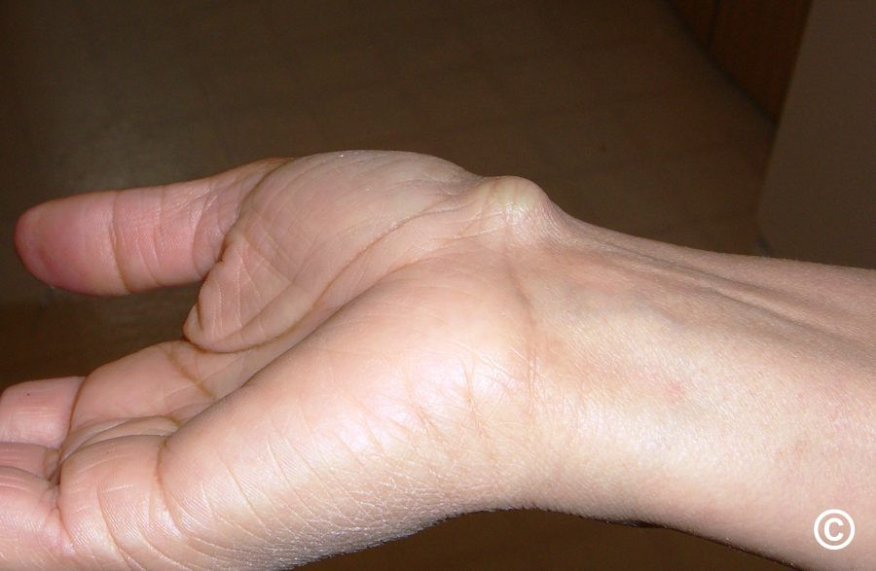
Ganglions
70% dorsal wrist
10-20% volar wrist
Also fingers and elsewhere
Reassure – primary management
USS – not normally required. But can get if uncertainty
Aspirate – but at least 50% recurrence rate
Surgery ‘not normally funded’ as of Sep 2025
  IFR if ‘The patient is significantly different to the general population of patients with the condition in question at that stage of the condition’s development. AND • The patient is likely to gain significantly more benefit from the intervention than might be normally expected for patients with that condition at that stage of the condition’s development.’

Slide 12
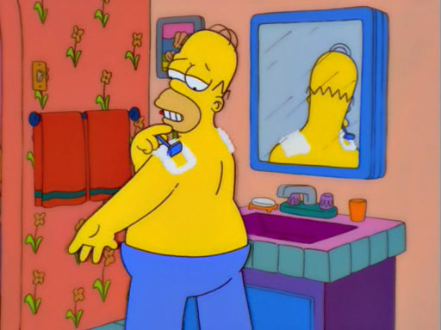
Shoulder pain
  Subacromial pain syndrome (35-75 years)
    Rotator cuff tendinopathy,
    Rotator cuff-related shoulder pain, impingement, subacromial bursitis, degenerative cuff tears
    Calcific tendinopathy
  Glenohumeral joint
    OA (> 60)
    Frozen shoulder (35 – 65)
  AC joint pain +/- OA (> 30)
  Instability (< 35)
  Referred from C-spine
    ? Referred from visceral
  Other cause e.g. inflammatory / PMR
  Traumatic cuff tear
  Other red flag condition – septic joint, cancer, fracture or unreduced dislocation

Slide 13
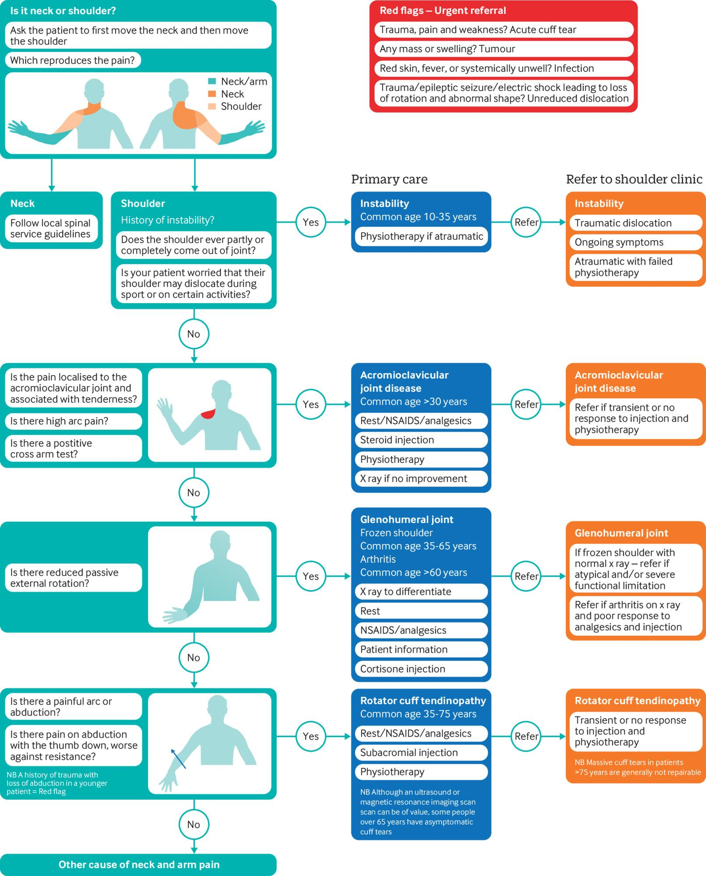
History
Time course. Pain. Restriction
Location of pain
Constant or activity related
Traumatic onset?
Instability symptoms
Neuro symptoms in arm
Red flags – fever / systemically unwell / active cancer

Slide 14
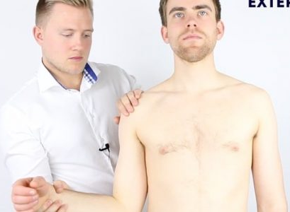
Examination
Order of importance:
  History -> Move/feel/look -> Special tests -> Investigations
Move
  Painful arc – SAPS
  Restricted passive ER – GH joint: Frozen shoulder or OA
  Do neck movements reproduce their pain
Feel
  AC joint tenderness – is it their presenting pain
  Less specific areas – GH joint, LHB, supraspin
Look (especially if severe pain / restriction / trauma / acute )
  Wasting – chronic cuff tear
  Erythema + heat – septic joint
  Bruising, winging
Special tests
  Empty can / Hawkins / Neer – SAPS / impingement
  Scarf test – ACJ
  Instability tests, or can pt reproduce the instability

Slide 15
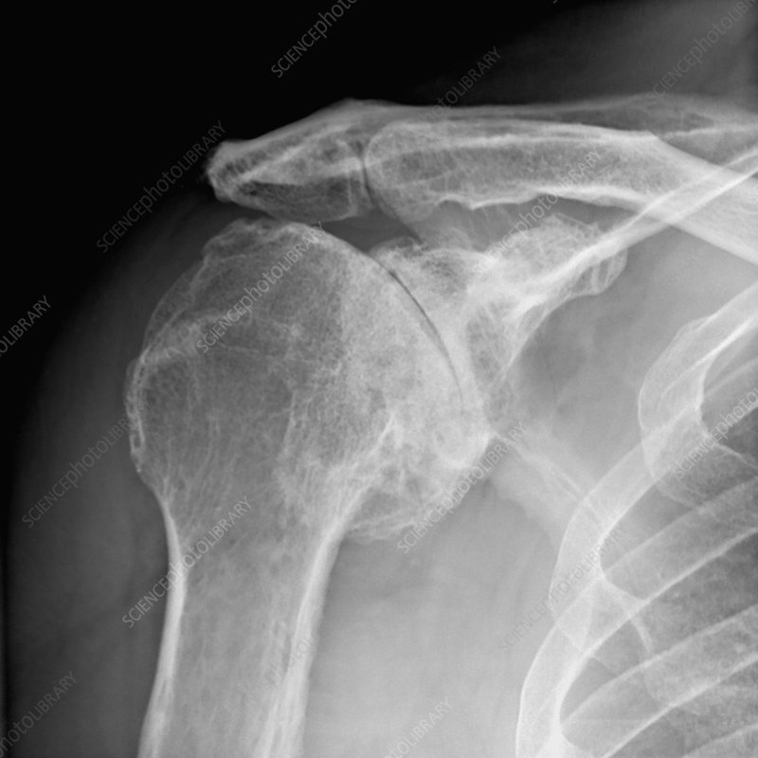
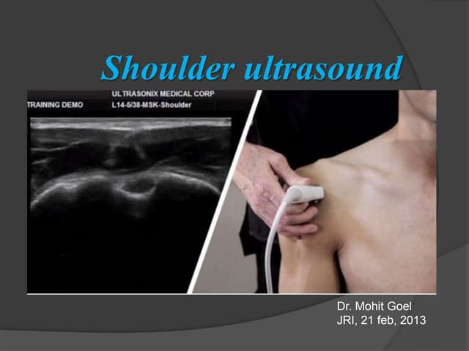
Investigations
Scans rarely change management in primary care
How will the test change the diagnosis/management?
Very high rate of incidental findings in asymptomatic shoulders
  ACJ OA – as high as 82% in on XR!
  Degenerative cuff tears – up to 51% aged 60-80 on US
XR can show – OA to GH or AC, calcification
Indications for XR (outside of acute trauma)
Restriction to ER – can differentiate between GH OA and frozen shoulder
Persistent SAPS being referred – will RO calcification
Persistent ACJ pain being referred
Ultrasound shoulder
Generally shouldn’t be requested in primary care
If acute trauma and ? Cuff tear – can request urgent US, or just refer if unsure

Slide 16
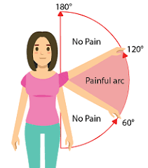

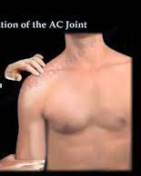
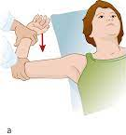
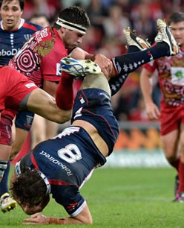
Management
SAPS
Frozen shoulder
GH OA
Rest, NSAIDs/analgesia
Rest, NSAIDs/analgesia
Rest, NSAIDs/analgesia
Steroid injection(s)
Steroid injection(s)
+ Education
Steroid injection(s)
Physiotherapy
Physiotherapy
Physiotherapy
Refer if persists (Most settle in 12 months)
Refer if persists (Majority settle in 18-24 months)
Refer if persists
Have a low threshold for early steroid injection in acute non-traumatic painful shoulder without red flags
AC joint
Instability
Traumatic cuff tear
Rest, NSAIDs/analgesia
Does fracture need excluding in ED / MIU?
Physiotherapy
Steroid injection(s)
Refer if persists despite full course of physio or if traumatic onset
If working age / very active retired and significant loss of function:
Either urgent US
Or urgent referral
Physiotherapy
Refer if persists

Slide 17
BMJ 2023;382:p1255

Slide 18
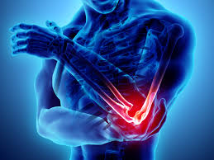
Elbow Pain
In Primary Care
Will Swain

Slide 19

Elbow pain
It’s probably tennis elbow
Other to consider
Golfers elbow – rare
Cubital tunnel syndrome
Olecranon bursitis – manage conservatively
Elbow OA – very rare
Inflammatory arthritis
Referred – e.g. cervical radiculopathy / shoulder
Not to miss
Infection / Tumour / Distal biceps rupture
Lateral_Epincondylitis.pdf
ExampleProgramme-17th Feb 2026 (Tennis elbow exercise program)

Slide 20

Any questions?

Slide 21

MCQs

Slide 22

You are in clinic with Joan, a 64 year old lady.
She’s just consulted about her hypertension and IBS then says ‘Whilst I’m here can you look at my hand’. She’s worried she has RA as maybe her gran had that
She reports:
P and N / tingling affecting all digits R hand
Mainly comes at night and also on holding a phone
Has to shake hand to relive it
Occasionally L hand but very mild
OE: No wasting. Normal power and sensation
Tinels –ve, Phalens triggers her symptoms R hand
Do you:
Request bloods including b12, fol, TFTs, HBA1C
Request NCS
Do an urgent spinal referral
Advise on an OTC futura splint
XR hands and RF + CRP + ESR

Slide 23
You are in clinic with Joan, a 64 year old lady.
She’s just consulted about her hypertension and IBS then says ‘Whilst I’m here can you look at my hand’. She’s worried she has RA as maybe her gran had that
She reports:
P and N / tingling affecting all digits R hand for 4 weeks
Mainly comes at night and also on holding a phone
Has to shake hand to relive it
Occasionally L hand but very mild
OE: No wasting. Normal power and sensation
Tinels –ve, Phalens triggers her symptoms R hand
Do you:
Request bloods including b12, fol, TFTs, HBA1C
Request NCS
Do an urgent spinal referral
Advise on an OTC futura splint
XR hands and RF + CRP + ESR

Slide 24

You have a tel consult with Temi, a 31 year lady
“My carpal tunnel has come back really bad. I need strong painkillers”
Had bad CTS in pregnancy. Resolved after delivery
Now 3 months post partum
Searing R hand pain, struggling to pick up baby or breastfeed
Feels the hand is swollen
You bring her in for exam:
Any thumb movements very painful
Exquisitely tender on radial styloid + visibly swollen there
What’s the diagnosis?
Carpal tunnel syndrome
De Quervains tenosynovitis
Base of thumb OA
Rheumatoid arthritis
Radial nerve compression
What would you do next?

Slide 25
You have a tel consult with Temi, a 31 year lady
“My carpal tunnel has come back really bad. I need strong painkillers”
Had bad CTS in pregnancy. Resolved after delivery
Now 3 months post partum
Searing R hand pain, struggling to pick up baby or breastfeed
Feels the hand is swollen
You bring her in for exam:
Any thumb movements very painful
Exquisitely tender on radial styloid + visibly swollen there
What’s the diagnosis?
Carpal tunnel syndrome
De Quervains tenosynovitis
Base of thumb OA
Rheumatoid arthritis
Radial nerve compression
What would you do next?

Slide 26

You have just manged 4 routine problems for Dave, a 59 YO plumber
“Whilst I’m here doc, can you look at my hand”
“Keeps getting a claw hand”
R ring finger keeps gets stuck in flexion.
Has to ping the finger straight with other hand
Worried as father and grandfather needed surgery for dupuytrens
Examination seems normal
What would you do next
Request an x-ray of the hand
Request an US of the hand
Advise on topical NSAID + finger splinting
Advise watch and wait – but advise he might need surgery one day if contracture develops

Slide 27
You have just manged 4 routine problems for Dave, a 59 YO plumber
“Whilst I’m here doc, can you look at my hand”
“Keeps getting a claw hand”
R ring finger keeps gets stuck in flexion.
Has to ping the finger straight with other hand
Worried as father and grandfather needed surgery for dupuytrens
Examination seems normal
What would you do next
Request an x-ray of the hand
Request an US of the hand
Advise on topical NSAID + finger splinting
Advise watch and wait – but advise he might need surgery one day if contracture develops

Slide 28
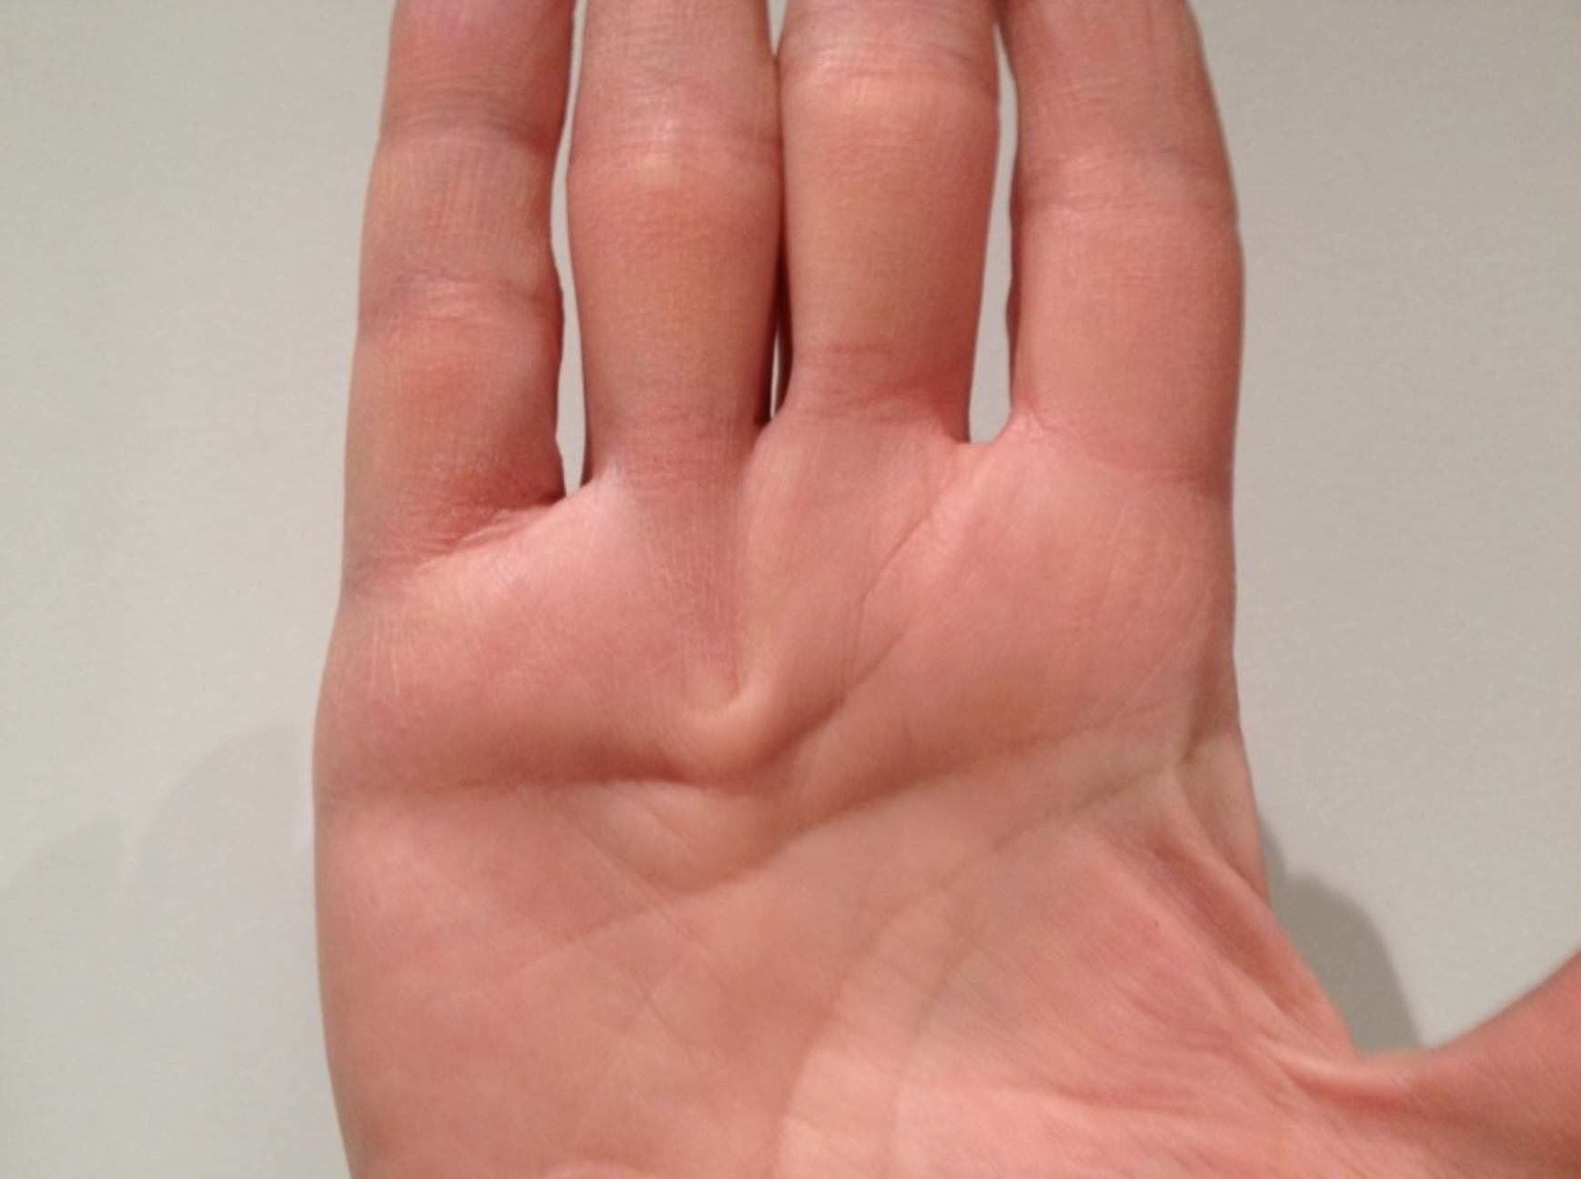
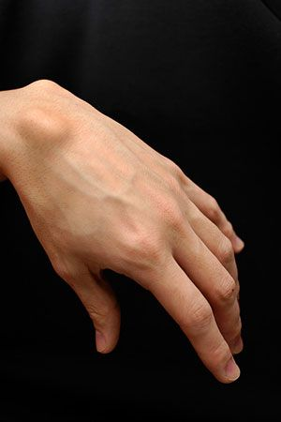
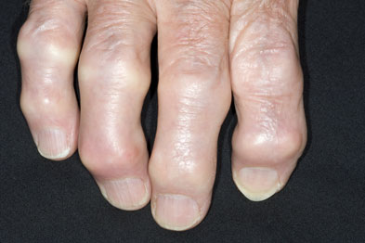
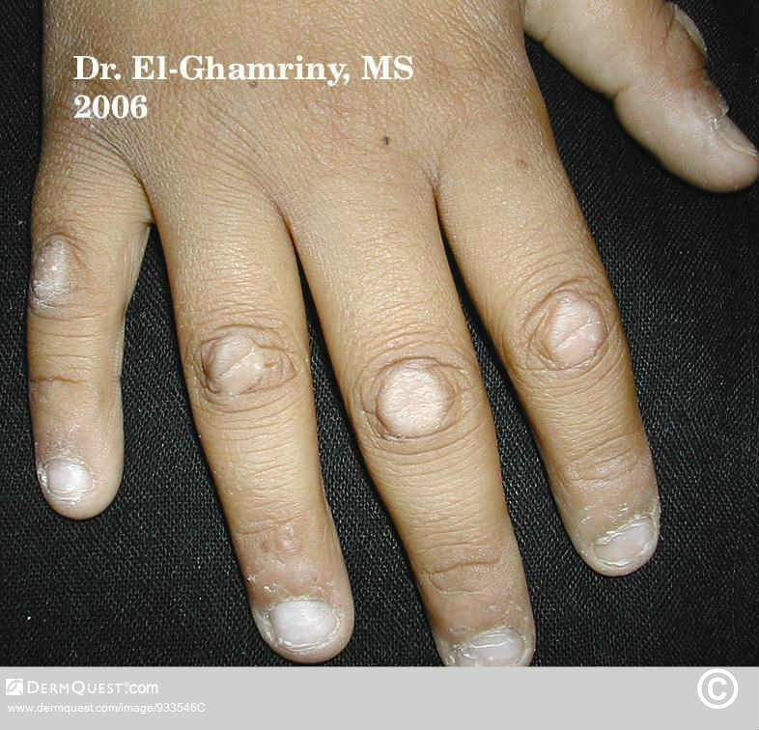
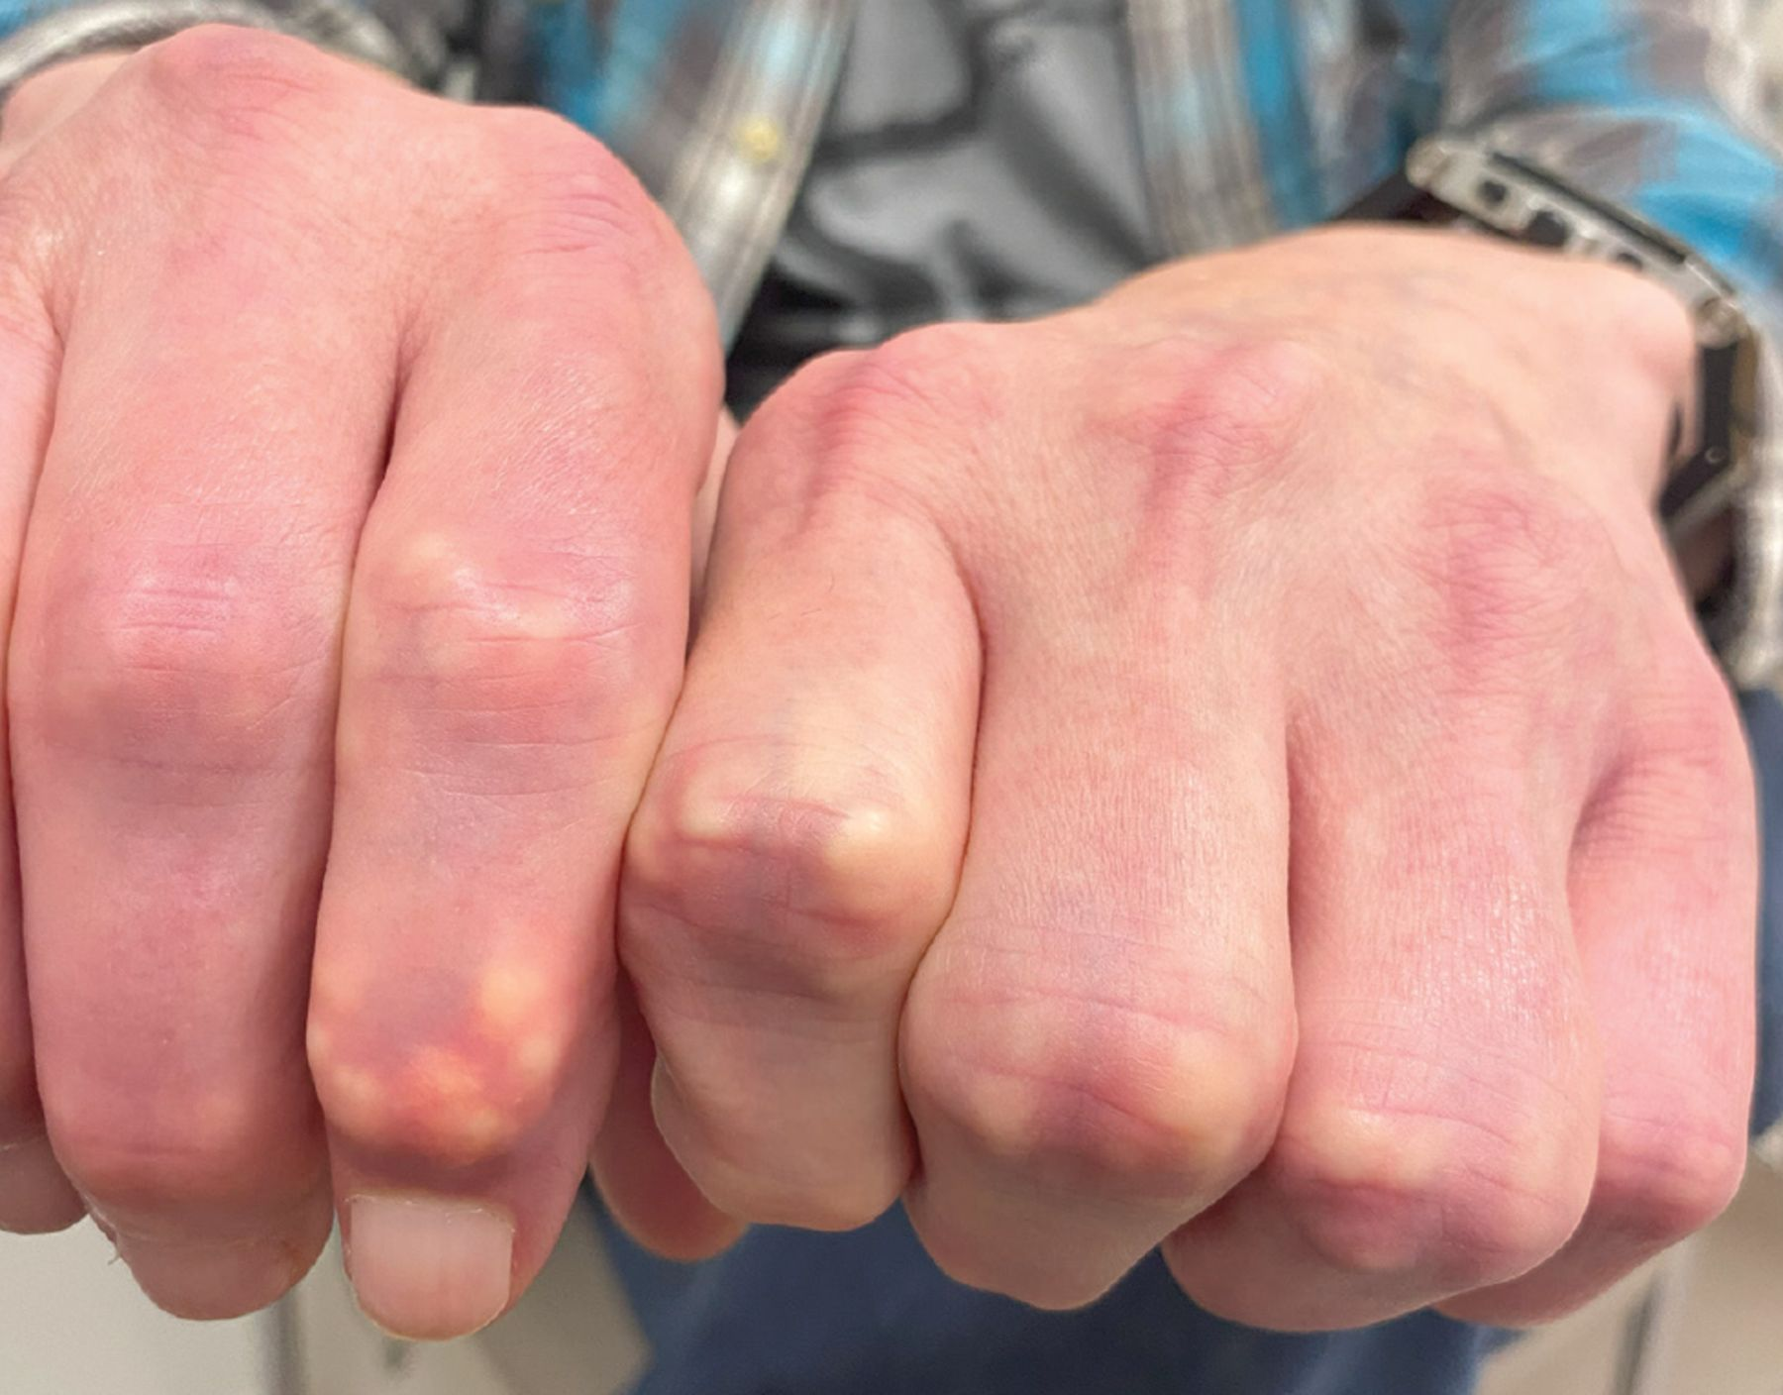
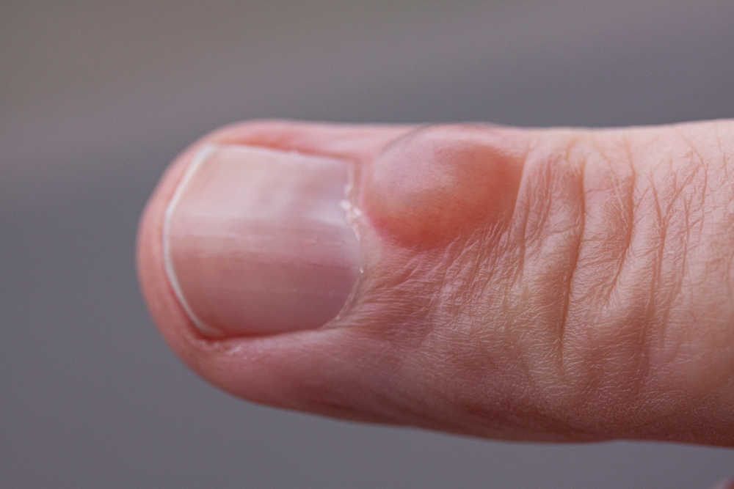
Lumps and bumps spot diagnoses
A
B
C
D
E
F

Slide 29
Lumps and bumps spot diagnoses
A
B
C
D
E
F

Slide 30
Lumps and bumps spot diagnoses
A
B
C
D
E
F
A) Dupuytren’s disease

Slide 31
Lumps and bumps spot diagnoses
A
B
C
D
E
F

Slide 32
Lumps and bumps spot diagnoses
A
B
C
D
E
F
B) Ganglion

Slide 33
Lumps and bumps spot diagnoses
A
B
C
D
E
F

Slide 34
Lumps and bumps spot diagnoses
A
B
C
D
E
F
C) OA – Bouchard’s and Heberden's nodes

Slide 35
Lumps and bumps spot diagnoses
A
B
C
D
E
F

Slide 36
Lumps and bumps spot diagnoses
A
B
C
D
E
F
D) Garrods pads (Holoderma)
Can be associated with dupuytrens or some genetic syndromes or idiopathic. Usually no management required

Slide 37
Lumps and bumps spot diagnoses
A
B
C
D
E
F

Slide 38
Lumps and bumps spot diagnoses
A
B
C
D
E
F
E) Digital mucoid/myxoid cyst. Usually associated with DIP OA. Generally best left alone. Aspiration carries infection risk + high chance of recurrence. Surgery not funded on NHS now

Slide 39
Lumps and bumps spot diagnoses
A
B
C
D
E
F

Slide 40
Lumps and bumps spot diagnoses
A
B
C
D
E
F
F) Gouty tophi

Slide 41
Resources
MSK - main page :: Hampshire and Isle of Wight NHS Foundation Trust
Lateral_Epincondylitis.pdf
ExampleProgramme-17th Feb 2026 (Tennis elbow exercise program)
Carpal_Tunnel_Syndrome_CTS_.pdf

Slide 42
Any questions?

