Slide 1
ST1 induction
Welcome to GP training in Southampton and Jersey
Notes:
Make sure Jersey on line and cameras on ☺

Slide 2

Notes:
Chat to neighbour about how you feel to be starting GP and where you want to be by the end

Slide 3
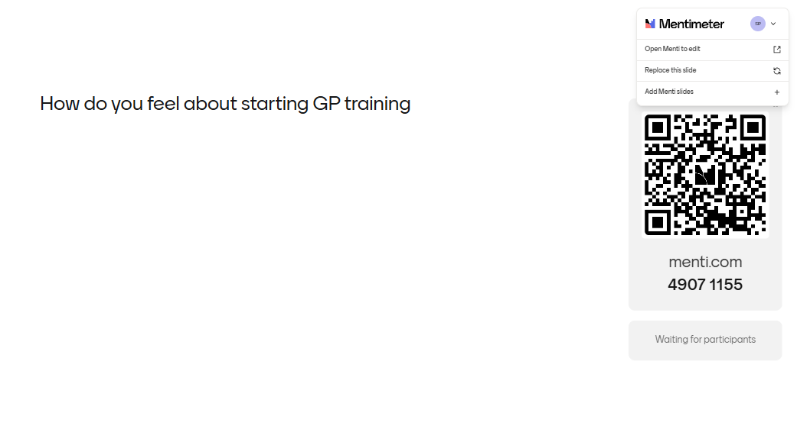
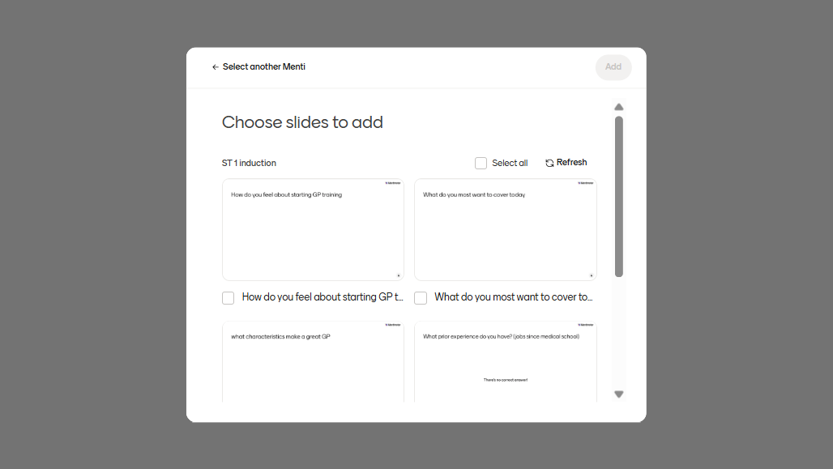
How do you feel about starting GP training
Notes:
Encourage Jersey to add too

Slide 4
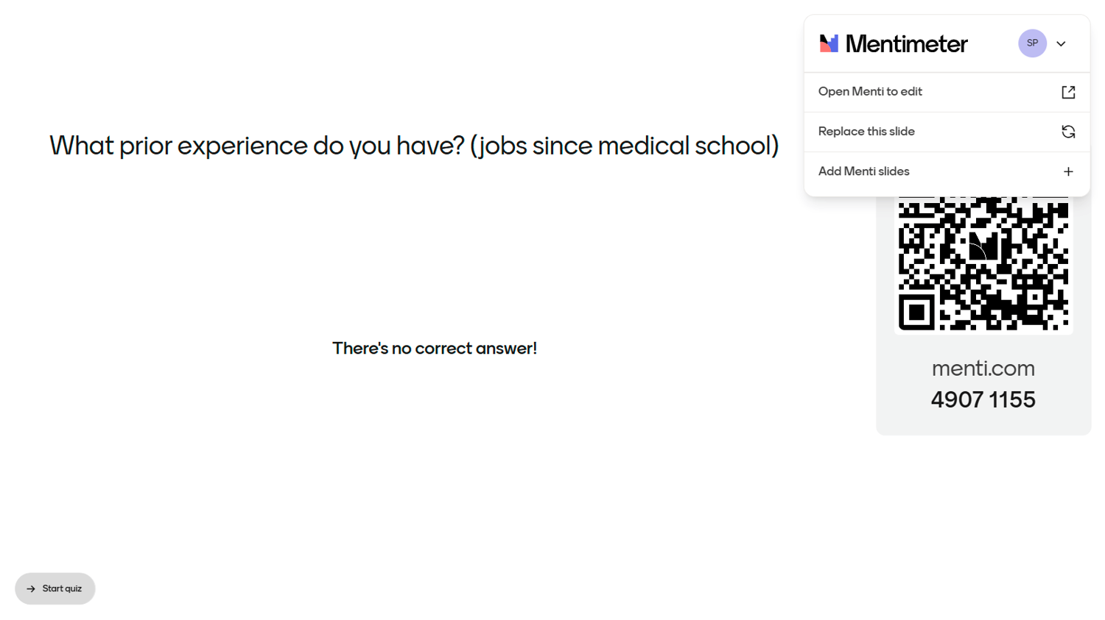

Slide 5

What prior experience do you have? (jobs since medical school)

Slide 6

What do you most want to cover today

Slide 7
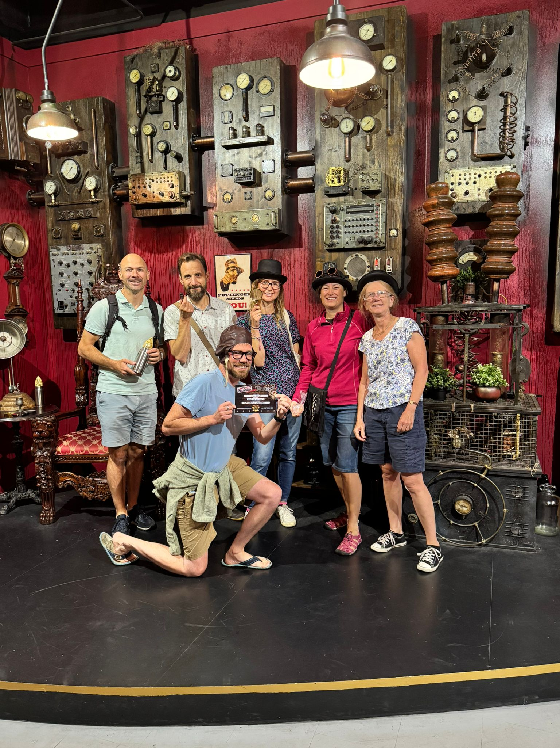
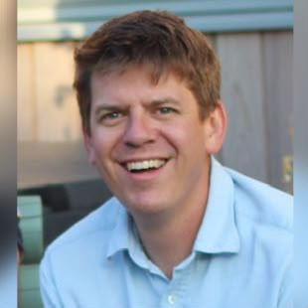
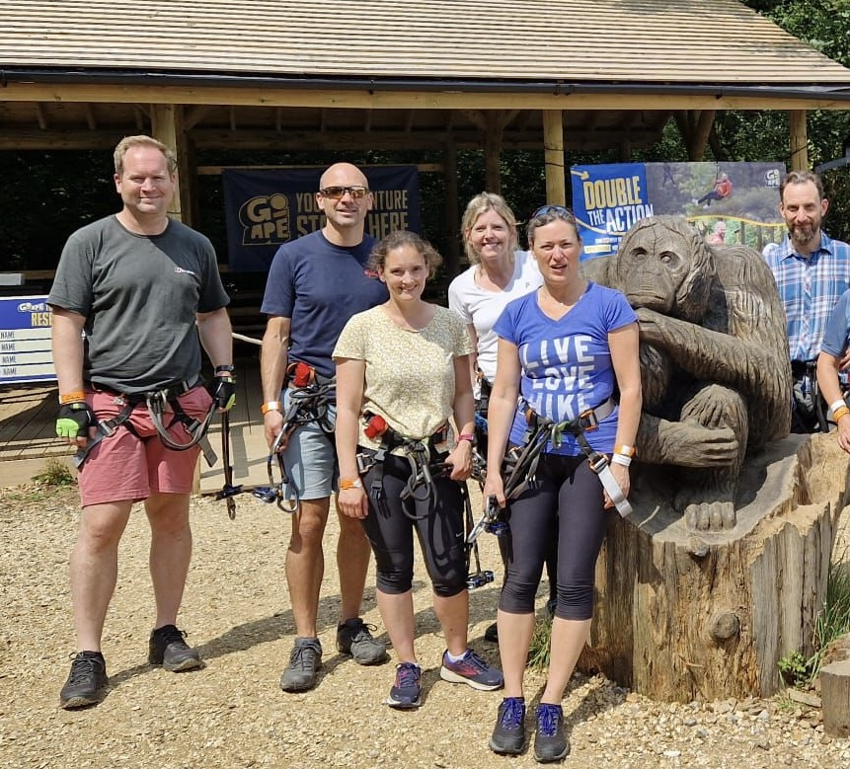
Meet The Team
Plus the AIT team:
wessexAIT@gmail.com
https://wessex.hee.nhs.uk/general-practice/wessex-ait-sub-committee/
Register as AIT on https://www.rcgp.org.uk/ait
Notes:
ADs
PDs - can speak to any of us. Lots of experience and different roles between us all. Specialist areas
Admin – ensure receiving emails
Educational supervisors
Clinical supervisors
Patches
Deanery and deanery admin – Sally Claughton and Krystina Snow
AIT reps

Slide 8
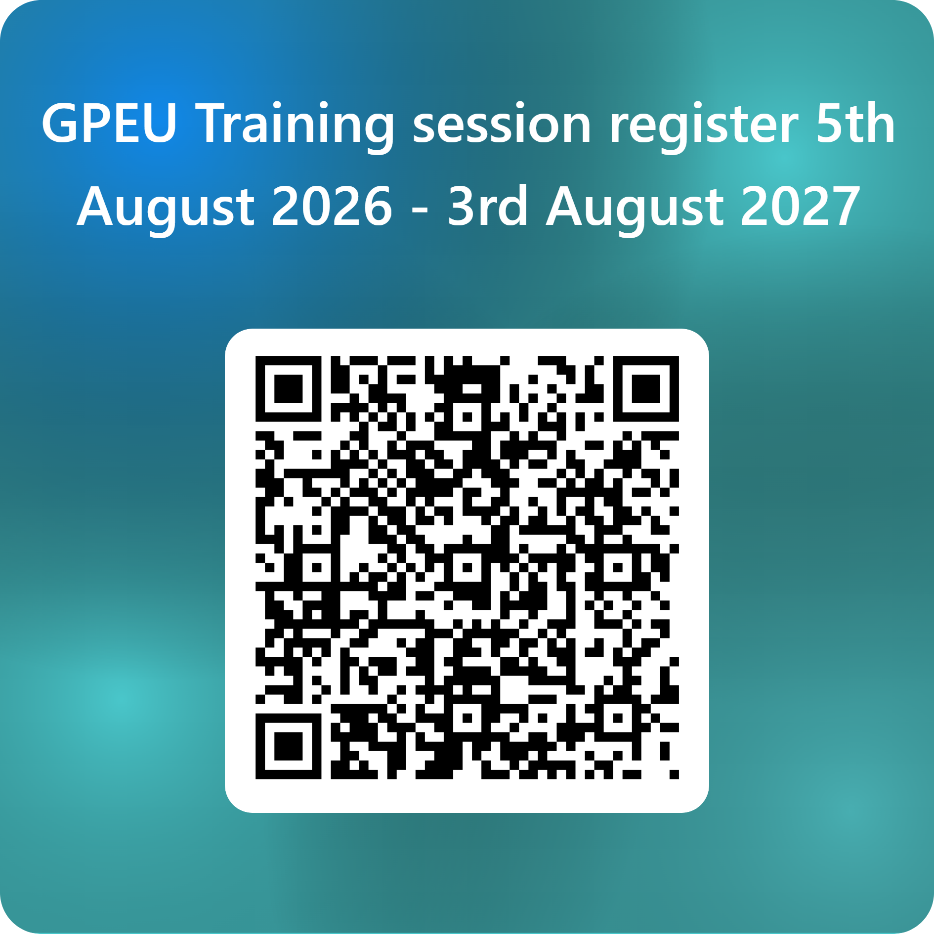
Day release
Adult learner
Attendance – must register yourself on the day. No reminders
Professionalism
How it works
Notes:
Regular, protected, GP-orientated educational sessions:
These are a mix of clinical and professional development sessions with emphasis on small group working and practical application of knowledge.
Attendance and punctuality:
remind them it will be documented in the educator notes
expectations = 70%, Study leave or absence due to rota issues need to send apologies. They can speak to their ES if they aren't being released in case it's a pattern that needs addressing with the department.
ST1 once a month - see timetable and make sure rota co-ordinator has it now and books them out appropriately. Curriculum covered over course of 2 yrs but superficially
ST2 or while in GP placements, twice a month – small group discussion about cases – bring cases.
ST3 – weekly except once a month. Generally small group work, some group teaching but they are adult learners, so we don’t teach much, that’s not the point. The art of being a GP. Communication skills, wider perspectives – health inequality, planetary health, wellbeing etc
PDs generally with their group but can speak to any of us. Lots of experience and different roles between us all.
Jersey – sessions on the island and sometimes joining us on line. ST3 on the mainland

Slide 9
QR code, whatsapp group and photos
You will not be sent info about teaching – YOU must check the website
Sometimes different times, venues or on-line and date changes
Resources will be on website
70% attendance expected at least.
Get onto the whatsapp group via peers
Send your photo to Sue (England.sotongpeuteam.se@nhs.net)
Notes:
Your responsibility to ensure you register every week what you’re doing – attending, annual leave, sick leave, etc
Can they get on the whatsapp group
Probity and professionalism issue if not attending. Paid to be here. Treat it like a clinic. Child care cover a must.

Slide 10
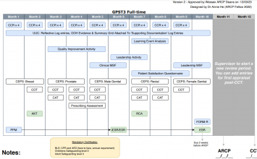
GP training roadmap
ST1 – hospital posts
ST2 – GP / ITP plus AKT towards the end if poss
ST3 – GP plus (AKT if not already and) SCA towards the end
It’s not how fast you go, it’s how well you go!
Notes:
ST3 on mainland for Jersey as no NHS on Jersey

Slide 11
Links to useful websites
Ours - https://wessex.hee.nhs.uk/general-practice/patch-team-contacts/southampton-new-forest-jersey-gp-homepage/
RCGP - https://www.rcgp.org.uk/
AIT - https://wessex.hee.nhs.uk/general-practice/wessex-ait-sub-committee/
PSW - https://wessex.hee.nhs.uk/wellbeing-and-support/psw/
Patch email address – remember, there are no email reminders england.sotongpeuteam.se@nhs.net
https://wessex.hee.nhs.uk/general-practice/international-medical-graduates-imgs/

Slide 12

Support available
For all
Additionally For IMGs specifically
PSW - https://wessex.hee.nhs.uk/wellbeing-and-support/psw/
PH- https://www.practitionerhealth.nhs.uk/
Your TPD
Your Trainer
Peers and colleagues
Financial supportRoyal medical benevolent fund - https://rmbf.org/
IMG PD
Welfare service
Thrive sessions

Slide 13
IMG Welfare service

Slide 14
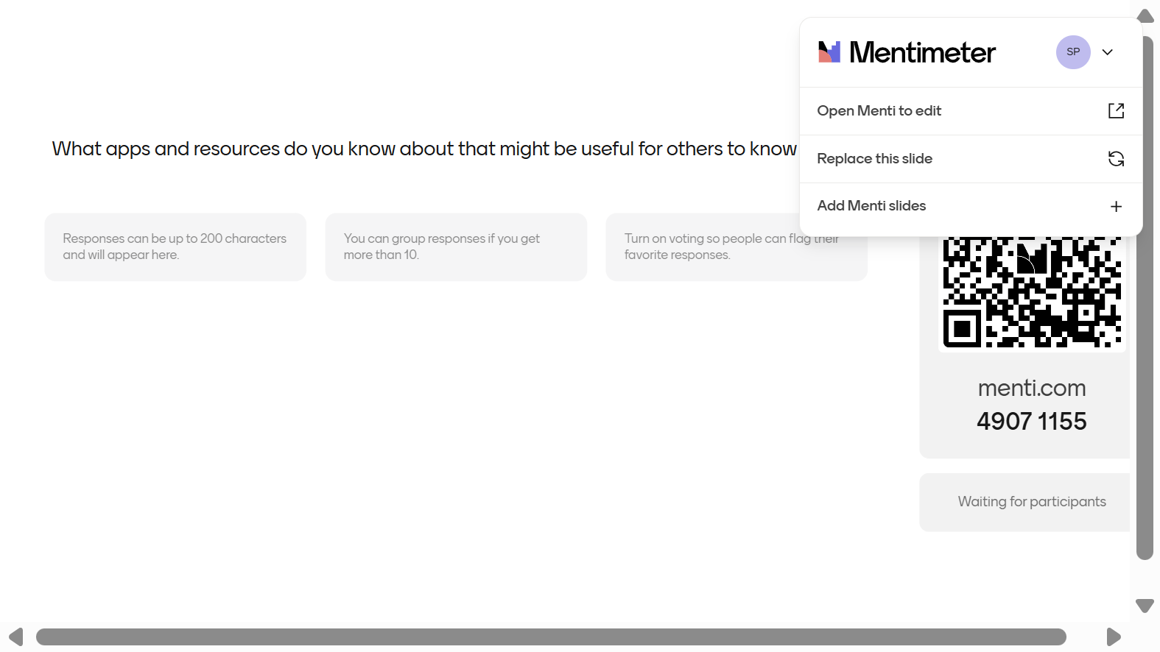
What apps and resources do you know about that might be useful for others to know about

Slide 15

Inductions
Trust induction
Hospital department (or practice)
IMG GP induction 7th September and 12th oct
GP Head of school (GP only) – online on Teams on 16/9/26 1-3pm
Notes:
you should have received emails from Sally Claughton and a form sent out for the GP head of school induction

Slide 16

Indemnity
https://wessex.hee.nhs.uk/trainee-information/employment-matters-2/medical-indemnity/
Take up the offer from MPS
Jersey trainees – get your health insurance sorted
Notes:
All Wessex GP Doctors in Training have access to free indemnity cover via Medical Protection Society (MPS).
We encourage all Doctors in Training to take up the offer of this cover as it provides support and advice unlike the NHS indemnity scheme which will only cover the financial aspects of a negligence claim.
You should have been contacted by MPS to register and take up the offer of block indemnity.
There is a link to information on the website under Medical Indemnity. Look out for email from MPS as there will be actions to complete for new ST1s.
If you do not have cover in place contact england.gp.wx@nhs.net

Slide 17
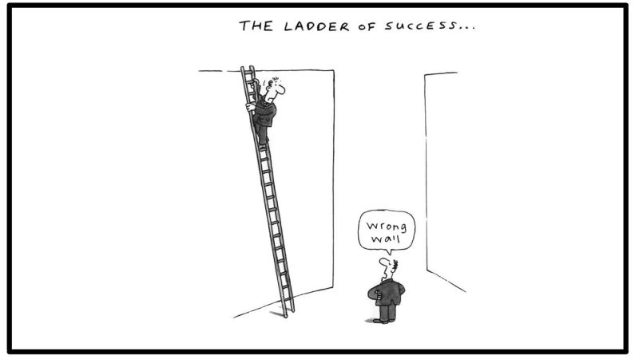
Getting to CCT
Portfolio – must be signed up to Fourteen Fish
Workplace Based Assessments
AKT
SCA
Professionalism and reputation
Notes:
All have to be done
Your reputation matters as well as your results
Not easy
Be sure you’re on the right career path. Better to find right career than be miserable

Slide 18
Eportfolio and WBPA’S
CCR
CBD
MSF
Placement planning meeting
miniCEX
Safeguarding and BLS
PDP
Patient safety project
ESR prep and timings
Learning event analysis

Slide 19
Other must do’s
Patient safety project
ESRs - meet your ES early and plan them
Notification of sick leave (employer, placement, patch team and GP school)
Report significant events
Mandatory training
PDP
Dyslexia screening

Slide 20
Useful to do’s
Driving
Claiming for correct expenses
Start your eportfolio early
Plan your annual leave in advance
Be in the NHS pension scheme – the employer and government contribute 23% on top of your contributions!
Understand cognitive biases and the impact of your choices, eg AI and de-skilling, mis-skilling and never-skilling

Slide 21
And some don’ts
Break GMC guidance
Do Locum shifts without checking with ES/ AD 1st
Request LTFT too late – window closes on 13/10/26 for February 2027 changes
Register at the GP practice where your trainer/ ES is based
Prescribe for yourself or family
Ask for funding for courses not funded
Be afraid to ask for help/ support
Break GMC guidance
Notes:
Discuss any locum work with your Educational/Clinical supervisor +/- associate dean before doing so ensuring that any work done does not taky you over your contractual working limits. You must be making substantial progress to undertake any locum work. You need to complete a reflection on work outside of training form and this needs signing by both placement and locum clinical supervisors as well as declaring it on FORM R. If it is in the department within which you are already working then just the FORM R declaration required.

Slide 22
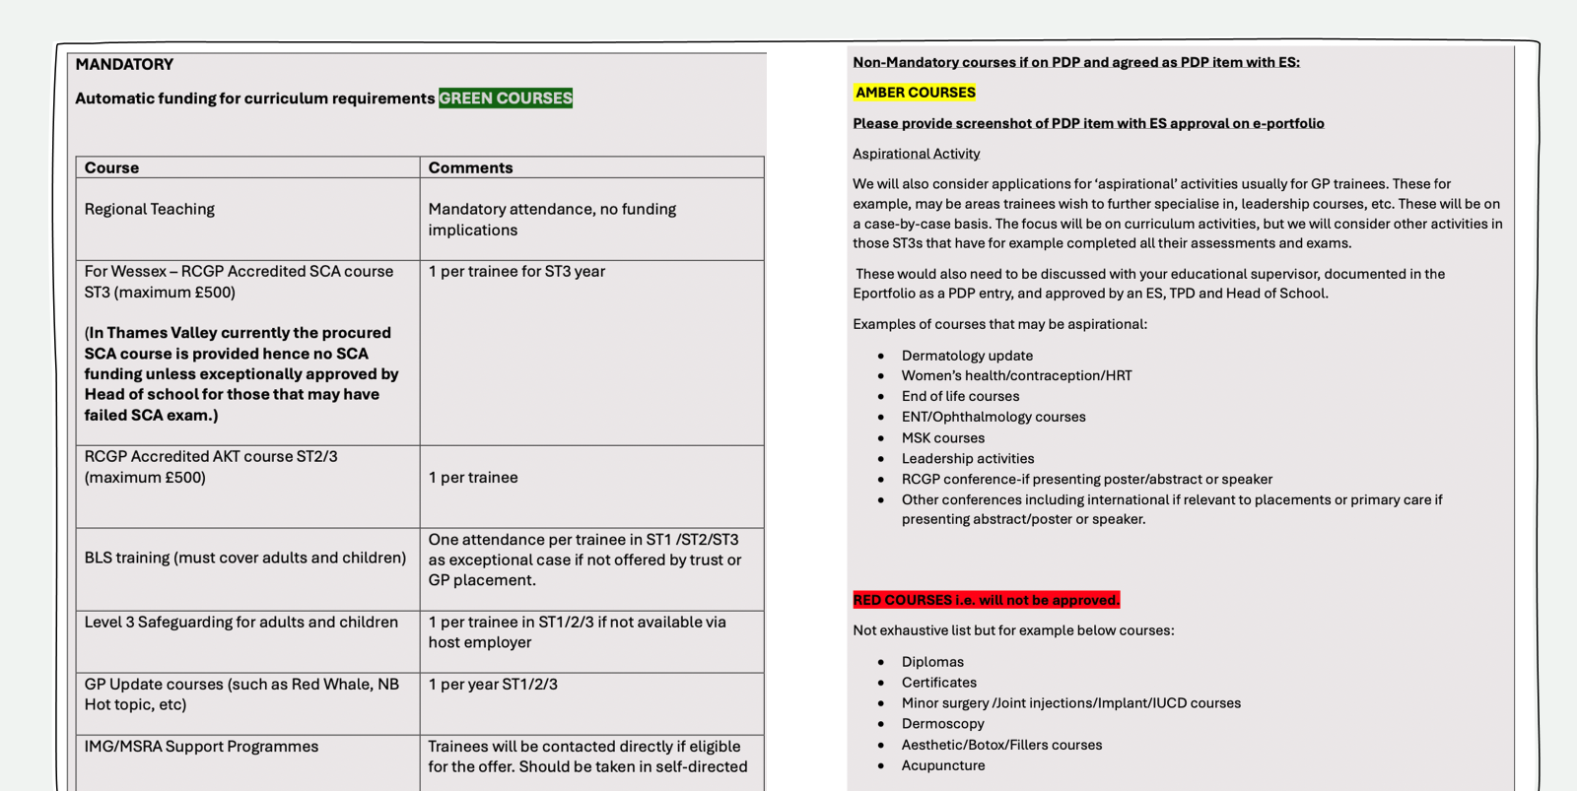

Slide 23
Planetary health awareness
Car share
Waterbottles
Reusable coffee cups
cycle/ walk/ bus etc
Save on printing stuff out
Don’t “reply all “ unless essential
AI!

Slide 24

https://www.civilitysaveslives.com
“The experience of rudeness at work can be upsetting, demeaning and belittling. It can leave you feeling alone, lost and maybe even hopeless. Then on top of all of this, it's typically YOUR problem to deal with. How do you call it out? Who do you speak to? What processes are there to help? Often we don't know the answers to this.

Slide 25
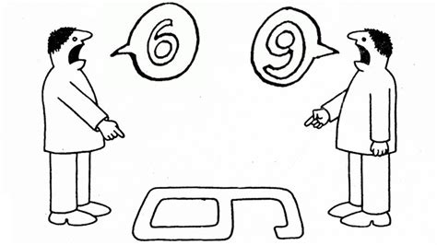

Slide 26


Slide 27
Getting the most out of hospital posts
10.30 with ST2s
Booking time off
Peer support
CS meetings – placement planning and supervisor report.
arrange both early

Slide 28

Eportfolio
After a comfort break

