Slide 1


Orthopaedic Choice
The Cervical and Lumbar Spine
Nicky Hodgkinson- Clinical specialist in spines
Komal Bhuchhada - spinal lead
Notes:
Joint presentation by spinal lead and consultant AH{

Slide 2
Contents
Who we are and what we provide
Pain
Degenerative Cervical Myelopathy
Lumbar Imaging
Lumbar Stenosis
Cauda Equina Syndrome
Questions

Slide 3
Who we are and what we provide
Provides specialist assessment of musculoskeletal spinal conditions and advice and guidance regarding management, including onward referral to other services such as physiotherapy,
We do not accept referrals for
Serious spinal pathology requiring emergency care – e.g. Metastatic cord compression (GP to contact on call spinal registrar at UHS re emergency admission), cauda equina
Suspected tumour/ malignancy – need to be referred via 2ww pathway
Physiotherapy treatment – please refer to musculoskeletal physiotherapy
Consider the pain team if all appropriate investigations have been completed and there is no surgical intervention required.
Notes:
We currently refer to New Hall – Sailsbury, UHS via VSC and currently have a new link with practice plus for possible NRBs- injection service meetings.

Slide 4
Message starts from the first contact
Education
New/ Flare up- what is different now?
Impact on their life
Reassurance
Pain medication
Natural resolution
Keep moving
Physiotherapy

Slide 5
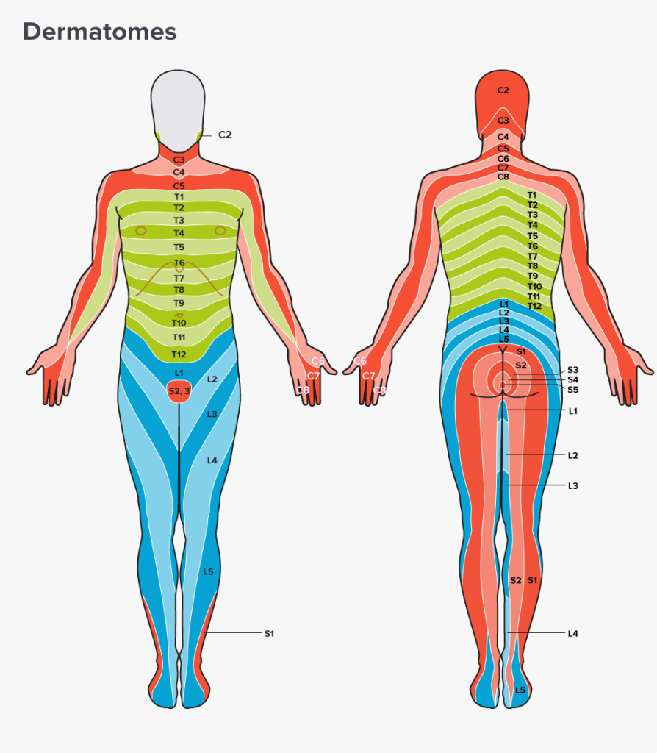
Pain
Radicular Pain:
Sharp/ electric
Nerve root pattern
One of the worst pains one can feel
Arm pain > Neck
Radiculopathy = Objective changes in sensation, muscle power
or reflexes
Somatic:
Dull ache in nature e.g. to the shoulder
Gnawing pain/ diffuse and can be difficult to localise
Natural resolution for painful flare ups
Note timeline, pain location, pain control
Central Sensitisation Pain:
Widespread pain, can shift
Allodynia
Can include sympathetic nervous system changes
Notes:
Radicular pain_ Most get better ☺
Natural resolution
Pain control+
Check re motor loss
If doesn’t improve within natural time and is truly radicular refer to Physiotherapy / OC

Slide 6
Neuropathic Pain Cervical Pain
Offer
Offer a choice of Amitriptyline, Duloxetine, Gabapentin or Pregabalin as initial treatment for neuropathic pain (except trigeminal neuralgia).
Offer
If the initial treatment is not effective or is not tolerated, offer one of the remaining 3 drugs, and consider switching again if the second and third drugs tried are also not effective or not tolerated.
Consider
Consider tramadol only if acute rescue therapy is needed.
Consider
Consider capsaicin cream for people with localised neuropathic pain who wish to avoid, or who cannot tolerate, oral treatments.
Notes:
Appreciate that Sciatica (lumbar radiculopathy) on CSK NICE states do not use gabapentiniod

Slide 7
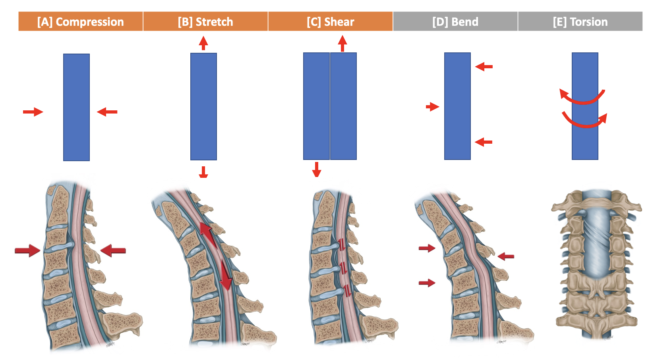
Cervical Myelopathy
What is Myelopathy?
Compression, torsion or stretching causing altered function of the spinal cord

Slide 8
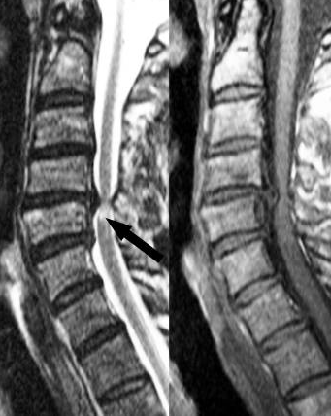
Degenerative Cervical Myelopathy
Most common type of myelopathy is DCM; Degenerative Cervical Myelopathy – age 50 or older(5% prevalence is over 40s)
More common in the cervical spine
Causes progressive neurological symptoms, functional disability and has a significant impact on quality of life
23% of the healthy population have spinal cord compression on MRI, 10% of these will progress to DCM i.e. it affects 2.3% of the adult population

Slide 9
Subjective Clues: ‘Cord Signs’
‘I am unsteady on my feet’
‘I cannot use a knife and fork properly
‘My writing isn’t controlled/ there is a change in my writing’
‘I struggle to coordinate to do up my shirt buttons/ tie my shoelace’
‘My legs feel heavy’
‘I am dropping objects’
Notes:
Neck pain +/- stiffness
Bilateral radicular pain arms +/- legs
Upper limb weakness, numbness, or loss of dexterity
Lower limb stiffness, weakness, or sensory loss
Bilateral paresthesia hands (glove) → feet (sock)
Autonomic symptoms such as bowel or bladder incontinence, erectile dysfunction, or difficulty passing urine
Imbalance/unsteadiness
Falls
Reducing mobility (e.g. previously supermarket, now housebound)
Paralysis

Slide 10
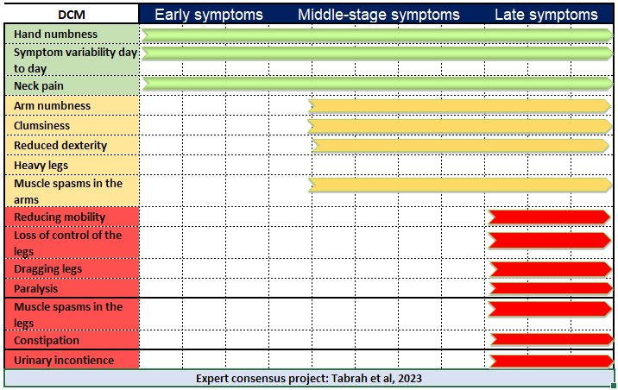
Degenerative Cervical Myelopathy Expert Consensus 2023 using a 2 stage survey
Notes:
HANDOUT – STUART
23% of the healthy population have spinal cord compression on MRI (Smith et al 2020, Global Spine J).
10% of these will progress to DCM i.e. it affects 2.3% of the adult population
Prevalence: European / American 39.7% and Asian subgroup 7.1%
Annual estimated cost in the UK £681,600,000 - a combination of disability payments, lost days work and disability costs
One of the worst quality of life scores of chronic disease (Taemin et al, 2017)
https://myelopathy.org/
Subjective Cord Signs
• Unsteadiness/ gait deviation/ broad based gait
• Loss off dexterity or coordination
• Upper limb or lower limb weakness
• Electric shock pain in the legs
• Neck stiffness/ shoulder pain/ paraesthesia
• Alteration in bladder/ bowel/

Slide 11
Physical Examination
Neurological exam is often normal in the early stages (myotomes and reflexes)
You can test power, Clonus, Hoffmans, Babinski, Tandem Walk
Gait deviation, positive hoffmans, inverted supinator sign, Babinski, age > 45- 3-5/5 tests effective in post-test probability to > 95%
Gait: Have a look at their gait when they come into your room but bear in mind – visibly poor balance and ataxia are later stage symptoms
Do not be reassured by negative tests if there is a clear subjective history, if you have a suspicion refer on to a specialist service

Slide 12
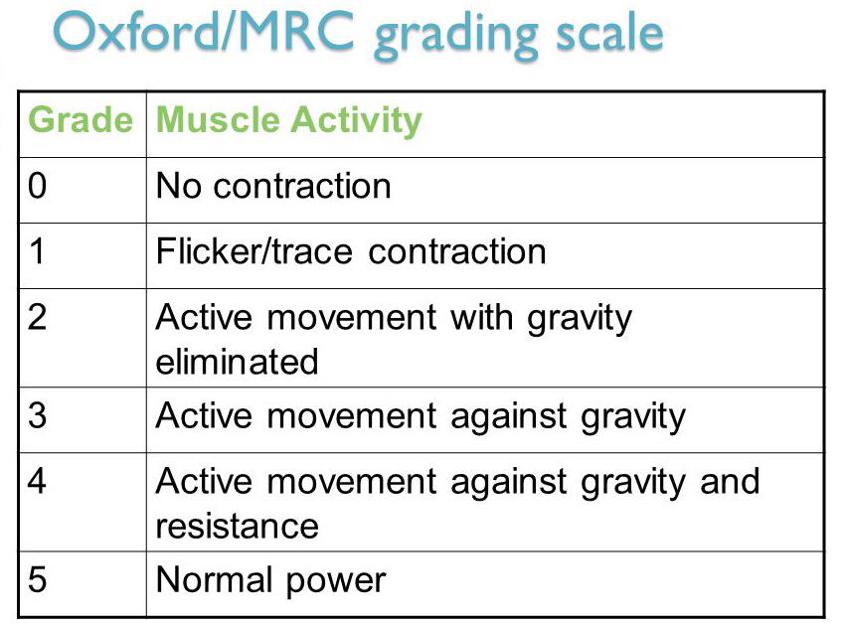
Notes:
<3- myotome weakness NOT PAIN Inhibition then it is for toc..

Slide 13
Practical - video clips
Hoffmans https://youtu.be/q_4gpNizwPg (18 seconds)
Invertor supinator sign https://youtu.be/_H5Pv8istcI (30 seconds)
Babinski The Babinski Sign or Reflex | Upper Motor Neuron Lesion – YouTube (30 seconds)

Slide 14
Common Differential Diagnosis
Parkinsons Disease
Stroke
B12 deficiency
Cervical Radiculopathy
Bilateral Carpal Tunnel Syndrome
Drug Intoxication / Withdrawal
Prostate Dysfunction
MND
MS
Peripheral Neuropathy
OA hands
Vestibular Cause
Frailty

Slide 15
Role of the GP
Physical examination using the cluster tests described above is more useful than a standard neurological examination
If there is a high index of suspicion and there is a rapid deterioration of neurology, please follow your local emergency pathway.
If suspicion is high and function is stable, then consider a referral to your local MSK specialist service (Orthopaedic Choice) where assessment +/- investigation will occur
Xray has no role in the diagnosis of DCM

Slide 16
Case study TOM
64-year old man with 8 months of tingling in both hands, initially diagnosed as bilateral carpal tunnel syndrome
Night splints did not help and in the last 4 months he has felt unsteady
Walking has reduced distance in the last 4/12
Mentioned some problems with handwriting
History of successful C5/6 decompression for radiculopathy 5 years ago, but does not have any neck or arm pain currently
Has Diabetes, Raynauds and is a smoker of 20 per day x 30 years.
Gait ok for a short distance, some hyper-reflexia.
Could this patient have DCM?
Plan: ED, urgent MSK (OC), routine MSK (OC), physio or watch and wait?

Slide 17
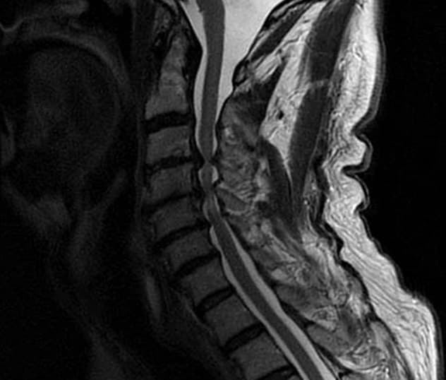
Tom scan
Tom was referred for an urgent specialist MSK assessment
He had an urgent cervical MRI scan which showed myelopathy at C3/4/5
He had a successful decompression

Slide 18
Pathways
Acute mechanical spinal pain with/ without unilateral arm pain, without significant neurological deficit – initially conservative care with reassurance – likely to resolve within 3/12 – may benefit from referral to Musculoskeletal physiotherapy.
Spinal and radicular pain with non-resolving neurological deficit despite initial conservative management including Physiotherapy – Routine referral to Orthopaedic Choice (Spines).
Non-resolving musculoskeletal spinal pain which may refer to the arm / leg, having tried conservative management, medication and Physiotherapy – Routine referral to Orthopaedic Choice (Spines).
Acute spinal and radicular arm or leg pain with deteriorating hard neurology/ weakness or new onset acute bilateral radicular leg pain (including unilateral progressing to bilateral) – Urgent referral to Orthopaedic Choice (Spines).
Chronic spinal pain with /without radicular arm or leg symptoms where all appropriate investigations have been carried out and where surgical management is not indicated – Pain management service.
Notes:
Indication of urgent serious spinal pathology – e.g. acute Cauda Equina Syndrome, discitis, rapidly deteriorating neurology – urgent immediate referral to acute hospital (UHS) via on call spinal registrar.
Suspected serious non-mechanical spinal pathology (e.g. cancer/ inflammatory disorder) – referral to appropriate specialist (e.g. oncology/rheumatology/ neurology – consider if 2ww pathway appropriate).
Radicular is the knee
Not dull ache referring to the buttock

Slide 19

Thank you
Any questions?

Slide 20
The Lumbar Spine
Notes:
Joint presentation by spinal lead and consultant AHP

Slide 21

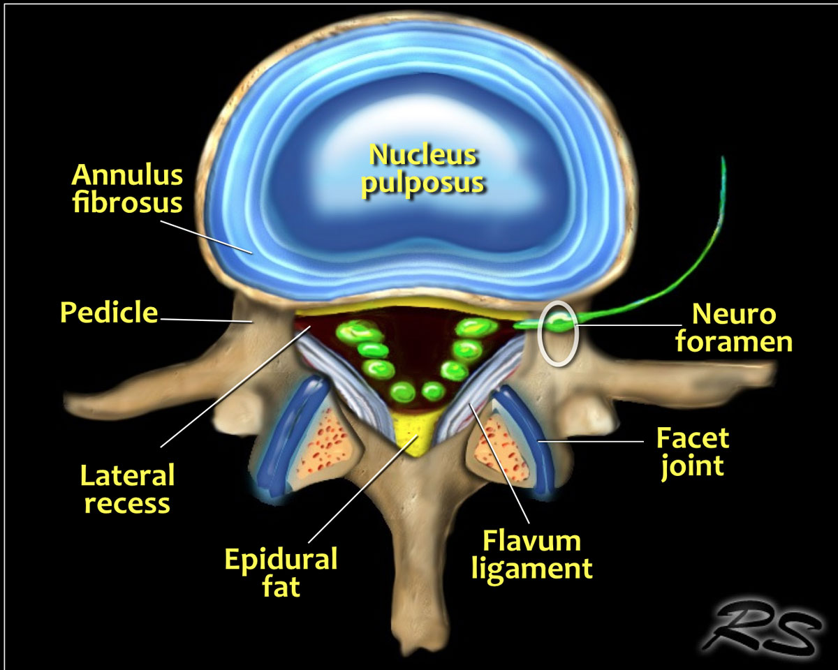



Lumbar Spinal Anatomy
Notes:
Anatomy
The illustration demonstrates the structures that surround the nerves within the spinal canal.
Flavum ligament
The flavum ligament is a strong ligament on the interior posterior side of the vertebral canal that connects the laminae of adjacent vertebrae.
As a result of aging and instability of the vertebral column due to facet arthrosis there will be more stress on the flavum ligament resulting in hypertrophy and fibrosis.
Hypertrophy of the flavum ligament is usually seen in combination with facet arthrosis and both result in stenosis of the lateral recess or when it is bilateral, in spinal stenosis.
Epidural fat
This is the fat that surrounds the dural sac, that contains the nerves.
Abundant fat can be seen in steroid therapy, extreme obesitas and rarely idiopathic.
Abundant epidural fat can contribute to stenosis of the spinal canal.

Slide 22
Imaging Guidelines
NICE Guideline for Low back pain and sciatica in over 16s:
1.1.4 Do not routinely offer imaging in a non-specialist setting for people with low back pain with or without sciatica. [2016]
1.1.5 Explain to people with low back pain with or without sciatica that if they are being referred for specialist opinion, they may not need imaging. [2016]
1.1.6 Consider imaging in specialist settings of care (for example, a musculoskeletal interface clinic or hospital) for people with low back pain with or without sciatica only if the result is likely to change management. [2016]
1.3.4 Do not offer imaging for people with low back pain with specific facet join pain as a prerequisite for radiofrequency denervation. [2016]

Slide 23
Normal MRI findings
At age 60:
  88% of asymptomatic adults will have disc degeneration
  70% will show disc bulges
  50% will show facet degeneration
  23% spondylolisthesis.
Lumbar stenosis is seen in up to 20% of those under the age of 40.
Moderate or severe spinal stenosis is seen in up to 64% of those in their 50s and 93% in those in their 80s.
The majority are asymptomatic, as only 17.5% of those with severe central stenosis may have symptoms.
In younger, asymptomatic adolescent sports players, up to 85% may show MRI changes including disc bulges, facet arthropathy as well as pars lesions.
22% of asymptomatic children can show disc degeneration on MRI. (Sajid et al, 2021)
Notes:
At age 60:
88% of asymptomatic adults will have disc degeneration
70% will show disc bulges
50% will show facet degeneration
23% spondylolisthesis.
Lumbar stenosis is seen in up to 20% of those under the age of 40.
Moderate or severe spinal stenosis is seen in up to 64% of those in their 50s and 93% in those in their 80s.
The majority are asymptomatic, as only 17.5% of those with severe central stenosis may have symptoms.
In younger, asymptomatic adolescent sports players, up to 85% may show MRI changes including disc bulges, facet arthropathy as well as pars lesions. Even 22% of asymptomatic children can show disc degeneration on MRI.
(Sajid et al, 2021)
Disc degeneration apparent in asymptomatic people – 37% of 20 year olds to 96% of 80 year olds.
(Brinjikji et al, 2015)

Slide 24
Harmful impact of MRI
Early MSK-MRI is linked to greater disability and prolonged recovery, with non-guideline imaging associated with transition to chronic back pain.
Findings can negatively affect patient perceptions, with lower confidence in conservative management, fear that exercise may worsen the condition, loss of control, over-reliance on surgery as well as poorer functional outcomes.
Cognitions may influence distress, disability and quality-of-life. Increased imaging access may lead to harmful disease-labelling of patients as well as incidental findings placing unnecessary pressure on clinical services.
Sajid et al (2021).
Notes:
What do patients want?
Reassurance – worry about significant pathology.
An explanation of symptoms – I just want to know what is causing my pain!
I’ve been told I need to have a scan.
If you know what is causing it, you will know how to treat it.
Early MSK-MRI is linked to greater disability and prolonged recovery, with non-guideline imaging associated with transition to chronic back pain.
Findings can negatively affect patient perceptions, with lower confidence in conservative management, fear that exercise may worsen the condition, loss of control, over-reliance on surgery as well as poorer functional outcomes.
Cognitions may influence distress, disability and quality-of-life. Increased imaging access may lead to harmful disease-labelling of patients as well as incidental findings placing unnecessary pressure on clinical services.
Sajid et al (2021).
BUT SCAN MAY NOT PROVIDE REASSURANCE, EXPLAIN SYMPTOMS OR CHANGE MANAGEMENT!
Important to emphasise lack of correlation between MRI and symptoms – examples of pristine MRI with extreme pain and poor MRI with no symptoms.
MRIs can show us where things are, if there is major mechanical damage – but not what the nerves, tissues and muscles are doing and not the cause of our pain.
Analogy of the house wiring diagram – doesn’t tell me which circuits are active, which lights are on and how much power or resistance there is.
Less than 5-10% of all low back pain is due to a specific underlying spinal pathology (Hall et al 2021).
Poor correlation of imaging with pain and pathology: patients may have pristine MRI imaging but severe pain – far from reassuring patients, they may feel that belief in their pain is undermined by their imaging.
False reassurance that imaging may provide – e.g plain film not showing metastases.
Importance of recognising normal age-related changes – how do we explain this in language that makes sense to patients?
Age-related mechanical change.
Face wrinkles
Furring inside a copper pipe

Slide 25
Lumbar X-Ray Indications
? Fracture
? Ankylosing Spondylitis
Instability – Flexion and Extension Views- Consultant request
Previous surgery – instrumentation check e.g. screws from previous lx fusion
Pre-operative if required by surgeon
Non-MRI compatible pacemakers (or CT scan)
Note: Typical Effective Dose for a Plain Film Lumbar Spine series is equivalent to the radiation dose from 50 chest x-rays or 5 months background radiation.
Notes:
Guidelines for Plain Film Imaging of the Lumbar Spine
These referral guidelines apply to imaging requests for adult patients.
LUMBAR SPINE X-RAYS are indicated with the following clinical indications:
? fracture with or without trauma
? ankylosing spondylitis or other inflammation (results of inflammatory markers required e.g. HLA-B27 +ve)
? tumour
? infection ( discitis / osteomyelitis)
Previous surgery – instrumentation / fusion
Patients with pacemakers (due to being unsuitable for MRI)
Pre-operative surgery ( Orthopaedic consultant request only)
Flexion and extension views for instability – laterals only and Consultant request only
Kyphosis
LUMBAR SPINE X-Rays are NOT routinely indicated for the following:
Low back pain in adults
Sciatica
? degenerative changes
Spondylolisthesis
Known osteoporosis
Scoliosis – refer to specialist unit
If a PELVIS and LUMBAR SPINE X-ray is requested:
Only a pelvis x-ray will be obtained unless the L- spine is indicated as above.
HELP US TO REDUCE UNNECESSARY EXPOSURE TO IONISING RADIATION:
Typical Effective Dose for a Plain Film Lumbar Spine series is 1.0 msv.
This is equivalent to the radiation dose from 50 chest x-rays or 5 months background radiation.

Slide 26
Lumbar MRI Indications
Urgent MRI (2 weeks):
Possible Cauda Equina compromise > 2 weeks as per GIRTH (where not for immediate emergency admission).
Cord signs/ ? Myelopathy (consider MRI Cx/Tx/ whole spine sagittal).
Foot drop/ deteriorating neurological weakness (3/5 or less).
Rapid deterioration of scoliosis (Likely if advised from VSC whole spine + bloods).
Routine MRI:
Radicular pain not improving within 12 weeks.
Non-improving neurological weakness (>3/5).
Non-resolving stenotic leg pain.
Notes:
Different weighting/ sequences:
T1 weighted – enhances signal of fatty tissue and suppresses signal of water – so fat bright fluid dark.
T2 weighted – enhances signal of water – so fluid bright.
STIR - Highly fluid sensitive and suppresses signal from fatty tissues so only fluid is bright.
Gadolinium Enhancement – introduces contrast that accumulates in tissues with increased extra-cellular space.
STIR (Short Tau Inversion Recovery) should be routinely requested for suspicion of:
Acuity of fracture
Inflammation
Infection
Tumour
Gadolinium:
Tumour would also normally need gadolinium but we would be unlikely to request this as if we suspect tumour then we will go via GP for 2/52 wait pathway. Also if concern re infection or disc herniation for patients with previous history of discectomy (Wilkinson et al, 1997).
AS – look for bony growth along posterior/anterior longitudinal ligaments and fusion/ ankylosis in SIJ.
If concerned re AS best to order plain films +/- MRI – can see better on plain film.
If requesting MRI and thinking about inflamm changes may be best to request stir.
Cord changes – look for different views on sagittal and axial – myelopathy/ MS/ metastases – if you have non-compressive myelopathy then good to get whole neuroaxis (brain and spine) scanned.
Generally would not rescan within 2 years unless new adverse signs/ symptoms – however if considering surgery will normally need a scan within 1 year.

Slide 27

Lumbar Canal Stenosis – Signs and Symptoms
Pain – stenotic pattern
  Bilateral > unilateral leg pain
  Improved with flexion
May be somatic/ somatic referred or radicular
May or may not have neurological deficit
Degenerative, acquired or congenital
Degenerative stenosis normally insidious onset and symptomatic during or after the seventh decade
Differential Diagnosis:
Neurogenic vs Vascular Claudication
Canal vs Foraminal Stenosis
Stenosis vs Mechanical back pain
If bilateral leg pain – consider a proximal cause
Notes:
Degenerative lumbar spinal stenosis (DLSS) is a narrowing of the spinal canal by the surrounding bone and soft tissues that compromises the neural structures, leading to intermittent claudication, leg pain, and walking disability.¹ The prevalence of the degenerative form increases with age.
Mild stenosis is found in ∼50% of people aged 60–69 years, with more severe findings in almost 20% of asymptomatic individuals.² The anatomic classification of DLSS comprises central stenosis affecting the central spinal canal and dural sac, lateral stenosis affecting the lateral recesses at the level of the facet joints, and foraminal stenosis in which narrowing is limited to the neural foramina.
Stenotic changes are the most prevalent at the L4-L5 level, followed by the L3-L4 and L5-S1 levels.³ Narrowing of the spinal canal in DLSS usually results from changes in the ligamentum flavum or marked hypertrophy of the facet joints, or a combination of both. In patients with DLSS, the ligamentum flavum is thicker than that in asymptomatic individuals.
Aimar et al, 2021
Hypertrophy of the facet joint, particularly the superior articular process, may result in reduced spinal canal dimensions and compressed neural elements (Fig. 1). The resultant venous congestion and hypertension around nerve roots are likely to be responsible for the symptom complex known as neurogenic intermittent claudication.
Lateral recess and foraminal stenosis are the result of the hypertrophy of the superior facet articular process of caudal vertebra. NIC resulted from the mechanical compression to the nerve root, the artery and vein surrounding the nerve root, provoking venous congestion or arterial ischemia of nerve root due to hypertension [¹⁷]. This vascular compromise leads to an ischemic neuritis that contributes to the clinical symptoms of stenosis [³]. Additionally, constriction of the cauda equina has experimentally been shown to lead to demyelination of the nerve roots [¹⁸]. This can play a part in creating unremitting pain.
In patients with central stenosis, symptoms usually involve both the buttocks and both the posterior thighs in a non-dermatomal distribution. With lateral recess stenosis, symptoms are usually found dermatomal because specific nerves are compressed. Patients with lateral recess stenosis may have more pain during rest and at night, but more walking tolerance than patients with central stenosis.
Lee et al, 2015.
Degenerative lumbar stenosis is a common cause of disabling back and lower extremity pain among older persons. The process usually begins with degeneration of the intervertebral disks and facet joints, resulting in narrowing of the spinal canal and neural foramina. Associated factors may include a developmentally narrow spinal canal and degenerative spinal instability. Nonoperative management includes restriction of aggravating activities, physical therapy, and anti-inflammatory medications. If nonoperative treatment has failed, surgical treatment may be appropriate.
Hilibrand et al, 1999.
Neurogenic vs Vascular Claudication:
Although both produce activity-limiting symptoms in the legs, the pathogenesis of each differs. For neurogenic claudication, an extended lumbar posture narrows a degenerative stenotic spinal canal to a critical threshold, leading to direct mechanical compression or indirect vascular compression of the nerve roots and/or cauda equina.^{5,6} In vascular claudication, arterial vessel narrowing restricts blood flow to levels insufficient to match the metabolic demands of the lower extremity musculature.
The symptom attribute best able to rule out intermittent neurogenic claudication (i.e., high sensitivity) was the absence of “triggering of pain with standing alone” The 3 largest PLR values were the alleviation of symptoms when sitting (PLR 3.8), triggering of symptoms when standing alone (rather than walking; PLR 3.2) and symptoms located above the knee (PLR 2.3; Table 3).
The absence of the triggering of pain with walking was the most sensitive symptom with which to rule out vascular claudication in this cohort (sensitivity 0.96). However, the specificity of this attribute was 0.10, and both the PLR and NLR were very close to 1 (PLR 0.99; NLR 1.1), indicating that patients with neurogenic claudication experience pain with walking almost as frequently as those with vascular claudication. Therefore this symptom cannot be used as a positive discriminator for vascular claudication.
The alleviation of pain with standing alone (i.e., standing still/no walking) represents moderate evidence for vascular claudication (PLR 7.8). Symptoms located below the knees had a weak association with this etiology (PLR 2.9).
Nadeau et al, 2013.
In the vascular group characteristic distinguishing features were: abnormal foot pulses, arterial bruits, relief of symptoms by standing, a constant claudicating distance and stocking sensory loss. In the lumbar group typical findings were: discomfort on lifting, bending, coughing or sneezing, pain on standing, history of back injury, variable claudicating distance and segmental sensory loss.
Hawkes and Roberts, 1978.
Vascular Claudication Risk Factors:
Risk factors
A family history of atherosclerosis, peripheral artery disease or claudication.
Age older than 50 years if you also smoke or have diabetes.
Age older than 70 years.
Chronic kidney disease.
Diabetes.
High blood pressure.
High cholesterol.
Obesity (a body mass index, or body mass index (BMI), over 30)
Claudication - Symptoms & causes - Mayo Clinic

Slide 28
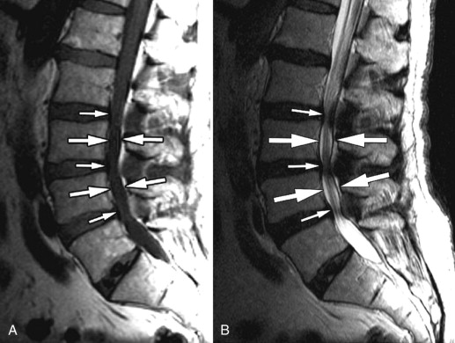
Lumbar Canal Stenosis MRI
Notes:
Congenital Central Spinal Canal Stenosis.
Sagittal T1 image A and sagittal T2 image B in a patient with diffuse spinal stenosis most pronounced at the L3 and L4 levels ( between large arrows ). There is no evidence of discogenic degeneration ( short arrows ) as the cause of the narrowing. This patient’s narrowing is secondary to congenital short pedicles.
Clinical Presentation
The patient is a 77-year-old man who presented with chronic low back pain. The patient has had progressive low back pain with radiation into both hips and buttocks over the last 5 years. The pain is made worse with movements and transitions from sitting to standing. He cannot walk more than 50 yards before he begins to feel deep low back aching. He states that he has to lean forward on a shopping cart to support himself while he does his grocery shopping. He also states that this forward flexed position tends to diminish his pain. The patient denies any bowel or bladder symptoms. On examination, straight leg raising maneuvers were negative. The patient was able to flex at the waist 90 degrees but extend only 10 degrees.
Imaging Presentation
Sagittal T1-weighted and T2-weighted magnetic resonance (MR) images demonstrate a long segment of narrowing of the central spinal canal without evidence of disc herniation, discogenic degenerative changes, or prominence of the epidural fat. The patient’s underlying abnormality is congenital narrowing of the lumbar spinal canal secondary to short pedicles. This patient is at a disadvantage because his small disc bulges at L2-3, L3-4, and L4-5 has converted him from asymptomatic to severely symptomatic

Slide 29
Lumbar Stenosis - Management
Evidence is contradictory (Kirker et al, 2023). No clear evidence for surgery/ injection/ rehabilitation in comparison to each other – depends on patient.
Cochrane Review 2016:
  We have very little confidence to conclude whether surgical treatment or a conservative approach is better for lumbar spinal stenosis
Radicular leg pain – NSAIDs/ anti-neuropathic medication.
Physiotherapy.
Spinal injections.
Surgical decompression.
Notes:
REMEMBER:
Lumbar stenosis is seen in up to 20% of those under the age of 40. Moderate or severe spinal stenosis is seen in up to 64% of those in their 50s and 93% in those in their 80s. The majority are asymptomatic, as only 17.5% of those with severe central stenosis may have symptoms.
NICE Guidelines for Low Back Pain and Sciatica in Under 16s:
Do not offer gabapentinoids, other antiepileptics, oral corticosteroids or benzodiazepines for managing sciatica as there is no overall evidence of benefit and there is evidence of harm.
Do not offer opioids for managing chronic sciatica.
Consider oral NSAIDs for managing low back pain, taking into account potential differences in gastrointestinal, liver and cardio-renal toxicity, and the person's risk factors, including age.
If prescribing NSAIDs for sciatica:
take into account potential differences in gastrointestinal, liver and cardio-renal toxicity, and the person's risk factors, including age
think about appropriate clinical assessment, ongoing monitoring of risk factors, and the use of gastroprotective treatment
use the lowest effective dose for the shortest possible period of time.
Consider epidural injections of local anaesthetic and steroid in people with acute and severe sciatica.
Do not use epidural injections for neurogenic claudication in people who have central spinal canal stenosis.
NICE Guidelines for Neuropatic Pain:
Offer a choice of amitriptyline, duloxetine, gabapentin or pregabalin as initial treatment for neuropathic pain (except trigeminal neuralgia).

Slide 30
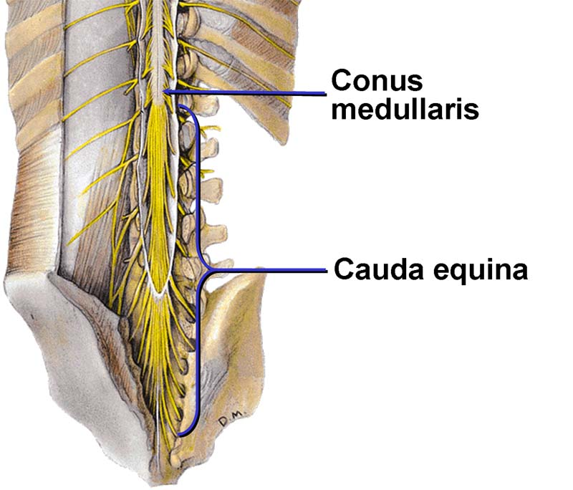
Cauda Equina Syndrome

Slide 31
Notes:
SAFETY NET! SAFETY NET! SAFETY NET!
MACP Cauda Equina Advice cards available as free downloads in multiple languages at Cauda Equina Information Cards | MACP (macpweb.org) https://www.macpweb.org/learning-resources/cauda-equina-information-cards.aspx
CES occurred in 0.08% of those with low-back pain presenting to primary care in 1 study, and a combined estimate of 0.27% was calculated for 4 studies of those with low-back pain presenting to secondary care. (Hoeritzauer et al, 2020).

Slide 32
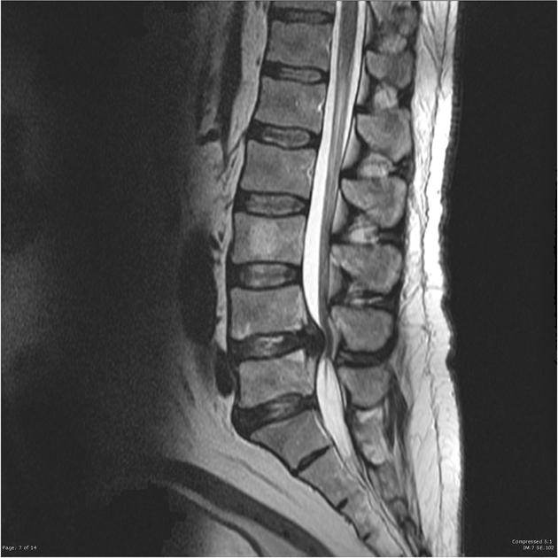
Cauda Equina Compression on MRI
Notes:
MRI of the lumbar spine demonstrates a very large focal central disc extrusion almost entirely fills the canal at L4/5, compressing the cauda equina posteriorly and slightly to the left.
The L5/S1 level demonstrates desiccated disc with some degenerative change of the facet joints contributing to moderate right sided and severe left sided neural exit foraminal stenosis. The canal is capacious.
The remainder of the lumbar spine is unremarkable. Incidental note is made of haemangioma in the vertebral body of L3.
This case illustrates the typical appearances of a large disc extrusion compressing the cauda equina. This is in many instances a surgical emergency requiring decompression. This is especially the case if there is bowel or bladder function impairment or lower limb weakness.
Conus medullaris – most distal bulbous part of the cord – tapering end is filum terminale. Usually around L1-2 level.
Distal to this is the Cauda Equina – L2-5, S1-5 and coccygeal nerve.
Spinal hemangiomas are the most common primary tumor of the spine. These lesions are of vascular origin and usually involve a proliferation of normal capillary and venous structures. These are usually an incidental finding found on radiological imaging of the body and spine. A minority of these lesions can be associated with symptoms, primarily involving back pain and neurologic complaints with some estimates of 0.9% to 1.2% becoming symptomatic.

Slide 33
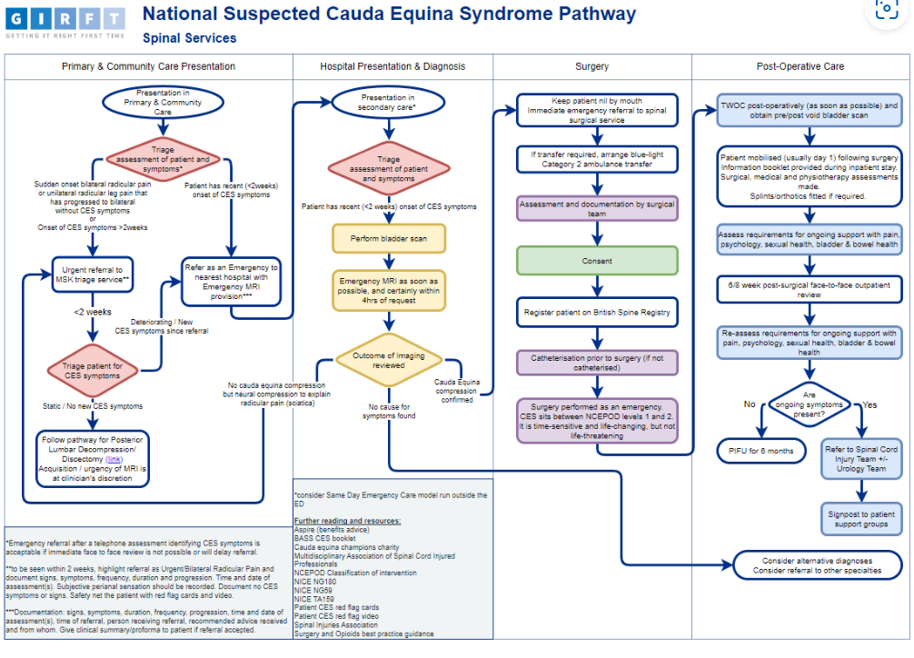

Slide 34
GIRFT pathway guidance app
Spinal – Suspected Cauda Equina Syndrome 2a – GIRFT – Pathways (sg-host.com)

Slide 35
Pathways
Acute mechanical spinal pain with/ without unilateral arm or leg pain, without significant neurological deficit – initially conservative care with reassurance – likely to resolve within 3/12 – may benefit from referral to musculoskeletal physiotherapy.
Spinal and radicular pain with non-resolving neurological deficit despite initial conservative management including Physiotherapy – Routine referral to Orthopaedic Choice (Spines).
Non-resolving musculoskeletal spinal pain which may refer to the arm / leg, having tried conservative management, medication and Physiotherapy – Routine referral to Orthopaedic Choice (Spines).
Acute spinal and radicular arm or leg pain with deteriorating hard neurology/ weakness or new onset acute bilateral radicular leg pain (including unilateral progressing to bilateral) – Urgent referral to Orthopaedic Choice (Spines).
Chronic spinal pain with /without radicular arm or leg symptoms where all appropriate investigations have been carried out and where surgical management is not indicated – Pain management service.
Notes:
Indication of urgent serious spinal pathology – e.g. acute Cauda Equina Syndrome, discitis, rapidly deteriorating neurology – urgent immediate referral to acute hospital (UHS) via on call spinal registrar.
Suspected serious non-mechanical spinal pathology (e.g. cancer/ inflammatory disorder) – referral to appropriate specialist (e.g. oncology/rheumatology/ neurology – consider if 2ww pathway appropriate).
Radicular is the knee
Not dull ache referring to the buttock

Slide 36
Thank you
Any questions?

Slide 37
What to do in 6 minute appointment?
Listen to patient rule out red flag or serious pathology Red flag symptoms and signs | Diagnosis | Sciatica (lumbar radiculopathy) | CKS | NICE
O/E altered neurology therefore need to do good neurology assessment if rapidly deteriorating follow urgent pathway if not then MSK specialist referral
If none of above then What? Assess gait (dragging leg, WBOS), observe posture ( active extender, reduced postural muscle tone)
Physio verses Specialist msk (ALSR validated test for testing core stability) if no conservative management send to physio unless hard neurology deficit. Encourage MOVEMENT and avoid fear.

Slide 38
HIOW MSK website
https://hiowhealthcare.nhs.uk/msk

Slide 39
References
Aimar E, Iess G, Gaetani P, Galbiati TF, Isidori A, Lavanga V, Longhitano F, Menghetti C, Messina AL, Zekaj E and Broggi G (2021). Degenerative Lumbar Stenosis Surgery: Predictive Factors of Clinical Outcome – Experience with 1001 Patients. World Neurosurgery, 147, e306-e314.
Hall AM, Aubrey-Bassler K, Thorne B, Maher C (2021). Do not routinely offer imaging for uncomplicated low back pain. BMJ Open Access, 372, n291. http://dx.doi.org/10.1136/bmj.n291
Hawkes CH and Roberts GM (1978). Neurogenic and Vascular claudication. Journal of the Neurological Sciences, 38,3 337-345.
Hilibrand AS, Rand N (1999). Degenerative Lumbar Stenosis: Diagnosis and Management.
Hoeritzauer I, Wood M, Copley PC, Demetriade AK. (2020). What is the incidence of cauda equina syndrome? Asystematic review. Journal of Neurosurgery, 32, 6, https://doi.org/10.3171/2019.12.SPINE19839
Kirker K, Masaracchio MF, Loghmani P, Torres-Panchame RE, Mattia M and States R. (2023). Management of lumbar spinal stenosis: a systematic review and meta-analysis of rehabilitation, surgical injection and medication interventions. Physiotherapy Theory and Practice. 39, 2, 241-286, DOI: 10.1080/09593985.2021.2012860
Lee YS, Kim T-H, Oh JK, Lee JS and Park MS (2015). Lumbar Stenosis: A Recent Update by Review of Literature. Asian Spine Journal, 9, 5, 818-828.
Nadeau M, Rosas-Arellano MP, Gurr KR, Bailey SI, Taylor DC, Grewal R, Lawlor DK, Bailey CS (2013). The reliability of differentiating neurogenic claudication from vascular claudication based on symptomatic presentation. Canadian Journal of Surgery, 56, 6, 372-377.
NICE Guideline for Low back pain and sciatic in over 16s (2016). NG59 updated 11 December 2020
https://www.radiologymasterclass.co.uk/gallery/imaging-galleries/mri-gallery/mri-spine-sciatica#top_1st_img
Sajid IM, Parkunan A, Frost K (2021). Unintended consequences: quantifying the benefits iatrogenic harms and downstream cascade costs of musculoskeletal MRI in UK primary care. BMJ Open Quality 10:e001287. doi 10.1136/bmjoq-2020-001287
Notes:
The ideal candidate for surgery will have the following preoperative characteristics: Schizas grade D, no signs of peripheral polyneuropathy, body mass index <30 kg/m², symptom duration of <2 years, gait autonomy <100 m, no radicular deficits, 1 level of stenosis, and an American Society of Anesthesiologists score of 1, 2, or 3. Aimar et al, 2021.
Schizas Grade D: Grade D, extreme stenosis, refers to no rootlets being recognizable and no epidural fat posteriorly.
ASA 1,2 or 3:
ASA 1: A normal healthy patient.
Example: Fit, nonobese (BMI under 30), a nonsmoking patient with good exercise tolerance.
ASA 2: A patient with mild systemic disease.
Example: Patient with no functional limitations and a well-controlled disease (e.g., treated hypertension, obesity with BMI under 35, frequent social drinker, or cigarette smoker).
ASA 3: A patient with a severe systemic disease that is not life-threatening. Example: Patient with some functional limitation due to disease (e.g., poorly treated hypertension or diabetes, morbid obesity, chronic renal failure, a bronchospastic disease with intermittent exacerbation, stable angina, implanted pacemaker).

