Slide 1

SEETA Clinical Endoscopist Training Programme
Training programme information pack 2026/27
South East Endoscopy Training Academy [SEETA]
May 2026
Notes:
Standard title slide

Slide 2
Introduction
Welcome to the South East Endoscopy Training Academy Clinical Endoscopist Training Programme.
We are delighted that you have chosen this exciting new step in your career. Our aim is to equip you with the confidence, competence, and clinical skills to become an independent and safe endoscopist, capable of delivering excellent patient care. Thank you for joining us — we are here to support you every step of the way.
The programme is offered and overseen by the South East Endoscopy Training Academy [SEETA]. You will need to know the following people:
Monika Obalka is your Project Officer who is responsible for organising the programme and is your first point of contact if you have any challenges or questions.
Matthew Cowan is a Consultant Gastroenterologist who is your Clinical Lead. He has oversight of the whole teaching programme and is responsible for signing off training.
We also normally have a Lead Clinical Endoscopist who will ensure your training runs to plan. We hope to recruit a new team member and will update this as soon as possible.
You can contact us at england.clinicalendoscopy.se@nhs.net
Notes:
Plain slide with subhead and bullets

Slide 3

Purpose of this document
This pack outlines key information to support you as you start with us, including an overview of your training programme and any key actions you will need to take to ensure that you can access all the training opportunities provided.
This symbol is used to identify any actions that you need to take to ensure you can access all opportunities the programme offers or requires. These will be highlighted throughout the information pack.

Slide 4
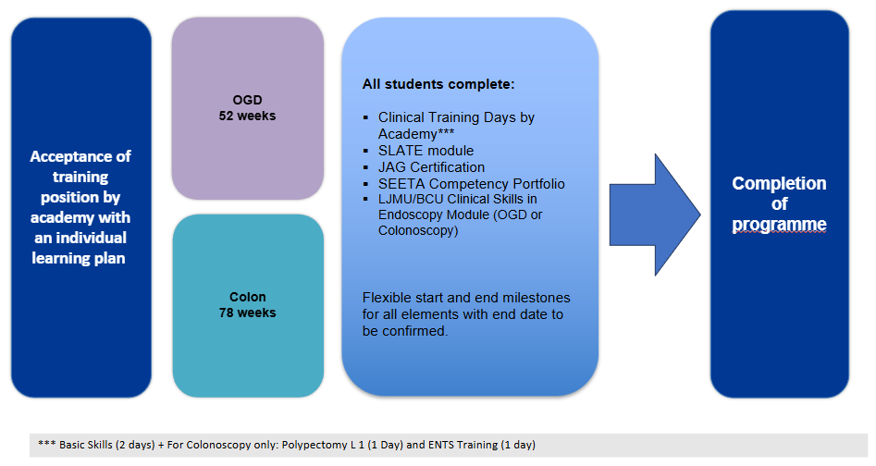
Structure of SEETA Clinical Endoscopist Training Pathway
Progress is monitored regularly with individual meetings at three monthly intervals.

Slide 5
South East Endoscopy Training Academy Hub sites
SEETA arrange courses and training opportunities in five main sites across the South East. All are JAG Regional Training centres. We will normally link you with your closest Hub, but this is not always possible. It is occasionally necessary to spread training across two sites.
The SEETA Regional Training centres are:
Maidstone and Tunbridge Wells NHS Trust
Oxford University Hospitals
University Hospital Southampton (courses may be limited in 26/27)
University Hospitals Sussex
Portsmouth Hospital University Trust
The SEETA team will discuss with you the most appropriate site for you in your Personal Development Planning (PDP) meeting before you start.
Notes:
Plain slide with subhead and bullets

Slide 6
Learning resources and training opportunities overview
As part of the SEETA Clinical Endoscopist Training Programme, trainees have access to a suite of learning resources and training opportunities. These include:
Academic module(s): these will be discussed and agreed at the Personal Development Meeting prior to formally starting the programme
Endoscopy Academies Portal and NHS Futures dedicated
SLATE
JAG Basic skills course
Endoscopy Non-Technical Skills (ENTS)
Polypectomy (for Lower GI endoscopists)
Advanced Communication Skills
Observation opportunities
Clinical Endoscopy Trainee Network
Regular interactive teaching sessions (30-minute teaching)
Annual face to face Study Day in London
BSG membership
Actions for trainee
Some of these learning resources and training opportunities require you to take a number of actions to ensure you can fully access these. More details can be found on the following slides.
Notes:
Plain slide with subhead and bullets

Slide 7
Learning resources: Academic module[s]
Actions for trainees
Apply for the academic course(s) identified in your personal development plan and work with your employing Trust management team to arrange payment. More details are provided below.
Essential Academic Skills module [if identified that you would benefit from this]
Birmingham City University ‘Essential Academic Skills Module’, through: Professional Practice - Module - 2026/27 Entry | Birmingham City University or
Open University ‘Succeeding in postgraduate study Module’ https://www.open.edu/openlearn/education-development/succeeding-postgraduate-study/content-section-overview?active-tab=description-tab#
For the Birmingham City module, you will need to specify that you are applying for the Essential Academic Skills module, and that you will be studying at level 7.
Lower GI and Upper GI Academic modules: all modules will be at level 7
Birmingham City University: Applications for September 26/27 Academic year, complete this form https://forms.office.com/e/0JLPM6MSnx . If you have queries, please contact: nur-in.mohammad@bcu.ac.uk
Liverpool John Moores University: Please contact: HealthCPD@ljmu.ac.uk
Arranging payment
Once you have applied, an invoice will come to your new university email address. It is your responsibility to contact your Trust finance team and arrange payment. If you do not contact them, the university will restrict all access to university modules.
Please contact your employing Trust’s finance team as soon as you receive the invoice to arrange payment of the academic module(s). This invoice is not sent to anyone or anywhere apart from your university email address.
Notes:
Plain slide with subhead and bullets

Slide 8
Learning resources: Endoscopy Academies Portal
The Endoscopy Academies Portal offers access to multiple resources for clinical endoscopist trainees. The portal is open access, but you will require a log in to the NHS Learning Hub to access.
Endoscopy Academies portal link:
https://learninghub.nhs.uk/Catalogue/endoscopyacademiesportal
Actions for trainees
Navigate to the portal link [above] and create a log in if you have not done so before
Navigate to “Clinical Endoscopist Learner” and then “Syllabus and Assessment”.
In “Syllabus and Assessment” you will find two documents to familiarise yourself with:
Revised Clinical Endoscopist (CE) Competency Assessment Portfolio” You may wish to print this, so that you can begin filling in relevant details.
“For Endoscopy Trainees: Colonoscopy / OGD Learning Content Outline” choose the modality you are training in. This file lists the resources available on the portal that are relevant to your course.
Notes:
Plain slide with subhead and bullets

Slide 9
Learning resources: NHS Futures
We upload useful resources including recordings and slides of our teaching sessions to our NHS Futures page. Please make sure that you explore the site.
NHS Futures link:
NHSE South East Cancer and Diagnostics programme NHS Futures pages, incl. SEETA [registration required]
https://future.nhs.uk/seworkforcetrainingeducation/view?objectID=55146224
Actions for trainees
Open the page link [above] and register by creating a log in if you have not done so before
Scroll down to and click on ‘Endoscopy - including the Endoscopy Training Academy’
Choose ‘Clinical Endoscopists’
Select ‘Current Clinical Endoscopist Trainee’s’, where you can access a library of past and future
30-minutes teaching sessions organised by SEETA.
Notes:
Plain slide with subhead and bullets

Slide 10
Learning resources: SLATE
SLATE is an on-line training package for GI endoscopy health professionals. It consists of six levels which aim to assess knowledge and skills on practical elements of GI endoscopy as well as areas such as lesion recognition, describing common pathology or anatomical variants and patient management. These levels are:
Level 1: Scope function, handling skills and orientation with the GI tract
Level 2: Differentiating normal from abnormal appearances in the GI tract
Level 3: Recognising and describing common pathology or anatomical variants
Level 4: Recognising and describing less common pathology or anatomical variants
Level 5: Assessing pathology – common differential diagnosis
Level 6: Classification and staging of pathology
Gastro-learn website link:
https://gastro-e-learn.rise.com/login
Actions for trainees
As a CE trainee, you will have access for the duration of your programme. You are required to complete all six levels over the duration of the programme.
    Please confirm to SEETA the email address you would like to use to access SLATE
Notes:
Plain slide with subhead and bullets

Slide 11
Endoscopy Training Courses and Observation Visit
We will arrange for you to attend several training courses normally provided in one of our Hub Sites. These will be arranged at the most appropriate stage of your training
JAG Basic Skills course: – a 2–3-day course with lectures and practical exposure to endoscopy.
ENTS – Endoscopic Non-Technical Skills course: a day learning about how human factors contribute to problems in the endoscopy unit.
Polypectomy course (colonoscopists only).
Observation visit: As you will be training in a single unit, you will benefit from seeing how other organisations run their endoscopy services. We will arrange for you to spend a few days observing the endoscopy in one of our Hub sites, including time with expert clinical endoscopists.
Advanced Communication Skills course – learning strategies for breaking bad news and other difficult clinical conversations.
Actions for trainees
The hub site contact will be in touch with you with the details of your courses. Ensure that you advise
your employing Trust of these dates.
The Advanced Communication Skills course is arranged by your hospital.
Notes:
Plain slide with subhead and bullets

Slide 12
Other opportunities
There are other opportunities to help build networks, knowledge and enrich your training experience including:
Clinical Endoscopy Trainee Network
Our group meets monthly and offers an opportunity for trainees to meet virtually and to provide peer support to fellow trainees. There is a WhatsApp group, make sure that you are involved!
Teaching programme
A regular programme of teaching sessions delivered by the SEETA team and clinical supervisors. All sessions are recorded and are accessible via the SEETA NHS Futures pages for catch up.
Annual Study Day
SEETA hosts an annual Study Day in London early in the year with expert local and national speakers covering a variety of topics. This is an excellent opportunity to meet us and your fellow trainees.
BSG Clinical Endoscopist Conference
Please make sure that you are aware of this annual conference in Birmingham in September.
Actions for trainees
Please do engage with these additional offers and provide feedback to ensure these continue to add value to the CE programme.
Notes:
Plain slide with subhead and bullets

Slide 13
SEETA Portfolio
To support successful completion of the SEETA Clinical Endoscopist Training Programme, trainees are required to maintain and complete a portfolio, elements of which will be agreed at the start of your training journey during the Personal Development Planning (PDP) meeting.
Actions for trainees:
    Maintain your portfolio throughout the programme.
    Ensure all competencies are reviewed and signed off by your Clinical Supervisor.
    Present your work clearly and consistently – your portfolio should be well-organised and easy to follow.
    Provide a variety of examples that demonstrate the breadth of your experience and learning.
    Your portfolio will be reviewed by SEETA as part of the final completion assessment process.
    Send completion certificates along with your portfolio to SEETA as evidence of training completion.
    SEETA will provide further guidance on how to submit and maintain your portfolio via teaching session.
Notes:
Plain slide with subhead and bullets

Slide 14
Monitoring your progress
We will meet up with you regularly over the course of your programme to review how you are getting on. You can expect to see us at the regular network meetings and teaching sessions. We visit most of our hospitals and training courses from time to time as well. You are always welcome to email us questions, and we want to know about any concerns that you have and cannot resolve locally.
We will meet with you online after you have been in the programme for about a month to see how things are going, and again once you have been training for three months. After the second meeting we usually meet quarterly thereafter, although this may be more frequent if you or we have any concerns. We normally agree the date of the next meeting at the end of each review. Our last meeting will be six months after you finish so that you can tell us how you are enjoying your new career!
We check in with your Clinical Supervisor regularly to ensure that they do not have any issues of concern.
Action for trainees
These review meetings are important! Please let us know if you do not have a date for your next
catch-up session or if you need us to change the time or date.
Notes:
Plain slide with subhead and bullets

Slide 15
Completing the programme
In order to confirm completion of the SEETA Training Programme and receive your certificate, you will
need to send us the following (to England.clinicalendoscopy.se@nhs.net):
Certificate or evidence of successful completion of your Academic module(s)
SEETA Portfolio, with the following attached:
  JAG Accreditation certificate in your chosen modality
  Basic Skills course certificate
  Endoscopy Non-Technical Skills [ENTS] certificate
  Polypectomy course (colonoscopy only) certificate
  Advanced Communication certificate
  SLATE certificate
Action for trainees
In order to complete your training programme, you will need to send us all of the above listed completed documents. Your portfolio and certificates will be reviewed by SEETA to confirm successful completion of your CE Training Programme.
Notes:
Plain slide with subhead and bullets

Slide 16

How to find out more and get in touch
NHSE South East Cancer and Diagnostics programme overall, Clinical Endoscopy training application queries
England.canceranddiagnostics.se@nhs.net
South East Endoscopy Training Academy (SEETA) Clinical Endoscopy inbox:
england.clinicalendoscopy.se@nhs.net
NHSE South East Cancer and Diagnostics programme NHS Futures pages, incl. SEETA [registration required]
https://future.nhs.uk/seworkforcetrainingeducation/view?objectID=55146224
NHSE South East Cancer and Diagnostics programme website pages, incl. SEETA
https://wessex.hee.nhs.uk/wider-workforce/cancer/
Notes:
Plain slide with subhead and bullets

