Slide 1
Bereavement

Slide 2
Why it’s important as a GP
Bereavement will be the most distressing experience we will ever face. Grief is what we feel when somebody we are close to dies. Everyone experiences grief differently and there is no 'normal' or 'right' way to grieve” Cruse Bereavement
Everyone experiences bereavement at some point in their lives, a recent survey suggested 72% had in the last 5yrs
Notes:
Secularisation, isolation, lack of social and family support, ageing population mean societal management of grief dwindling although majority of people still rely on it

Slide 3
Grief
“The pain I feel now is the happiness I had before. That’s the deal” C.S. Lewis
BBC stories
https://www.youtube.com/watch?v=5wVLDHUc5ic
The ball in the box
https://www.youtube.com/watch?v=ugPOAeQJQHE

Slide 4
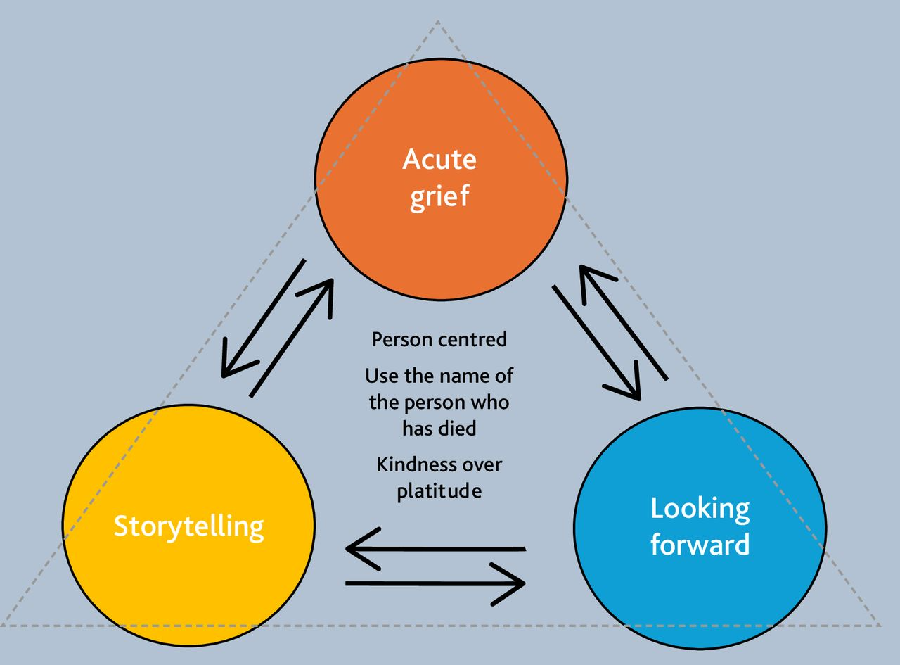
Acute grief
There is great value in simply acknowledging the pain of grief and helping someone to understand that there is no ‘right’ way to grieve.

Slide 5
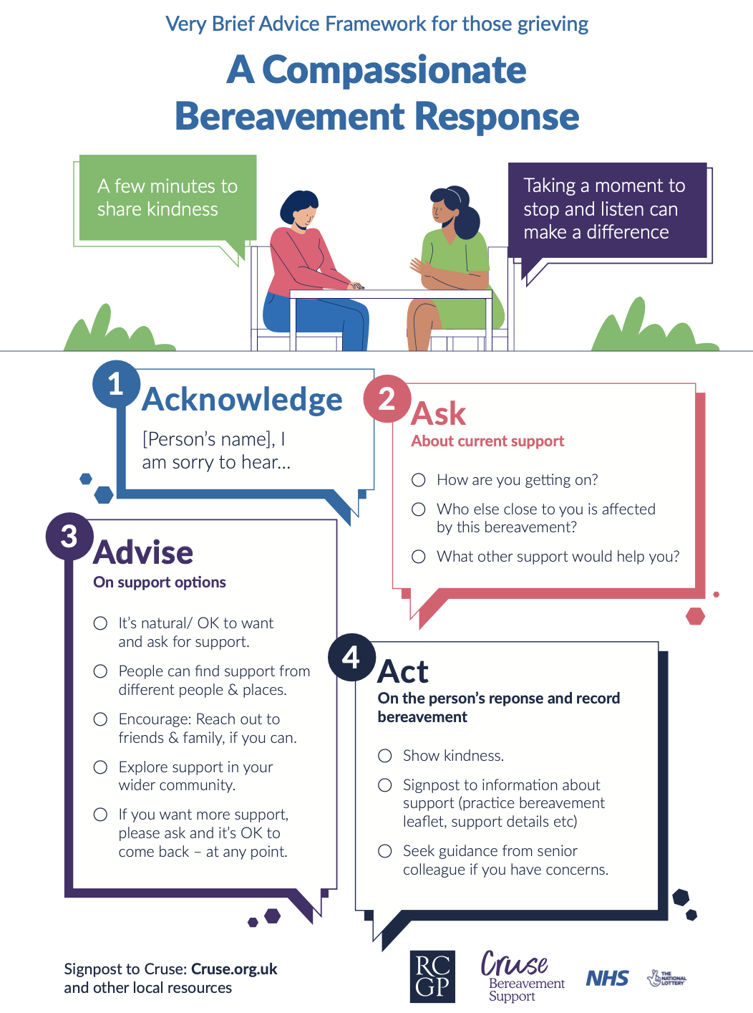

Slide 6
Prolonged Grief Disorder
Intense yearning, emotional pain and inability to function following a bereavement lasting more than a year
Usually needs professional psychological support – refer to talking therapy
Complicated grief therapy

Slide 7
RCGP /Marie Curie Daffodil Standards
The General Practice commits to: | To meet this standard the practice commits to: | Self-Assessment
7.1 Have understanding and be able to manage grief and bereavement | 7.1a Understand the process of anticipatory grief and bereavement | Roles and responsibilities for each team member discussed and recorded
 | 7.1b Understand how all staff can support bereaved people | Practice policy of what patients and carers can expect from the practice to support their individual anticipatory grief and bereavement needs e.g. compassionate bereavement response, condolence letters, information leaflet, death certification, bereavement call/ visit, referral to services Practice plan on verification of death and certification
7.2 Knowledge of local systems | 7.2a Ensure the bereaved are aware of how the practice can support and also local support available | Practice support information available: How the practice can support a bereaved person Local / National offer signposting to available bereavement support in the community and services
Notes:
The Daffodil Standards offer a free, evidence-based framework designed to support general practices in delivering consistently high-quality care for patients approaching the end of life and those who are bereaved. They help practices self-assess, reflect, and embed simple quality improvement steps into everyday care — creating a culture of continuous learning and proactive support.

Slide 8


Slide 9
https://www.childbereavementuk.org/pages/faqs/category/faiths-beliefs-cultures-and-communities#:~:text=Aspects%20that%20may%20differ%20between%20faith%20groups%20can,7%20Ways%20of%20remembering%20someone%20who%20has%20died

Slide 10
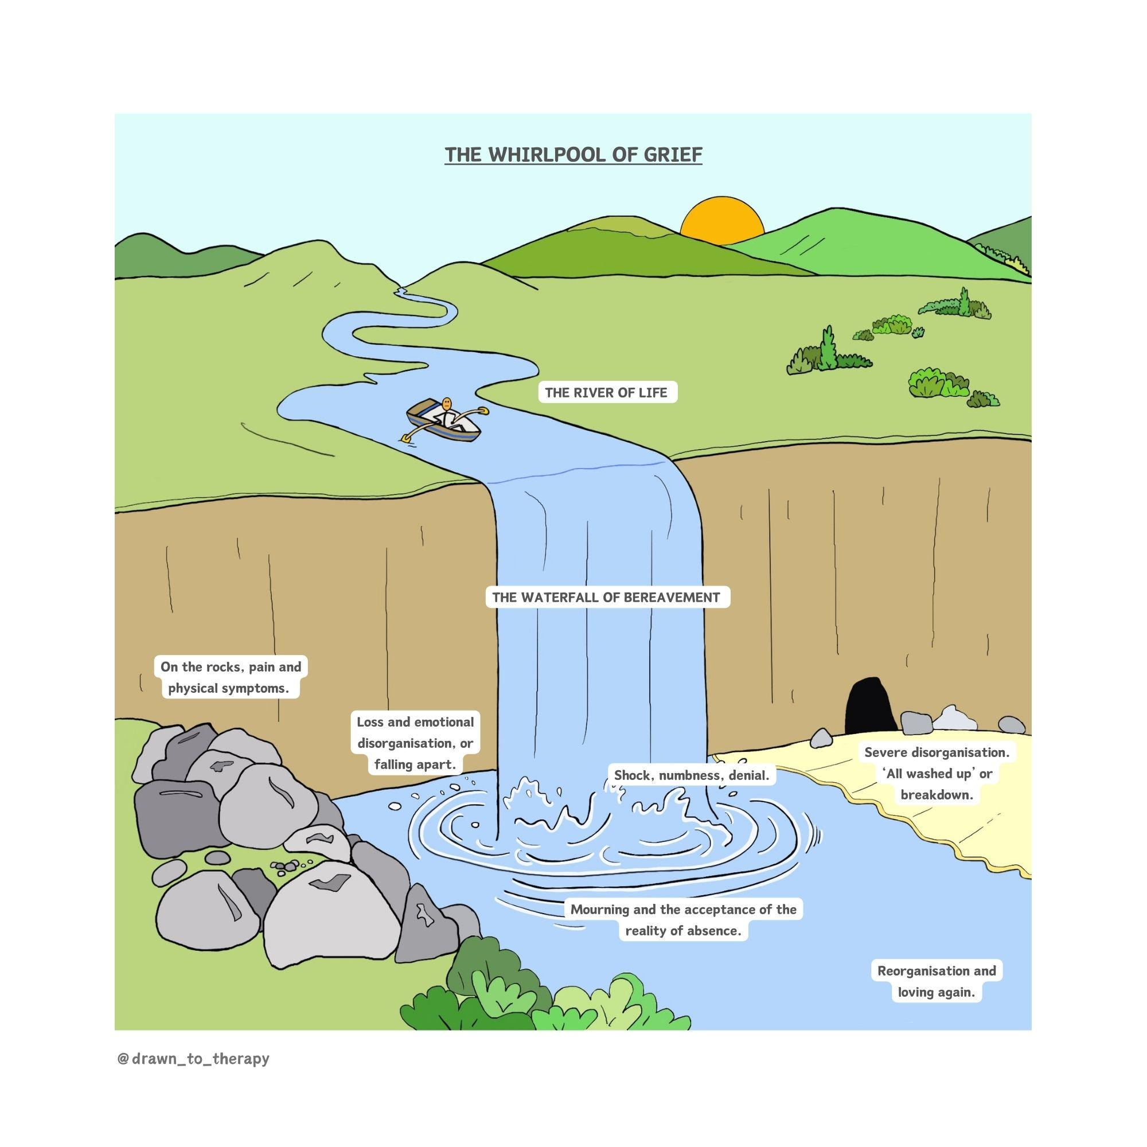

Slide 11
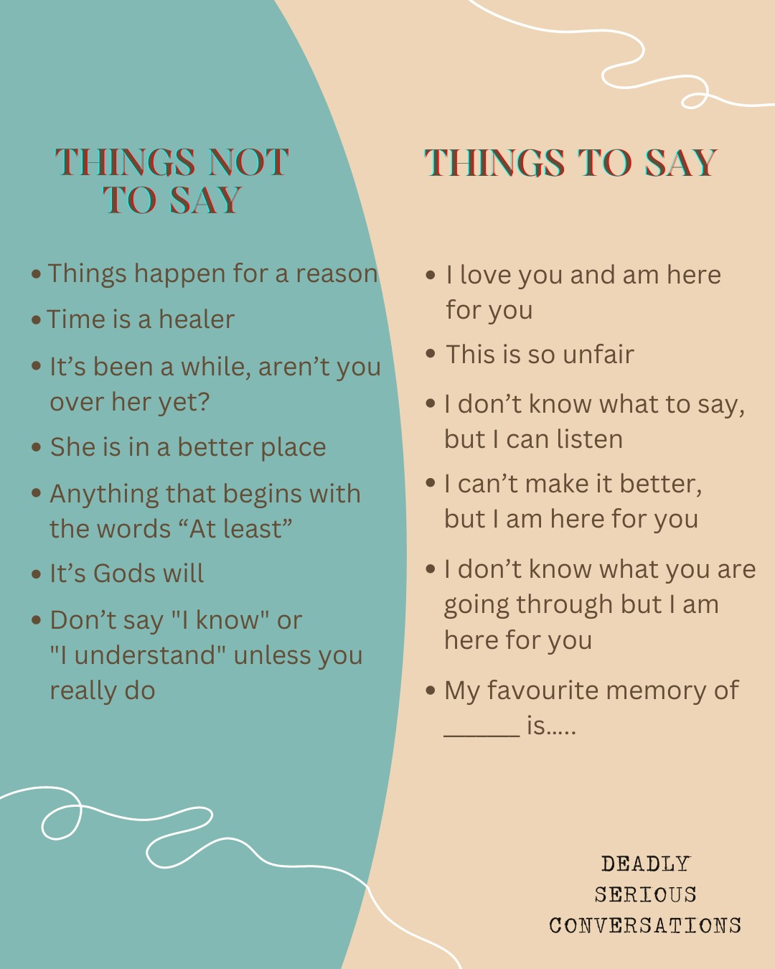

Slide 12
Cases to discuss:
Husband of a patient with terminal illness such as lung cancer, where it was an expected death
Daughter of an elderly gentleman with Alzheimer’s, an unexpected but not unsurprising death
Dad of a 5 year old from who died from meningitis - an unexpected and sudden death
8 year old brother of the 5 year old who died from meningitis
Partner of a suicide patient
Woman who had a termination who feels guilty

Slide 13
Bereavement support resources
Gov.uk, what to do after someone dies: https://www.gov.uk/after-a-death https://www.gov.uk/after-a-death
Adult Bereavement Care Pyramid - Irish Hospice Foundation
Sue Ryder, grief guide: https://griefguide.sueryder.org
Cruse: https://www.cruse.org.uk
National Bereavement Alliance, grief support guide. https://nationalbereavementalliance.org.uk https://nationalbereavementalliance.org.uk/support/
Primary Care Network support in England, for example, care navigators, counselling via NHS Talking Therapies, MIND, etc.
Good Grief Festival — online community bringing together grief experts and the bereaved for virtual and in-person events: https://www.goodgrieffest.com

Slide 14
Read
Atul Gwande’s Being Mortal
Dear Life -Rachel Clarke
Matt Haig’s Reasons to Stay Alive
JoJo Moyes’s Me Before You
Kate Gross’s Late Fragments
C.S. Lewis – A Grief Observed
Watch:
About a Boy
Breathe
Nora McInerney Ted Talk – We don’t move on from grief, we move forward with it https://www.youtube.com/watch?v=khkJkR-ipfw
https://www.itv.com/watch/jason-and-clara-in-memory-of-maudie/10a1660
Listen:
https://www.dyingmatters.org/page/dying-matters-podcast
https://player.fm/series/boggled-docs/when-people-dont-know-what-to-say-finding-the-right-words-in-a-heartbreaking-situation

