Slide 1

SEETA Clinical Endoscopist Training Programme
Training programme information pack 2025/26
South East Endoscopy Training Academy [SEETA]
June 2025
Notes:
Standard title slide

Slide 2
Introduction
Welcome to the South East Endoscopy Training Academy Clinical Endoscopist Training Programme. The programme is offered and overseen by the South East Endoscopy Training Academy [SEETA]*.
Message from Chiara Camaioni, Clinical Endoscopy Lead, SEETA:
“I’m delighted to welcome you to the SEETA CE Training Programme. This programme represents an exciting and transformative journey in your professional development. We are proud to offer structured, high-quality training supported by experienced supervisors and a collaborative community of peers and faculty across the South East Region. Our aim is to equip you with the confidence, competence, and clinical skills to become an independent and safe Endoscopist, capable of delivering excellent patient care.
Thank you for joining us — we are here to support you every step of the way.”
We are looking forward to working with you on your learning journey.
* SEETA sits within the South East Cancer & Diagnostics Programme, part of the NHSE Workforce, Training and Education Directorate [W,T&E] of NHS England
Notes:
Plain slide with subhead and bullets

Slide 3

Purpose of this document
This pack outlines key information to support you as you start with us, including an overview of your training programme and any key actions you will need to take to ensure that you can access all of the training opportunities provide.
This symbol is used to identify any actions that you need to take to ensure you can access all opportunities the programme offers or requires. These will be highlighted throughout the information pack.

Slide 4
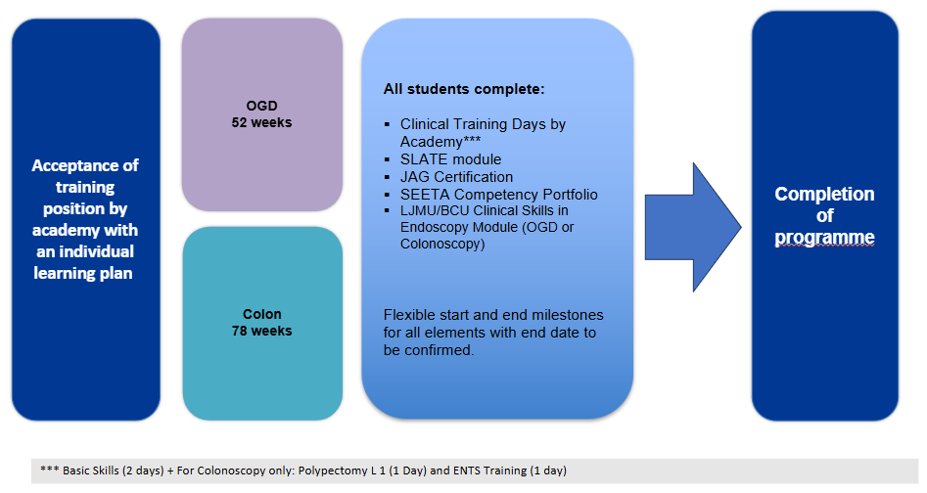
Structure of SEETA Clinical Endoscopist Training Pathway
Progress is monitored regularly with individual meetings at three monthly intervals.

Slide 5

South East Endoscopy Training Academy Hub sites
SEETA arrange courses and training opportunities in five main sites across the South East. All are JAG Regional Training centres. We will normally link you with your closest Hub, but this is not always possible. It is occasionally necessary to spread training across two sites.
The SEETA Regional Training centres are:
Maidstone and Tunbridge Wells NHS Trust
Oxford University Hospitals
University Hospital Southampton
University Hospitals Sussex
Portsmouth Hospital University Trust
The SEETA team will discuss with you the most appropriate site for you in your Personal Development Planning (PDP) meeting before you start.
Notes:
Plain slide with subhead and bullets

Slide 6

Learning resources and training opportunities overview
As part of the SEETA Clinical Endoscopist Training Programme, trainees will have access to a suite of learning resources and training opportunities. These include:
Academic module(s): these will be identified at the Personal Development Meeting prior to formally starting the programme
Endoscopy Academies Portal
SLATE
JAG Basic skills course
Endoscopy Non-Technical Skills (ENTS)
Polypectomy (for Lower GI endoscopists)
Observation opportunities
Clinical Endoscopy Trainee Network
Teaching programme
Annual face to face study day
Actions for trainee
Some of these learning resources and training opportunities require you to take a number of actions to ensure you can fully access these. More details can be found on the following slides.
Notes:
Plain slide with subhead and bullets

Slide 7
Learning resources: Academic module[s]
Actions for trainees
Apply for the academic course(s) identified in your personal development plan and work with your employing Trust management team to arrange payment. More details are provided below.
Essential Academic Skills module [if identified that you would benefit from this]
Birmingham City University ‘Essential Academic Skills Module’, through: Professional Practice - Module - 2025/26 Entry | Birmingham City University or
Open University ‘Succeeding in postgraduate study Module’ https://www.open.edu/openlearn/education-development/succeeding-postgraduate-study/content-section-overview?active-tab=description-tab#
For the Birmingham City module, you will need to specify that you are applying for the Essential Academic Skills module, and that you will be studying at level 7.
Lower GI and Upper GI Academic modules: all modules will be at level 7
Birmingham City University: Applications for September 25/26 Academic year, complete this form https://forms.office.com/e/0JLPM6MSnx . If you have queries, please contact: nur-in.mohammad@bcu.ac.uk
Liverpool John Moores University: Please contact: HealthCPD@ljmu.ac.uk
Arranging payment
Once you have applied, an invoice will come to your new university email address. It is your responsibility to contact your Trust finance team and arrange payment. If you do not contact them, the university will restrict all access to university modules.
Please contact your employing Trust’s finance team as soon as you receive the invoice to arrange payment of the academic module(s). This invoice is not sent to anyone or anywhere apart from your university email address.
Notes:
Plain slide with subhead and bullets

Slide 8

Learning resources: Endoscopy Academies Portal
The Endoscopy Academies Portal offers access to multiple resources for clinical endoscopist trainees. The portal is open access, but you will require a log in to the NHS Learning Hub to access.
Endoscopy Academies portal link:
https://learninghub.nhs.uk/Catalogue/endoscopyacademiesportal
Actions for trainees
Navigate to the portal link [above] and create a log in if you have not done so before
Navigate to “Clinical Endoscopist Learner” and then “Syllabus and Assessment”.
In “Syllabus and Assessment” you will find two documents to familiarise yourself with:
Revised Clinical Endoscopist (CE) Competency Assessment Portfolio” You may wish to print this, so that you can begin filling in relevant details.
“For Endoscopy Trainees: Colonoscopy / OGD Learning Content Outline” choose the modality you are training in. This file lists the resources available on the portal that are relevant to your course.
Notes:
Plain slide with subhead and bullets

Slide 9

Learning resources: SLATE
SLATE is an on-line training package for GI endoscopy Health Professionals. It consists of six levels which aim to assess knowledge and skills on practical elements of GI endoscopy as well as areas such as lesion recognition, describing common pathology or anatomical variants and patient management. These levels are:
Level 1: Scope function, handling skills and orientation with the GI tract
Level 2: Differentiating normal from abnormal appearances in the GI Tract
Level 3: Recognising and describing common pathology or anatomical variants
Level 4: Recognising and describing less common pathology or anatomical variants
Level 5: Assessing pathology – common differential diagnosis
Level 6: Classification and staging of pathology
Gastro-learn website link:
https://gastro-e-learn.rise.com/login
Actions for trainees
As a CE trainee, you will have access for the duration of your programme. You are required to complete all six levels over the duration of the programme.
    Please confirm to SEETA the email address you would like to use to access SLATE
Notes:
Plain slide with subhead and bullets

Slide 10
Endoscopy Training Courses and Observation Visit
We will arrange for you to attend several training courses normally provided in one of our Hub Sites. These will be arranged at the most appropriate stage of your training
JAG Basic Skills course: – a 2–3-day course with lectures and practical exposure to endoscopy
ENTS – Endoscopic Non-Technical Skills course: a day learning about how human factors contribute to problems in Endoscopy Unit
Advanced Communication Skills course – learning strategies for breaking bad news and other difficult clinical conversations.
Polypectomy course (colonoscopists only)
Observation visit: As you will be training in a single unit, you will benefit from seeing how other organisations arrange and run their endoscopy services. We will arrange for you to spend a few days observing the endoscopy in one of our Hub sites, including time with their expert clinical endoscopist.
Actions for trainees
Ensure that you know the dates of your courses provided to you by SEETA, and advise
your employing Trust of these dates.
The hub site contact will be in touch with you with the details of your basic skills course.
Notes:
Plain slide with subhead and bullets

Slide 11



Other opportunities
There are other opportunities to help build networks, knowledge and enrich your training experience including:
Clinical Endoscopy Trainee Network
This regional group meets monthly and offers an opportunity for trainees to meet virtually, share experiences and to provide peer support to fellow trainees. There is a WhatsApp group, make sure that you are involved!
Teaching programme
A regular programme of teaching sessions delivered by the SEETA team and clinical supervisors. All sessions are recorded and are accessible via the SEETA NHS Futures pages for catch up.
Annual study day
SEETA hosted the first face to face study day for all CE trainees and hope to hold the next study day in February 2025. This is an excellent opportunity to meet fellow trainees, hear from external speakers, and join interactive session.
Actions for trainees
Please do engage with these additional offers and provide feedback to ensure these continue to add value to the CE programme.
Notes:
Plain slide with subhead and bullets

Slide 12

SEETA Portfolio
To support successful completion of the Clinical Endoscopist (CE) Training Programme, trainees are required to maintain and complete a SEETA portfolio, elements of which will be agreed at the start of your training journey during the Personal Development Planning (PDP) meeting.
Actions for trainees:
    Maintain your portfolio throughout the programme.
    Ensure all competencies are reviewed and signed off by your Clinical Supervisor.
    Present your work clearly and consistently – your portfolio should be well-organised and easy to follow.
    Provide a variety of examples that demonstrate the breadth of your experience and learning.
    Your portfolio will be reviewed by SEETA as part of the final completion assessment process.
    Send completion certificates along with your portfolio to SEETA as evidence of training completion.
    SEETA will provide further guidance on how to submit and maintain your portfolio via teaching session.
Notes:
Plain slide with subhead and bullets

Slide 13
Monitoring your progress
We will meet up with you regularly over the course of your programme to review how you are getting on. You can expect to see us at the regular network meetings and teaching sessions. We visit most of our hospitals and training courses from time to time as well. You are always welcome to email us questions, and we want to know about any concerns that you have and cannot resolve locally.
We will meet with you online after you have been in the programme for about a month to see how things are going, and again once you have been training for three months. After the second meeting we will normally meet quarterly but this may be more frequent if there are any concerns.
We will normally agree the date of the next meeting at the end of each review.
Action for trainees
These review meetings are important! Please let us know if you do not have a date for your next catch up session or if you need us to change the time or date.
Notes:
Plain slide with subhead and bullets

Slide 14
Completing the programme
What to send us at the end of your training programme:
Certificate or evidence of successful completion of your Academic module(s)
SEETA Portfolio
JAG Accreditation certificate in your chosen modality
Basic Skills course certificate
Endoscopy Non-Technical Skills [ENTS] certificate
Polypectomy course (colonoscopy only) certificate
SLATE certificate
Action for trainees
In order to complete your training programme, you will need to send us all of the above listed completed documents. Your portfolio and certificates will be reviewed by SEETA to confirm successful completion of your CE Training Programme.
Notes:
Plain slide with subhead and bullets

Slide 15



How to find out more and get in touch
NHSE South East Cancer and Diagnostics programme overall, Clinical Endoscopy training application queries
England.canceranddiagnostics.se@nhs.net
South East Endoscopy Training Academy overall
england.endoscopyacademy.se@nhs.net
NHSE South East Cancer and Diagnostics programme NHS Futures pages, inc SEETA [registration required]
https://future.nhs.uk/seworkforcetrainingeducation/view?objectID=55146224
NHSE South East Cancer and Diagnostics programme website pages, inc SEETA
https://wessex.hee.nhs.uk/wider-workforce/cancer/
Notes:
Plain slide with subhead and bullets

