Slide 1




Registered Nurse Degree Apprenticeship
Information for General Practice
Thames Valley and Wessex

Slide 2
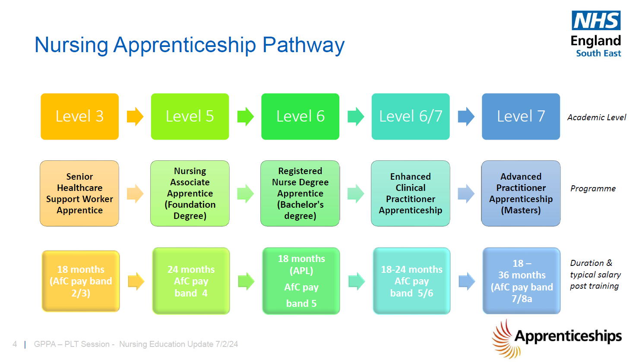
*L7 apprenticeship funding is available to learners aged under 22.

Slide 3
Registered Nurse Degree Apprenticeship (RNDA)
The Role | Registered Nurses play a vital role in providing, leading and coordinating care that is compassionate, evidence-based, and person-centred, regulated by the NMC. The RNDA offers an alternative, flexible route to obtain a nursing degree.
Duration | 18-24 months (if undertaken as ‘top up’ from the nursing associate with accreditation of prior learning. Option to completed full RNDA, taking up to 4 years.
Level of Study | Level 6 (Degree Apprenticeship)
Academic qualification | BSc Nursing
Entry criteria | Learners who have completed a Level 5 Nursing Associate degree will be able to complete a reduced top up programme (typically 18-24 months) For the full RNDA, entry criteria is typically 3 A Levels at BBC including a science or social science subject/ Access to Higher Education Diploma in Nursing or Social Care with at least 45 credits at Level 3 with 30 credits at distinction/BTEC DMM in a health or science subject) Maths and English at Level 2 or equivalent
Who it would suit | The top up route would suit those who have completed their Nursing Associate apprenticeship, consolidated their practice for 6-12 months and aspire to progress their career across the vocational nursing pathway to become a Registered Nurse in the field of Adult, Children and Young People, Learning Disabilities or Mental Health.
Apprenticeship requirements | 4600 hours of learning, divided equally between 50% (2300 hours theory) and (2300 hours in practice), over the duration of the programme. Up to 50% of these can be evidenced via NA or AP programme hours. Delivery models vary
Course Assessment | A variety of assessment methods including project work, essays, presentations and exams; completion of Practice Assessment Document (PAD) to evidence placement-based learning.
Supervision and assessment in practice | Supervision and assessment follows the NMC Standards for student supervision and assessment (nmc.org.uk), with a named Academic Assessor within the University, and named Practice Assessor & Practice Supervisor/s within the learning environment.
Future Scope | Should progress on to complete the GPN Fundamentals course (funded via NHSE). Support with student supervision and progress to develop assessor skills.

Slide 4
What does the APL route (18 – 24 months) typically look like?
The degree is split into theory and practice hours, set by the NMC. Whilst Universities vary in their delivery of the programme, typically this looks like:
Study days in blocks or 2 days per week
3 to 4 placement blocks of 7 to 10 weeks each over the programme duration.
The final placement can be home based as a supernumerary placement, however please check with the university – not all will permit this.
Therefore the first placements will usually be within a ward, outpatient or community-based setting.

Slide 5
Entry requirements
Most universities require learns to be employed for 37.5 hours per week, with a minimum of 30 hours.
Learner must have the right to live and work in the UK.
All international applicants must have permission (visa) to stay and work in England for the duration of the apprenticeship programme they are applying for.
Must have resided in the UK for a minimum of 3 years on the day of starting their programme.
GCSE in English and mathematics minimum grade C or 4 or Level 2 equivalency in literacy and numeracy (the functional skills requirements typically required for clinical degree apprenticeships).
Fitness to Work Health Check, Enhanced Disclosure and Barring Service (DBS) check.

Slide 6
University options for the APL route (18 – 21 months)
Practices in the Thames Valley are served by several universities. Programmes used by Practices in our area are:
Brunel University, Uxbridge, March and September cohorts
University of West London, Reading and London campuses, April cohort only
University of Winchester, September cohort only
SOLENT University, March cohort only
Open University, February and October starts.
Bucks New University, January and May starts
Oxford Brookes University / Oxford Health partnership programme
University of Gloucestershire
University of Bedfordshire
Programme delivery schedules vary, as are the minimum working hours requirements. For more information email england.primarycareschooltvw.se@nhs.net
For a full list of university options follow this link on the Skills England apprenticeship portal: Training providers for Registered nurse degree (NMC 2018) (level 6)

Slide 7
Funding and Finances
Primary care employers are entitled to a NHSE employer support grant to support a nursing apprentice.
Funds are subject to change each year. The funding set for financial year 2025-26 is £9,027 per year of the apprenticeship programme with a total of £18,054 (subject to variation).
Funding the apprenticeship training fee
You have 2 options to pay the university training fee:
Enter Government co-funding where you pay 5% of the training fees*. For example for the nurse degree apprenticeship fee of £19,500, you will pay £975 over the 18 months programme. (*This is set to reduce to 75% government co-funding from August 2026).
or
Request full funding from a levy-paying organisation. Learn more about levy transfers: Find a business to fund apprenticeship training

Slide 8
Funding and Finances
Salary
For a Nursing Associate enrolled onto the Registered Nurse Degree Apprenticeship 18 - 24 months Recognised Prior Learning programme, the employer can continue to claim salary costs whilst the employee is not working within their substantive NA role (i.e. when they are on academic and placement hours).
National Insurance Contributions - under 25 exemptions (as at February 2026)
Employers may not need to pay Class 1 National Insurance contributions for an apprentice, if the apprentice:
is under 25 years old
earns less than £967 a week (£50,270 a year)
For more information visit: Paying employer National Insurance contributions for apprentices under 25 - GOV.UK

Slide 9
Resources
Visit the Apprenticeships in Primary Care - Working across Wessex page for links to:
Functional Skills information pack
Nursing onboarding pack
Case studies
Understanding levy transfers

