Slide 1
Wessex Medical Educators Conference Innovative training 22nd January 2025
Rachel Elliott, Bryony Sales
and Amad Abdulmula.
Notes:
Standard title slide

Slide 2
Plan
GP trainee expansion data. Numbers and size of issue
LTWP and expansion in other specialities, South East and other clinical roles
Need for space, how it feels and managing expectations
ITP posts & Foundation trainee expansion ideas
Q&A
Notes:
Plain slide with subhead and bullets

Slide 3
Expansion and the Long-Term Workforce Plan
Currently 4,000 GP registrars recruited each year in England.
3 year training programme, 2 years in GP, extensions and LTFT, approx. 15,000 GP trainees in total with 10,000 in GP placements
Moving to 6000 GP registrars recruited each year in England by 2031
3 year training programme, 3 years in GP, extensions and LTFT, approx. 22,000 GP registrars in GP placements.
MORE THAN DOUBLE THE NUMBER OF GP PLACEMENTS NEEDED
Notes:
Plain slide with subhead and bullets

Slide 4
Expansion and the Long-Term Workforce Plan
Also, foundation numbers expanding and all to have community placement experience
Wider workforce teams in Primary Care also need training placements
How can we innovate to enable this?
Notes:
Plain slide with subhead and bullets

Slide 5
Innovation
Ideas?
Wes has ideas…and wants more… apparently
Definition of primary care
SE increased quota, redistribution of trainees.
Notes:
Plain slide with subhead and bullets

Slide 6
Activity
Return to seats, no extra people
Thank you and Kit Kats
How did it feel?
Making good enough good enough
Notes:
Plain slide with subhead and bullets

Slide 7
Strategy, Solutions and Support
Choice
Engagement
Understanding
More trainers
Change
Notes:
Plain slide with subhead and bullets

Slide 8
What are Integrated Training Posts (ITP)?
Post based in GP but with half of the time spent in a Hospital Specialism or other area associated with health care
Funded by GP School = counts as a GP placement
Educational Supervisor = GP
Opportunity for trainees to gain additional experiences to enhance training
Used in both Foundation and GP training
Notes:
Plain slide with subhead and bullets

Slide 9
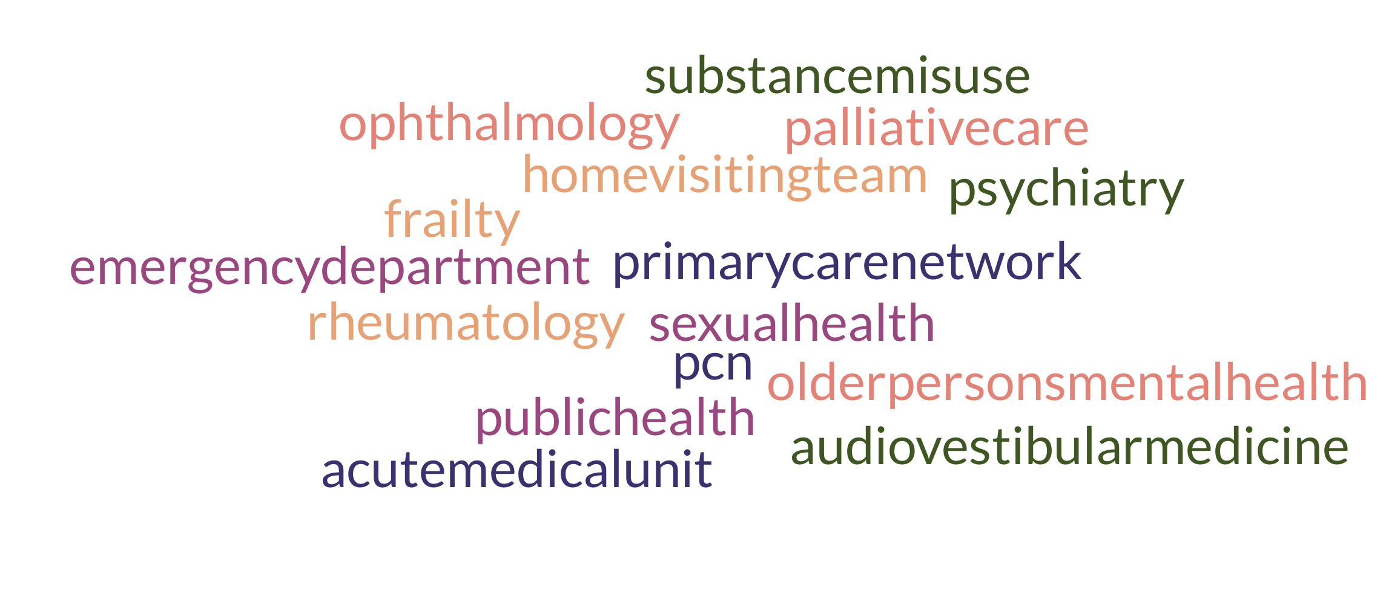
ITP examples
Notes:
Portsmouth ITPs – looking to expand – community paeds, working with the ICB, Derm lends its hand

Slide 10
ITP from a trainee perspective
The working week
Things enjoyed
Challenges
Learning from the post
Advice to trainees in the future
Dr Amad Abdulmula, GP ST2
Notes:
Plain slide with subhead and bullets

Slide 11
Tips to maximise benefit of ITPs
Opportunity to showcase departments
Improve primary: secondary care interface
Create experiences focused to GP training e.g. reviewing/treating the patients that are referred in by GPs
Whilst also providing service commitment, responsibility to educate trainees
Provide comprehensive clinical supervisor reports/written feedback on WPBA to help both the trainee and the ES
Notes:
Plain slide with subhead and bullets

Slide 12
Foundation expansion ideas
Incorporate the Foundation trainee within the ‘On the day’ capacity, working with allied health care professionals
Two foundation trainees working at the same time in same room (e.g. one typing & consulting & swapping)
Pair up two different types of trainee in one post
Expand ITP Posts with wider primary care experience
Work along other allied health care professionals in home visiting team/care homes (not independent working but supporting) and practice nursing team undertaking reviews e.g. learning disability, chronic disease and pharmacist – processing prescription queries, completing audits
Notes:
Plain slide with subhead and bullets

Slide 13
Questions?

