Slide 1
2025 Educator Forum Supporting a Diverse Workforce Welcome
Paul Sadler
Notes:
Standard title slide

Slide 2
Housekeeping
Remote/Virtual delegates (via Microsoft Teams)
During presentations, please turn off your camera and microphone off by using the below buttons on the meeting controls.
If you want to focus on a particular video, right click and select Pin. The video will be pinned to your screen.
Whilst on a break, please do not hang up from the meeting. Please just turn your camera and microphone off.

Slide 3
Housekeeping
Explorer House delegates
Please do not join the event in the room using MS Teams
Emergency Exits
Toilets
Refreshments/lunch

Slide 4
Housekeeping
All
Programme – on our webpage (See MS Teams Chat)
Assumed we have photograph permission
To submit questions and comments:
in Explorer House, raise your hand,
if joining remotely, raise your virtual hand, and if selected by the facilitator, please unmute yourself and turn your camera on,
or use Mentimeter links and QR codes for surveys etc

Slide 5
Thank you for coming
Busy and pressured everywhere
Educator time and resource squeezed
Relevant title
Diverse programme
Thank you from others
I made it this year!

Slide 6
Meet the team

Slide 7
Sad Farewells

Slide 8
Addressing the Long Term Workforce Plan / 10 year plan?
Paul Sadler
Notes:
Standard title slide

Slide 9
2024
Thoughts?

Slide 10
For me?
Change
New government
Embedding in NHSE
Financial restriction
Manpower restriction
Difficult communication
Reviews
Plans

Slide 11
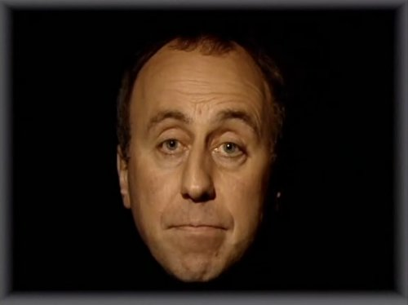
Reviews
PGMDE Operational Improvement Review
Professional Support and Wellbeing Services
National Recruitment
Deanery Teams and Business processes
Training numbers
Distribution
Expansion
Digital systems
PGVLE, TIS, Oriel
Education Reform
Generalism, Flexibility, SAS, LED, EWS
Improving Doctors Working Lives
NHSE Operational review
And Many More!

Slide 12
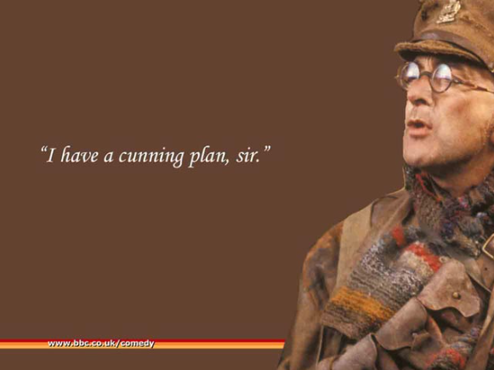
Plans
Financial Recovery / Savings Plans
Waiting for single year budget plan
LTWP (start of first revision)
10 YP
Elective Recovery Plan
And many more again!

Slide 13
NHS Long Term Workforce Plan
The Plan sets out an expansion in training, changes to ways of working, and improvements to culture that will increase the NHS permanent workforce over 15 years. It is focused around the following three aims
Train: Growing the workforce
Retain: retaining the existing talent by boosting flexibility, wellbeing support etc
Reform: Working and training differently, new tech, therapy and treatments.

Slide 14
National Expansion Numbers

Slide 15
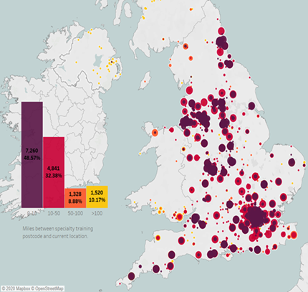
Is it worth training locally?
Redistribution of specialty training posts:
Map highlights most doctors work close to where they trained.
majority of doctors in training tend to work in or close to where trained.
49% of specialists who gained CCT 2012 – 2019 are based <10 miles from specialty training postcode
80% within 50 miles
A ten-year programme in 3 waves. SE the largest recipient of posts – > 950 new posts.
Aim to rebalance based on
Population density
Deprivation
Remote & Rural

Slide 16
How about in our region?
We are medical student light
Ask for 227% expansion
We are doctor light in parts
KSS main importer in Distribution & Expansion
Wessex and TV – up and down
Expansion required near national norm in other professions
Challenging when HEI’s not creating placements or not getting applications

Slide 17
How do we expand medical school numbers?
New medical schools
More entrants in existing schools
New programmes
shorter (PG, APEL, 4 year UG)
more compact (Uni of Bucks)
More clinical placements in each provider
Faculty?
Placement reform – e.g. hybrid
New locations for placements
Estates – educational / accommodation
Focus on local students?

Slide 18
SE Medical School Expansion 2026-30
2026/27 | 2027/28 | 2028/29 | 2029/30
65 | 70 | 87 | 256
Need some certainty
> 18 month lead in time for a new programme

Slide 19
MS Placement sessions in the South East region – NHS Trusts
Placement Sessions % by Education Provider Region for NHS placements in each South East ICS
ICB | London | South East
South East | 22.2% | 77.8%
BOB | 0.1% | 99.9%
Frimley | 34.1% | 65.9%
HIOW | 0.3% | 99.7%
KM | 71.0% | 29.0%
Surrey | 67.6% | 32.4%
Sussex | 4.6% | 95.4%

Slide 20
Challenges for Expansion
Credibility
Size of the ask and moving goalposts
Distribution paused
Money
Restriction
Inequity
Linking spend to intended activity
3 year CSR
Estates
Supervisors / Trainer capacity
Competing interests – clinical / educational
Competing priorities for organisations
Elective Recovery plan

Slide 21
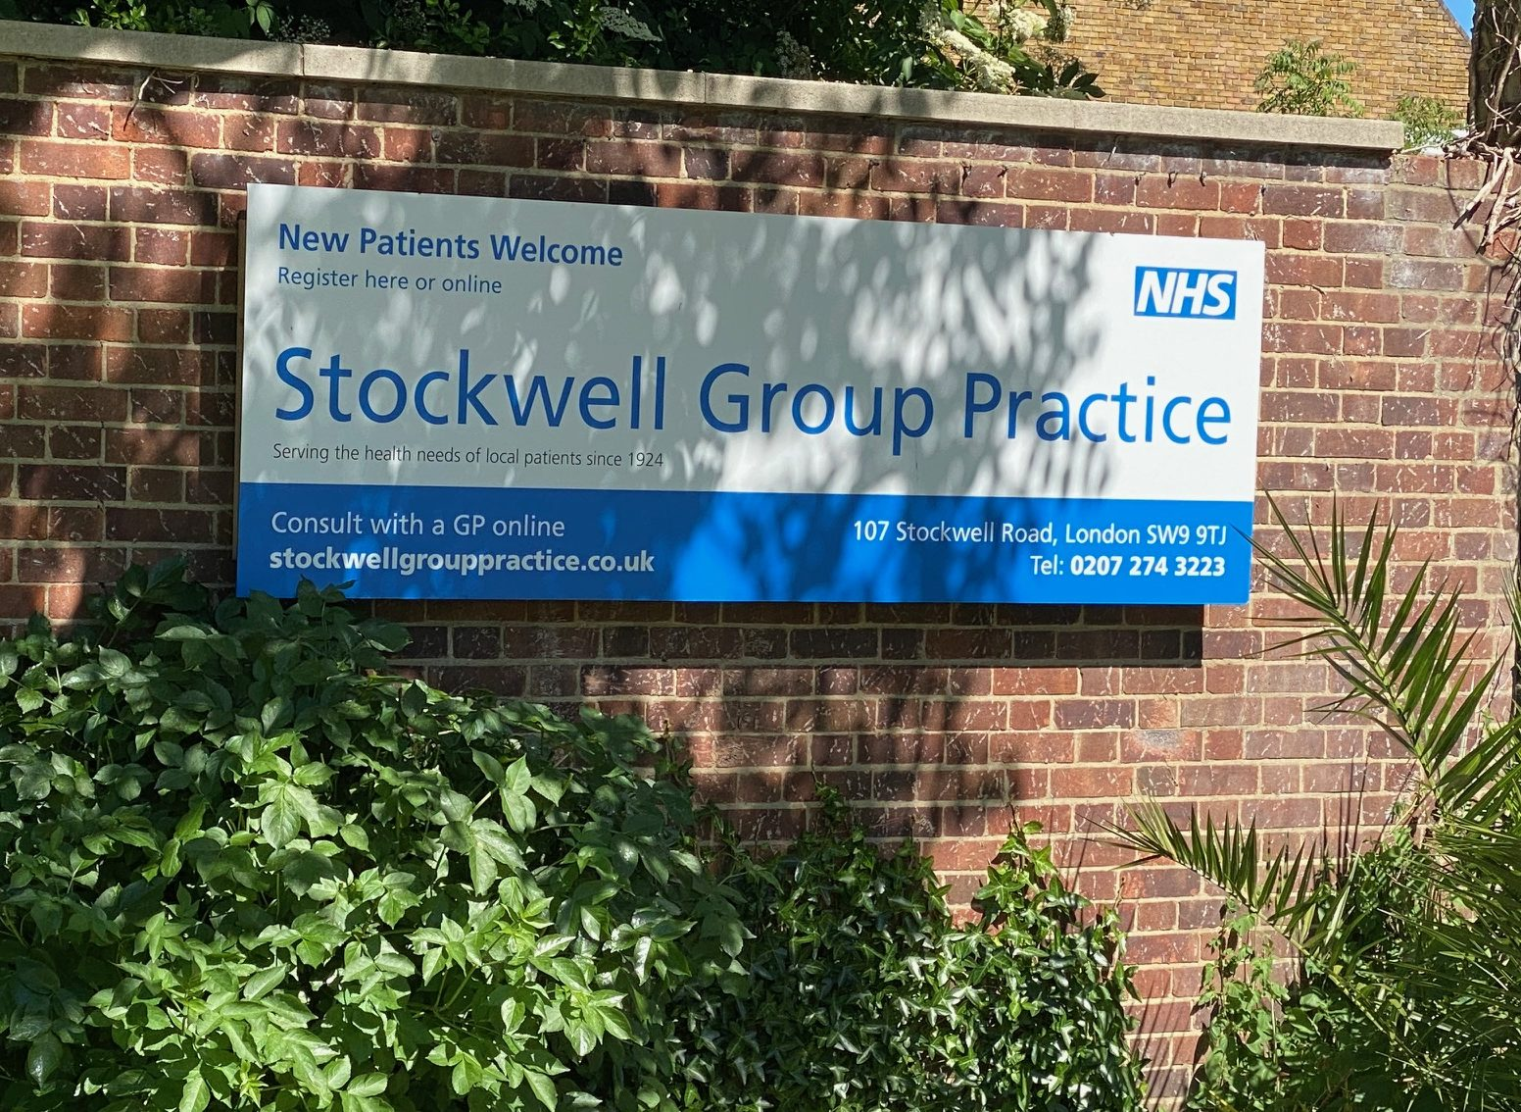
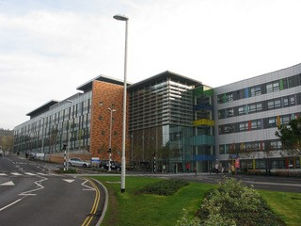
Estates
Issue across Primary & Secondary
TEL and home working?
Space for education / learners squeezed out
Space in new developments / hubs?

Slide 22
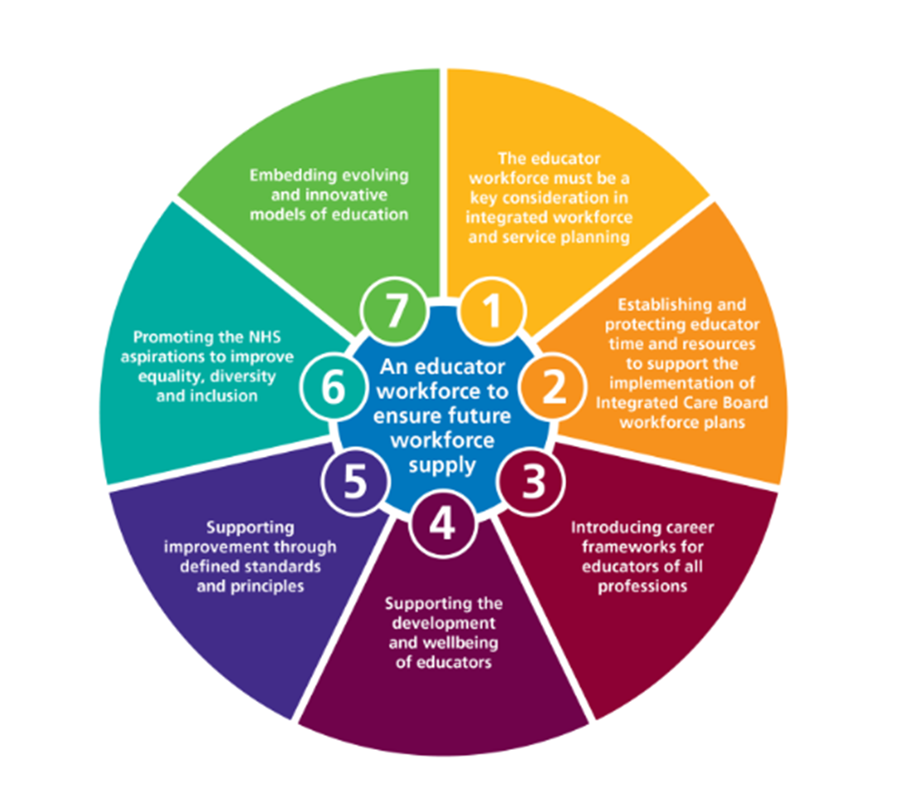
Valuing Educators
Do we really do this?
Job planning & Appraisal
Development offer
Kudos of role
I will say no more Asif!
https://www.hee.nhs.uk/sites/default/files/EducatorWorkforceStrategy.pdf
Notes:
10 outcomes-based functions to be delivered by NHS leaders and organisations in collaboration with their ICS partners Supporting the health and wellbeing of all staff
• Growing the workforce for the future and enabling adequate workforce supply
• Supporting inclusion and belonging for all, and creating a great experience for staff
• Valuing and supporting leadership at all levels, and lifelong learning
• Leading workforce transformation and new ways of working
• Educating, training and developing people, and managing talent
• Driving and supporting broader social and economic development
• Transforming people services and supporting the people profession
• Leading co-ordinated workforce planning using analysis and intelligence
• Supporting system design and development.
Building strong integrated care systems everywhere: guidance - ICS people function (NHS England, August 2021)

Slide 23
Is Technology Enhanced Learning the solution?
Maximising value of every learning opportunity
Accessible TEL resource prior to clinical activity
Robotic Surgery – GKT
GP hybrid placements at Medical School
National On line Surgery programmes
Human Factors / professionalism related capabilities – many specs!
Faculty Development
Regional offer for Sim – 16 faculty now in ED alone running 30 min sessions
“Tea Trolley” format
POCUS – TPD now supporting regionally across Anaes / ICM / EM / AIM
Evidencing progression – curriculum reform needed
IMT – Reg Ready courses in Thames Valley – focus on skills / areas highlighted as needed to progress

Slide 24
Training in new locations
Elective Recovery plan will scale up requirement
Elective Hubs (often existing locations!)
Independent Sector
Contracted in work
Contracting to train
Culture of those leading the work
We did it during a pandemic…….

Slide 25
The Case for change
Number are not adding up
Population is changing
Care is changing
New tech in care and education
Learners unhappy with current system
GMC NTS majority still happy…..
Rotational training
Medical workforce is changing
Expansion in LED

Slide 26
The Enhance Offer
Generalist Capabilities are key to ensuring that future healthcare professional can respond to population needs in a changing healthcare landscape. Enhance has been developed as a multi-professional development offer to optimise and embed generalist skills at all stages of postgraduate training.
Notes:
Chris Whitty

Slide 27
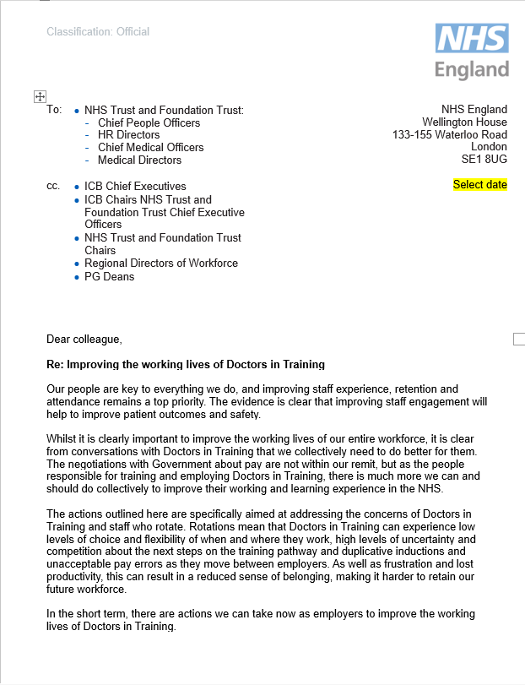
On 25 April, NHS England issued a letter to all trusts outlining the importance of addressing issues that negatively impact the working lives of Post-Graduate Doctors in Training (PGDiT).
Addressing issues that negatively impact the working lives of PGDiTs :
Rota Code of Practice notice periods
Payroll errors
Clear provider Board reporting
Revision of study leave provision
Setting out requirements for ongoing programmes that require future trust involvement
Reform of Statutory and Mandatory training
Digital staff passport
Protected job planned time for education
making a small number of longer-term commitments
expanding the Lead Employer Model
Changes to rotations and geographies
Notes:
Plain slide with subhead and bullets

Slide 28
Flexible Medical Careers: Initiatives in progress
Out of Programme Pause | Flexible Training | Flexible Portfolio Training
OOP-P allows trainees to step out of formal training for up to 12 months. This flexibility initiative can be a vital tool to support trainee wellbeing. Any capabilities gained whilst on OOP-P can be assessed upon their return and contribute to their CCT. 2025 -> full rollout | Allows the opportunity to apply to train for > 50% WTE for well-founded reason, including wellbeing or through personal choice. Next steps : Increased cultural acceptance within the workplace Recruitment to pre-planned flexible rotations from August 2025 in pilot geographies and specialties Recruitment change needed? People v WTE Increased entry points in year Issue with on boarding / induction | Flexible Portfolio Training (FPT), protects 1 day a week (or 20% time equivalent) for professional development in one of four pathways: Clinical informatics pathway Medical education pathway Clinical Service Improvement Research pathway Next steps : Now offered in most specialties in secondary care, GP will now be considered for implementation.
Notes:
Plain slide with subhead and bullets

Slide 29
Supporting Resident Doctors
Rotational Training review
DHSC & BMA led with NHSE
Limit moves
Prolong jobs
Decrease need to move
Surgical Residents survey – 0 / 1 need to move base through specialty training
If had longer term knowledge of training locations would be better
Capability (digital) Passport
Take what you have learned with you if move location / specialty
Can attain when not in formal training
Include GMC professional capabilities
Enable later entry if move specialty / enter later in career

Slide 30
10 Year Health Plan
Notes:
Standard title slide

Slide 31
3 big shifts
Hospital to community (left shift)
Analogue to Digital
Sickness to Prevention

Slide 32
10YP
Patient Focussed
“Health in the broadest sense”
Social issues of relevance to the NHS
Admission avoidance
Discharge Planning
Public & Staff engagement
Online portal
Staff Workshops
Stakeholder engagement
National Summit to come
Vision & Enabling working groups – People is one of the groups
Leadership across Ministers, DHSC, NHSE
Final Plan – May 2025

Slide 33
Important links
Revised LTWP shortly after 10YP
Multi-year spending review (CSR)
Need to make workforce a clear priority
Numbers
Training and Education requirements for change in care

Slide 34
Review of Medical Training
Diagnostic coming soon!
Please keep quiet until full announcement
Led from the top
Listening Events with key groups (providers, residents, faculty, colleges, faculties etc)
Please engage with this
Notes:
Please do not share on social media until formally announced

Slide 35
Summary
10YP will ask for reform and improvement at a time challenge and restriction
It can be done
Invest in the right way to save in the longer term – 3 year CSR
No educators today = no workforce tomorrow
Education & Training as part of Core Business today
Change from viewing training and educator time as a cost to viewing as an investment

