Slide 1
International Medical Graduate Fellowship
Dr Henry Harcourt

Slide 2
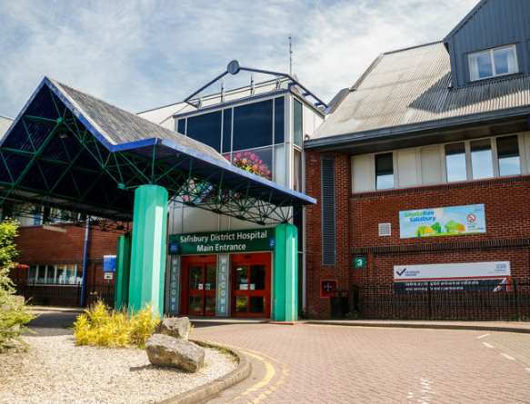
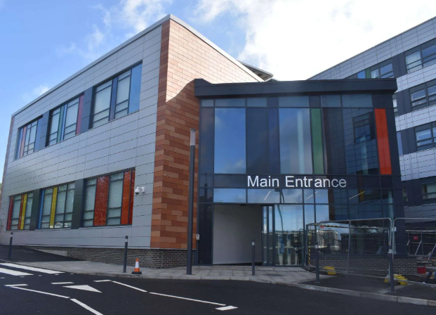
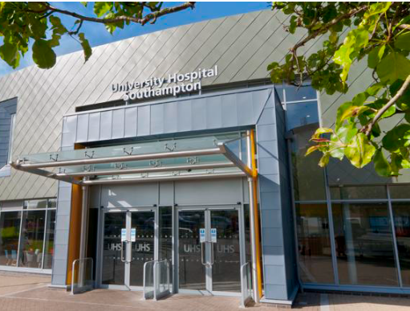
Notes:
Introduction to experience and rationale for doing IMG fellowship

Slide 3
Maintain
Develop
Initiate
Notes:
Advise from supervisor, building on work of previous fellows. Outline each setion

Slide 4
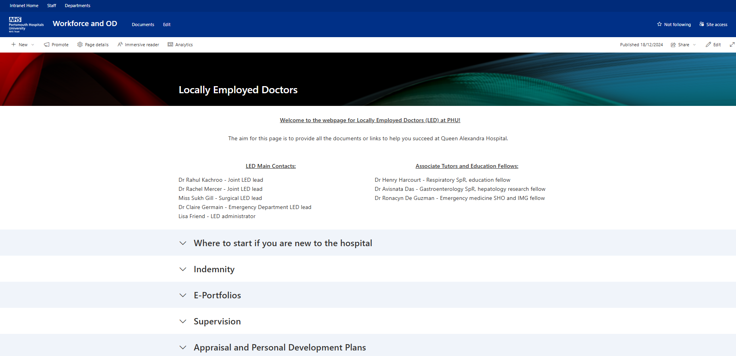
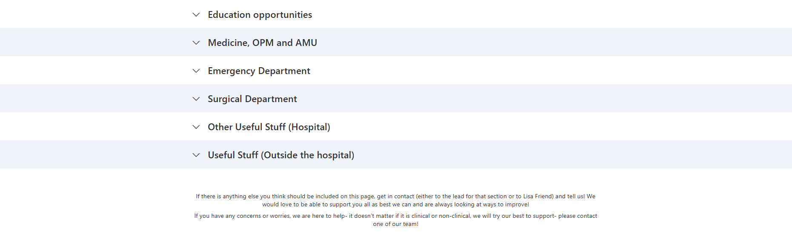
Notes:
Bringing together existing resources

Slide 5
Notes:
“my cohort” seeing through process

Slide 6
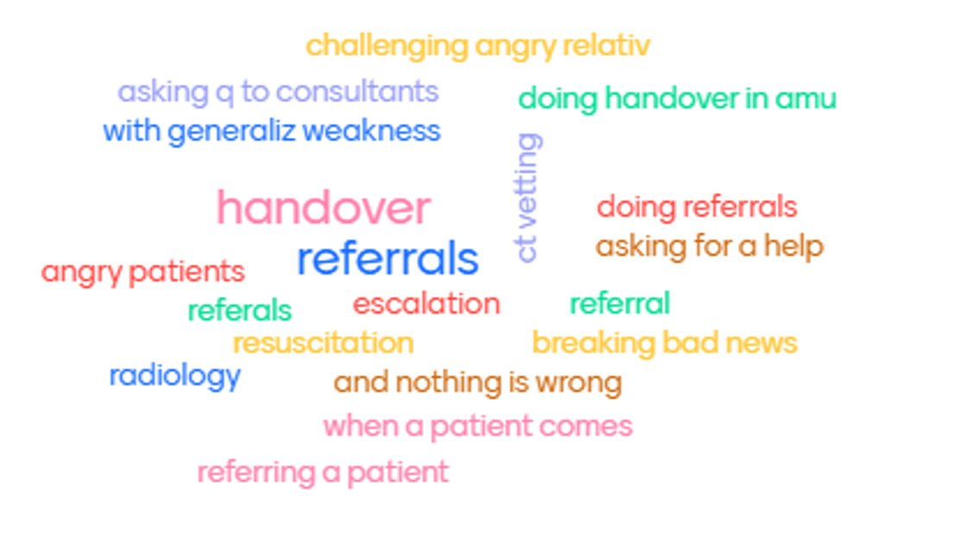

Slide 7
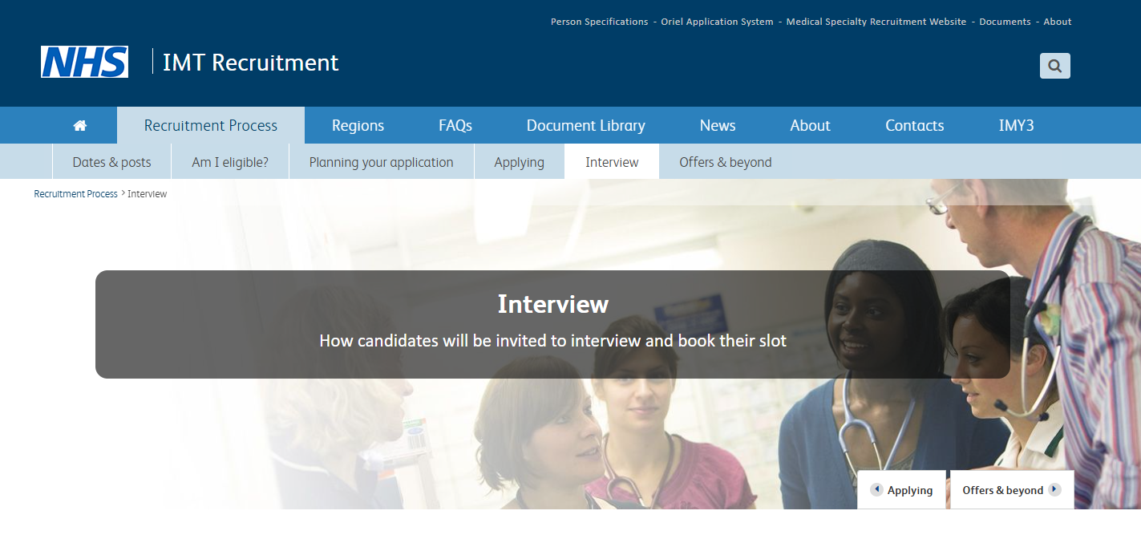
Notes:
Advise from interview by Dr Rushton- differential attainment in recruitment- help with interviews? Ongoing project
Finish on “value” to IMGs, to trust, to me
Future- IMG study days?

