Slide 1
BRAIN AI
Dr Dilan Sanli

Slide 2
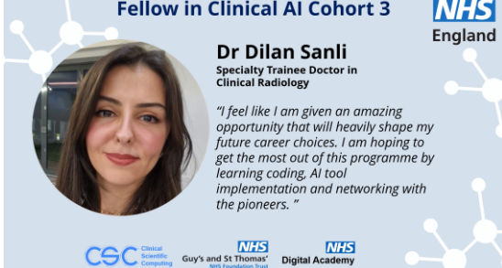

Slide 3
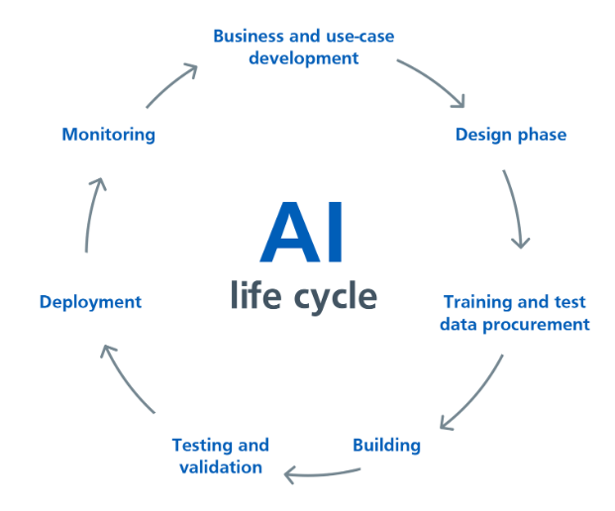

Slide 4
Nature of the Project
BRAIN AI
Over 850,000 people live with dementia in the UK
1 in 3 people born in 2020 will develop dementia
Currently, 1 in 5 people over the age of 65 show symptoms of dementia and out of those, 1 in 3 people progress to develop dementia.
Early objective and more accurate diagnoses of dementia is needed.
Notes:
Dementia affects patients’ memory, language and problem-solving abilities and as the disease progresses it
impacts the patients’ ability to carry out their normal daily activities. Currently there is no cure for dementia, but
there are drugs that can improve symptoms and, in some cases, delay progression.
1 in 3 people progress to
develop dementia. However, it is difficult to predict which patients will progress so more accurate early diagnosis
is crucial to help with this prediction and to provide effective treatment options and support for patients and their
carers.
Prescriptive
AI: Provides recommendations or solutions (e.g., decision-support systems).

Slide 5
BRAIN AI: Biomarker Research to Assess Inflammation in Neurodegeneration using Artificial Intelligence
Funded by NIHR, in house project
Prescriptive AI (provides recommendations/solutions)

Slide 6
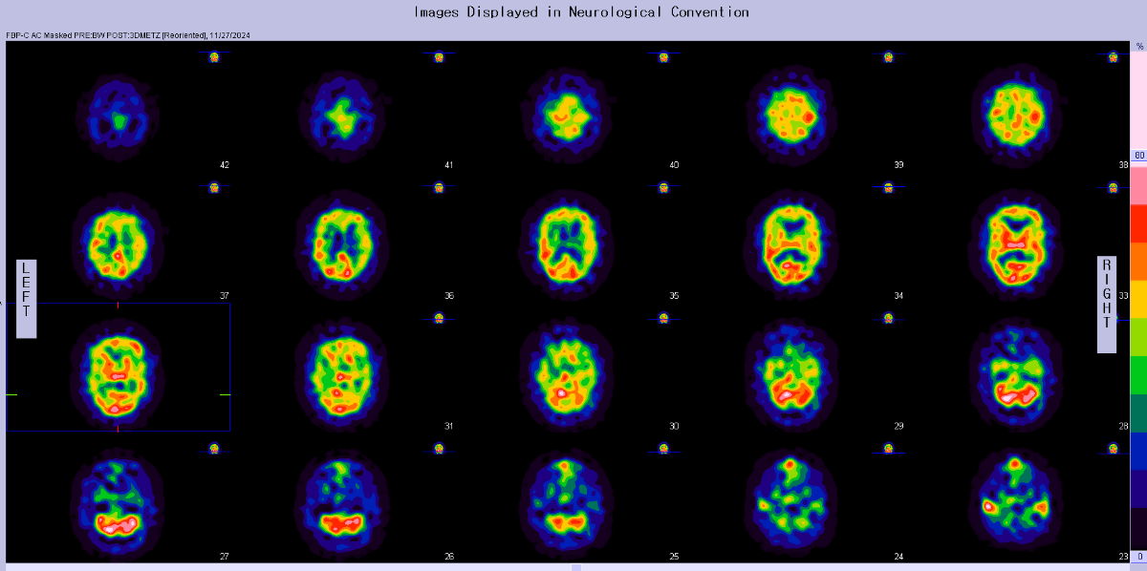
THIS IS HOW IT WAS ORGINALLY
Notes:
Neuroimaging studies show that reduced brain perfusion is an early functional marker of dementia.
In addition, new evidence implicates inflammation as a driving force for neurodegeneration. Blood and CSF biomarkers of
inflammation, are associated with accelerated progression of dementia. The quantitative combination of these diagnostic techniques could support earlier
diagnosis of dementia

Slide 7
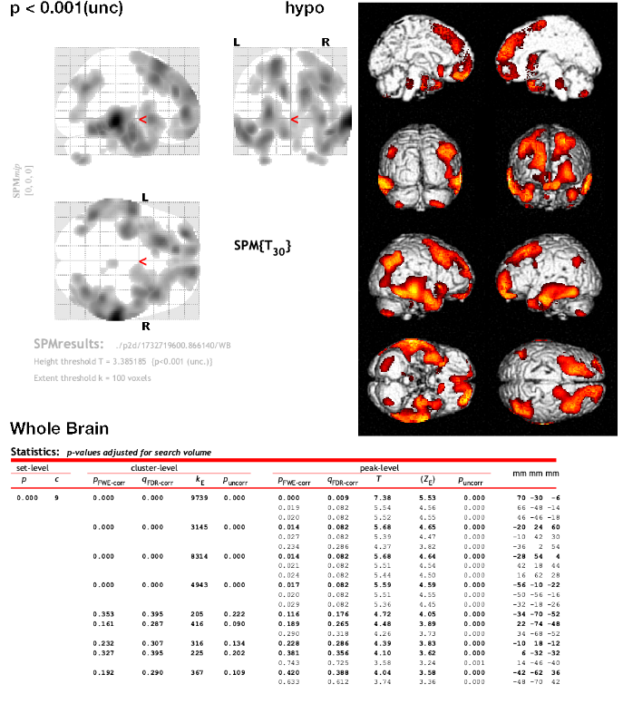
Notes:
P2D USES STATISTICAL PARAMETRIC MAPPING which is an analytical technique and software used widely in neuroscience.

Slide 8
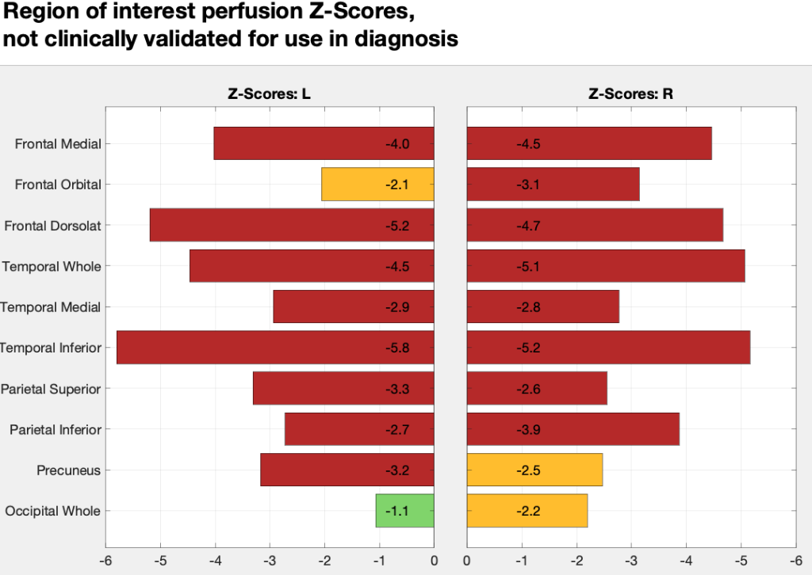
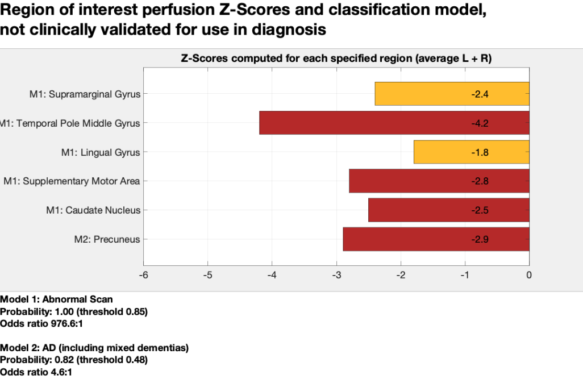
A quantitative diagnosis support tool for objective assessment of dementia
Following age normalisation, more than 100 brain regions were extracted from the scans for assessment of the regional brain perfusion, using Maximum Relevance Minimum Redundancy for feature selection.​
Trained 2 classification models using logistic regression:
Normal vs Abnormal​
AD vs No AD
Notes:
Neuroimaging studies show that reduced brain perfusion is an early functional marker of dementia.
In addition, new evidence implicates inflammation as a driving force for neurodegeneration. Blood and CSF biomarkers of
inflammation, are associated with accelerated progression of dementia. The quantitative combination of these diagnostic techniques could support earlier
diagnosis of dementia

Slide 9
My Role
Evaluation and commissioning
Requires learning Nuclear Medicine/ HMPAO scans
Liaising with Prof Kipps for learning and evaluation
Involvement and training of team members
Notes:
Currently deployed in shadow mode.

Slide 10
Side Projects
Public involvement:
Conducted a Survey: “Public Perspective on the Use of AI in Dementia Diagnosis”
Currently in the process of publishing in a Neuroradiology journal.
Helping UHS to create AI regulatory framework for the Trust.
Post-deployment evaluation and auditing of RAPID AI

Slide 12
Lessons Learnt
Interdisciplinary Collaboration
Adaptability
Critical Thinking
Different mindset
Notes:
data scientists, engineers, clinicians, and policymakers, ensuring alignment with clinical goals.
Critical Thinking: carefully evaluate the performance of vendors and do your own evaluation.
Adaptability: understand the health care system dynamics well first and evolve your AI solution accordingly.
Behold AI went into administration: is a formal process that a company goes through when it can't pay its debts and becomes insolvent.

Slide 13
RECOMMENDATIONS
Project Proposal
AI Board Group for Vendor Check
AI Review Group
AI Oversight Group
Trust Board

Slide 14
Thank you!

