Slide 1
Nursing associate and Registered nurse degree apprenticeships
This pack covers two main actions:
Accepting levy transfers (if applicable)
Adding your apprentice
Contents:
Setting up a Digital Apprenticeship Service Account – slide 2 (only applicable if you do not have an account).
Request or accept a levy transfer* – slide 3
Add your apprentice – slides 4 – 6
Understanding the funding streams – slide 7
*Apprentices aged is 16 – 21 or those with an Education and Healthcare Plan are fully funded, go straight to slide 4 - Add your apprentice (these rules apply from 1st April 2024).

Slide 2
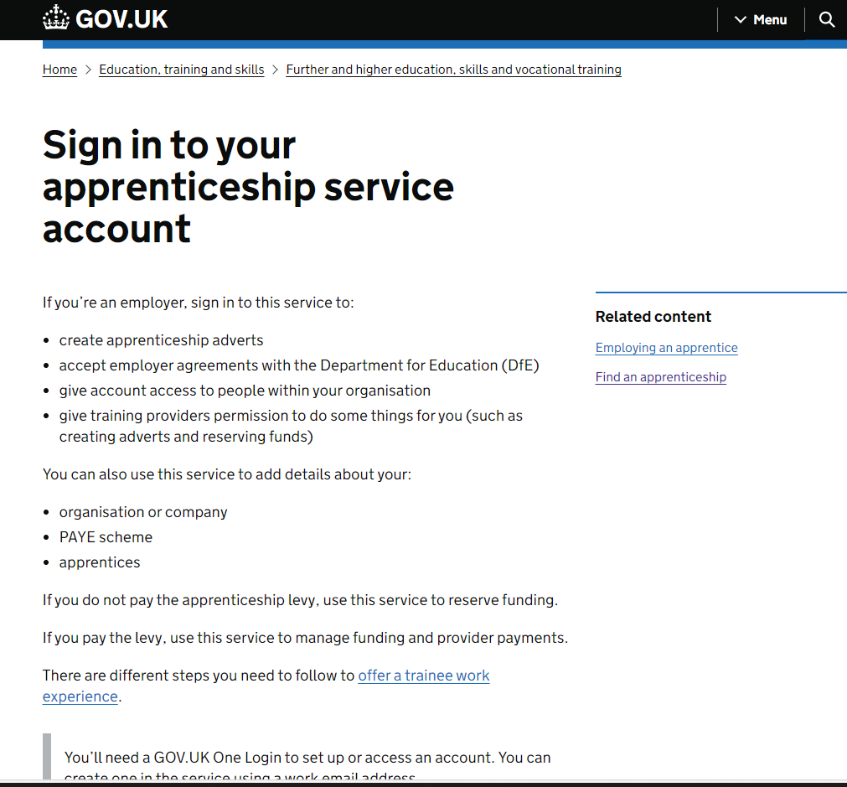
Digital apprenticeship service (DAS) account
Nothing happens without an Apprenticeship Service account The employer who will pay the apprentice salary through their payroll will need to create this account (e.g. PCN vs Practice).
In this system you can:
make automated payments to the training provider
have control of the apprentice details
use of the apprenticeship recruitment service
Accept levy transfer connection requests
…and more
Top tip 2: Change the name on your DAS account to match the name of your Practice. Training Providers often struggle with the names on your PAYE account, e.g. Drs. Smith & Jones, when they are dealing with several Practices.
Top tip 1: to enable the full functionality of the DAS, you must accept the Apprenticeship Agreement
Click here for instructions and information videos

Slide 3
Levy transfers
If you have not requested a levy transfer
1. Send your apprenticeship service account number to kusham.nijhar@nhs.net
2. We will source levy and help you with the application
3. Check that you have accepted the most recent Apprenticeship Agreement in your account
Accept the levy connection request
Once levy transfer has been sourced, the levy transferring organisation will send
you a connection request
2. You will receive an email from ‘gov.uk’ address to notify you
3. Log into your DAS account and accept the levy connection
Can’t see the email?
check your junk box
have you accepted the apprenticeship agreement?
- sometimes the connection request is displayed in the ‘Transfers’ section
Failing all this – contact the help desk via your digital apprenticeship account
If the levy transfer organisation is the same as you have used for a previous apprentice
Ignore this step and go straight to Add your apprentice.

Slide 4
Adding your apprentice
Once the contracting and enrolment has started, and at least 2 weeks prior to the training start date, you will need to add the apprentice and training provider details to your DAS account.
Before adding your apprentice, please have ready your apprentice’s:
NHS email address
Date of birth
Select Add an Apprentice
When you see the funding options
If your employee is 16 – 21 or 22 to 24 and has an education and healthcare plan, select the Government funding option
Otherwise select the option displaying the name of the levy transferring organisation (not reserve funds. If you can’t see the options please contact kusham.nijhar@nhs.net)
Select Training Provider UKPRN number – find this here under ‘Apprenticeship provider and assessment register’ or ask your university to provide this information
Name of apprenticeship – Nursing Associate Level 5 2018 OR Registered Nursing Degree Apprenticeship 2018
Apprenticeship start and end date and price – if you are not sure please contact the university
Reference number – anything you want for your own reference

Slide 5
Once your cohort has been confirmed by the training provider, the levy transferring organisation will also confirm the request. They may ask you to make minor changes, this will all be tracked through the system.
Once all parties have confirmed, your apprenticeship payments are ready to commence. Don’t ignore the ‘approve your cohort email’ from gov.uk
Accepting the ‘cohort’
What happens next?
Once the training provider submits the individual learning plan and starts claiming funds, the payments will be made monthly as follows:
Funding leaves levy gifting organisation each month
Enters your DAS account
Transferred to the provider
80% fees paid whilst learner is on main training programme
20% fees paid once the end point assessment is complete (automated through the system)
Check your finance tab 3 months into the programme start to check payments are being made
If they are not, please contact your training provider, as this can effect the levy finances of the transferring organisation

Slide 6
Further information: Apprenticeship funding vs NHSE support funding
Funding processed via the apprenticeship service account pays the training fees only – apprenticeship levy cannot be used for ineligible costs such as salary or backfill.
NHSE support funding e.g. the nursing associate £8,160k funding is a separate payment. Once NHSE have carried out their validation process, they will transfer funds as follows:
In Frimley payment is made via Frimley ICB
In BOB the payment will be made directly to the Practice, providing you have submitted your payment details on request by the ICB.

