Slide 1
Apprenticeships in primary care Bitesize session 2: Understanding Levy Transfers
1st May 2024
Kusham Nijhar and Kate Long, Apprenticeship Leads
Thames Valley and Wessex

Slide 2
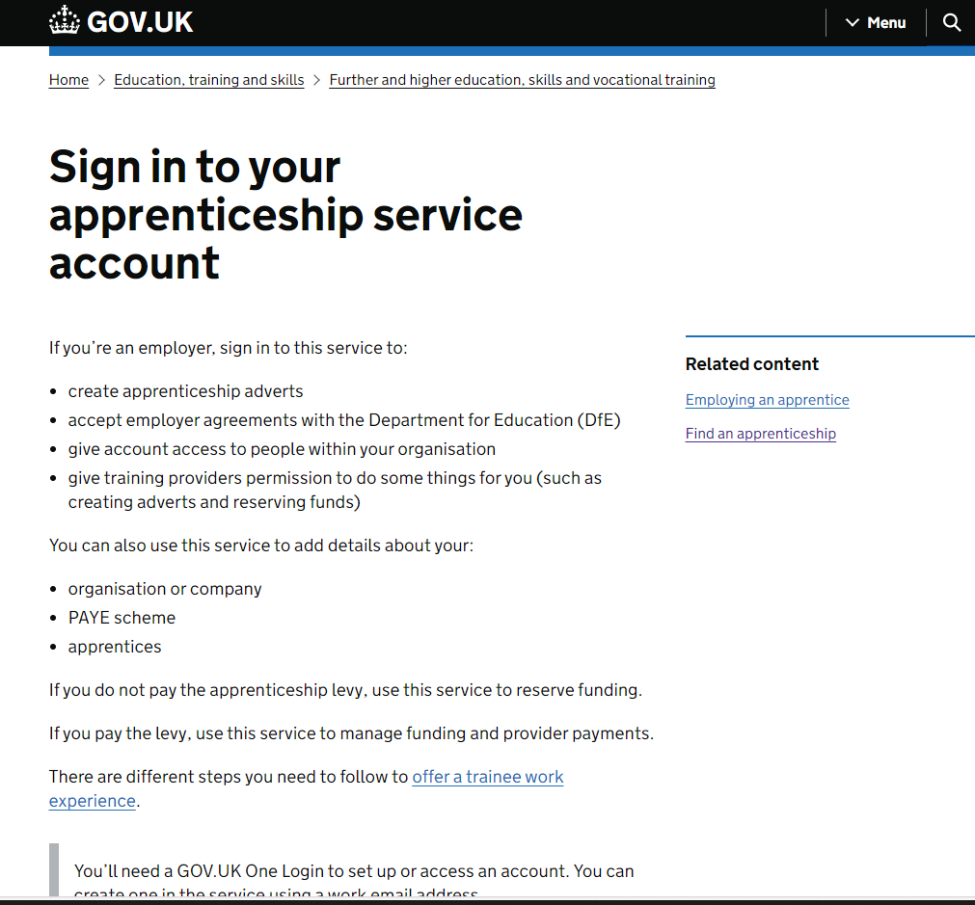
Digital apprenticeship service (DAS) account
Nothing happens without an Apprenticeship Service account The employer who will pay the apprentice salary will need to create this account (i.e. through their payroll).
In this system you can:
make automated payments to the training provider
have control of the apprentice details
use of the apprenticeship recruitment service
Accept levy transfer connection requests
…and more
Top tip 2: Change the name on your DAS account to match the name of your Practice. Training Providers often struggle with the names on your PAYE account, e.g. Drs. Smith & Jones, when they are dealing with several Practices.
Top tip 1: to enable the full functionality of the DAS, you must accept the Apprenticeship Agreement
Click here for instructions and information videos

Slide 3
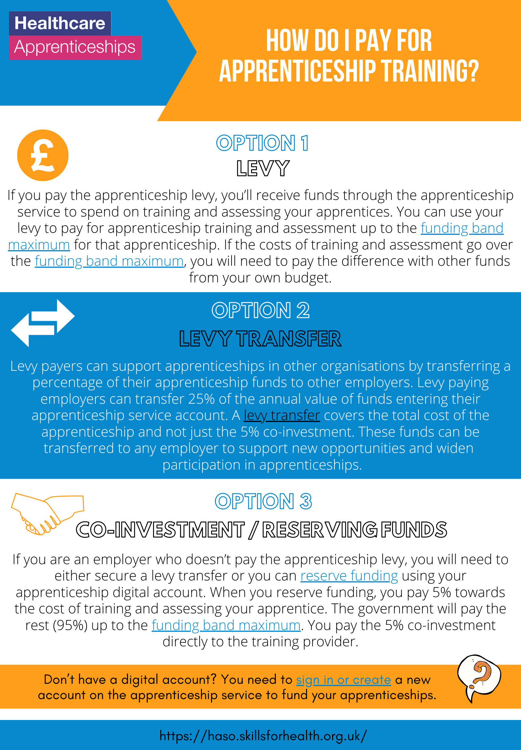
Apprenticeship programme funding options
Employer Apprenticeship Levy – if your PCN or Federation has an annual salary pay bill > £3million you will be paying the Apprenticeship Levy and can draw down these funds.
Most primary care employers do not pay the levy, or if they do are likely to have limited funds available.
Co-Investment / Reserve Funds – the Government can fund 95% of the programme costs for non-levy paying organisations (reserve funds within one calendar month of the programme start date)
E.g. for a programme costing £15,000, you would pay only 5% of the fees = £750 over the duration of the programme
For young people the Government will fully fund the training costs:
16 - 21 years old
22 - 24 years old with an education and healthcare plan
Levy Transfer – levy payers can support apprenticeships in other organisations by transferring up to 50% of their annual value of funds. A Levy transfer covers 100% of the total cost of training (from April 2024) – this is the focus of today’s presentation.

Slide 4
When should you set-up a levy transfer?
As soon as possible
Some levy transfer organisations have approval processes in place that can take between 1 to 2 months
The apprenticeship cohort should created before the apprentices starts their training.
Therefore delaying this process creates a risk to the apprenticeship start date

Slide 5
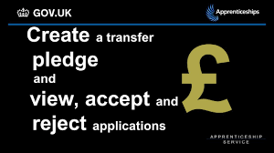
Step 1: Source a levy transferring organisation
Contact your local training hub for support and connections or;
Option 1:
Contact your local networks
Contact your NHS Trust, Local Authority or Local Enterprise Partnership
As your apprenticeship numbers increase, you will build your own networks
- making the transfer process a lot smoother.
Access the pledging service via your digital apprenticeship service account
Here you can navigate employers willing to fund healthcare organisations, filtered by region and apprenticeship categories
The pledging service can be straightforward if you have experience with levy transfers
Many transferring organisations are not able to provide technical support to other employers
Not all large employers use the pledging service
Option 2:
Apply via the national levy pledging service
Receive a levy transfer from another business to fund an apprenticeship - GOV.UK (www.gov.uk)

Slide 6
Make a good case for why you are seeking funding. - Targets/KPIs this training will help to achieve - How will the training impact on workforce retention and your ability to succession plan - How does the programme fit into your workforce planning to meet current and future population health demands - How will the training impact on your service quality / benefit the local community.
Step 2:
Complete the levy transferring organisation’s application form or process
Step 3:
Accept the levy connection request
1. Once accepted, the levy transferring organisation will send you a connection request
2. You will receive an email from ‘gov.uk’ address to notify you
3. Log into your DAS account and accept the levy connection
Can’t see the email?
check your junk box
have you accepted the apprenticeship agreement?
- sometimes the connection request is displayed in the ‘Transfers’ section
Failing all this – contact the help desk via your digital apprenticeship account

Slide 7
Step 4:
Add your apprenticeship details
Once the training provider has been selected and everything is in place for your employee to start the apprenticeship, you will need to add the apprentice and training provider details to your DAS account.
You will be guided by your local apprenticeship lead or training provider on how and when to add these details.
DfE video instructions are also available: https://youtu.be/MGvvTNmlcNY?si=jE0zJEQLsNn_5CQg
Warning!
When adding your apprentice, you will be asked to select an option to fund the apprenticeship (providing you have connected to your levy transferring organisation).
Click on the option displaying the name of your levy transferring organisation. Sometimes employers miss this option and select Government co-funding instead.
It is not easy to un-do this so please select carefully!

Slide 8
Once your cohort has been confirmed by the training provider, the levy transferring organisation will also confirm the request.
Once all parties have confirmed, your apprenticeship payments are ready to commence. Don’t ignore the ‘approve your cohort email’ from gov.uk
Step 5:
Accepting the ‘cohort’
What happens next?
Once the training provider submits the individual learning plan and starts claiming funds, the payments will be made monthly as follows:
Funding leaves levy gifting organisation each month
Enters your DAS account
Transferred to the provider
80% fees paid whilst learner is on main training programme
20% fees paid once EPA is complete
Check your finance tab 3 months into the programme start to check payments are being made
If they are not, please contact your training provider, as this can effect the levy finances of the transferring organisation

Slide 9
Gremlins in the system!
Firewalls
Security settings
The system doesn’t update in real time – give your changes 24 hours before contacting the help desk.

Slide 10
Apprenticeship funding vs NHSE support funding
Funding processed via the apprenticeship service account pays the training fees only – apprenticeship levy cannot be used for ineligible costs such as salary or backfill.
NHSE support funding e.g. the nursing associate £8,160k funding is a separate payment, paid via NHSE or your ICB through an invoicing process. Contact your local training hub or primary care school for support.

Slide 11
Useful contacts and links
For local support email: england.primarycareschooltvw.se@nhs.net
Create your Digital Apprenticeship Service account (DAS): Create an apprenticeship service account
Apprentices service video guides: Using the Apprenticeship Service - YouTube
Using the levy pledging service: Receive a levy transfer from another business to fund an apprenticeship - GOV.UK (www.gov.uk)
Find your Local Enterprise Partnership: LEP Growth Hubs | The LEP Network
General tips to support your apprentice - DfE videos for small employers
Apprenticeships in Primary Care - Working across Wessex (hee.nhs.uk)

Slide 12
Apprenticeships: information sessions
6th March – Apprenticeships: What’s available for Primary Care and how to get started – recording : Understanding apprentices in Primary Care and how to get started. (youtube.com)
1st May – Apprenticeships: Understanding levy transfers
3rd July – Apprenticeships: Understanding the Pharmacy Technician programmes
4th September – Apprenticeships: Management and Leadership
6th November – Apprenticeships: Digital and Quality
All sessions run from 12:30 – 13:00
Click here for more information and to book.

