Slide 1
Welcome to the
HEE Maternity Support Worker Webinar,
Monday 24 January, 1.30 – 3pm
Please note the webinar will be recorded and made available for those not able to attend. The webinar will start shortly.

Slide 2
Agenda
HEE Maternity Support Worker Webinar
National Maternity Programme
Agenda
MSW Transformation Project background
Framework mapping results
Implementing the framework:
Midlands
North West London pilot
Where to find learning resources and support?
Care Certificate
Public health initiatives
Functional Skills
L3 SCHSW Apprenticeship Procurement
Q&A

Slide 3
MSW Transformation Fund Project Background
Sally Ashton-May
Lead Midwife
HEE National Maternity Programme

Slide 4
Context
Better Births (2016), highlighted the need for multi-professional working, breaking down barriers between midwives, obstetricians and other health professionals to deliver world-class safe, personalised care for women and their babies.
Maternity support workers (MSWs) are an integral part of the maternity workforce and play an important role in supporting midwives and the wider maternity teams, mothers and their babies through pregnancy, labour and during the postnatal period. However, within the current workforce, the roles, responsibilities and job titles of MSWs in England vary widely.
In March 2018, the Secretary of State for Health and Social Care announced a package of measures aimed at professionalising the maternity support worker role.
HEE has led this important piece of work and developed the Maternity Support Worker Competency, Education and Career Development Framework working closely with a wide range of partners and stakeholders. The framework draws from and builds upon excellent examples of good practice from across the system. It outlines the competence and education levels required to support the delivery of Better Births and the Long Term Plan.

Slide 5
Framework Mapping Results
Alison Smith
Senior Project Manager
HEE National Maternity Programme

Slide 6
Mapping exercise
Following a successful pilot of the framework across organisations of North West London, HEE secured funding to support plans for full implementation across all maternity units in England.
The 2020/21 funding was available to Local Maternity Systems (LMSs) to support desktop review and mapping of maternity support staff against the framework.
All maternity units were encouraged to review their MSW workforce, including support staff that are not described as MSWs (historically, support workers have had numerous titles associated with their roles).
Each maternity unit was then asked to map their MSWs against the education and competency requirements at levels 2, 3 and 4 described in the framework.

Slide 7
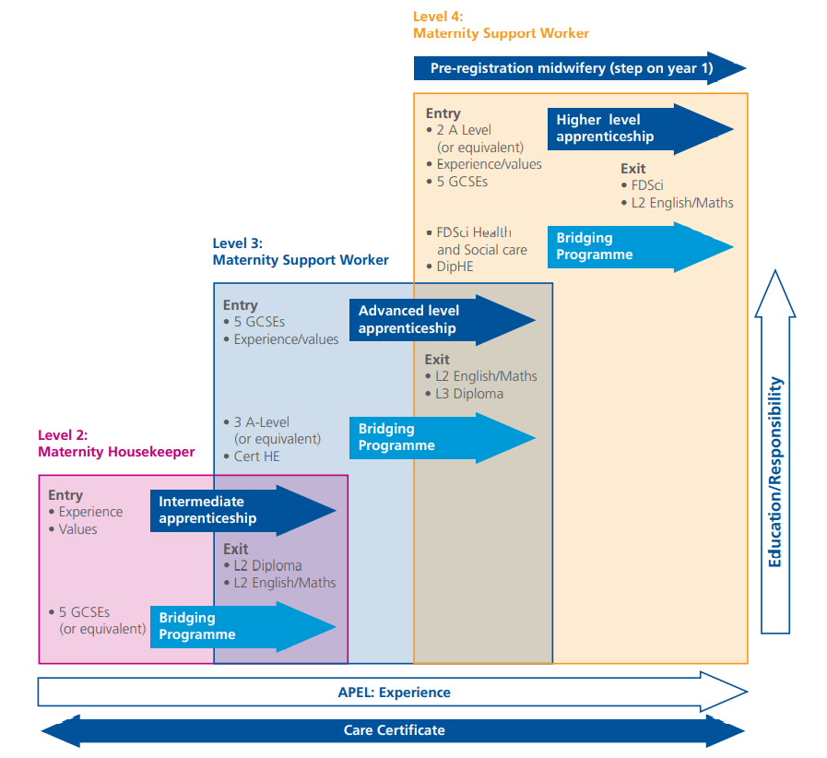
Framework
Progression through the Maternity Support Worker Competency, Education and Career Development Framework is summarised in the diagram.

Slide 8
Staff reviewed
% shown are proportion of total maternity support staff.
Region​ | No. of LMSs reporting​ | Maternity support staff total​ | Staff in scope​ | No. reviewed​
EoE​ | 6​ | 847​ | 843 (99.5%)​ | 632 (74.6%)​
London​ | 5​ | 1285​ | 1260 (98.1%)​ | 991 (77.1%)​
Midlands​ | 11​ | 1411​ | 1385 (98.2%)​ | 1155 (81.9%)​
NE & Yorkshire​ | 6​ | 1122​ | 1009 (89.9%)​ | 768 (68.4%)​
NW​ | 2​ | 414​ | 361 (87.2%)​ | 302 (72.9%)​
SE​ | 8​ | 1453​ | 1392 (95.8%)​ | 1302 (89.6%)​
SW​ | 5​ | 569​ | 559 (98.2%)​ | 487 (85.6%)​
Grand Total​ | 43 (98%)​ | 7101​ | 6809 (95.9%)​ | 5637 (79.4%)​
Notes:
Summary of MSWs captured in the mapping exercise. Data were exported end of November 2021.
Total in scope is not available for each MSW role (levels 2, 3 and 4).
Where the total reviewed was different than the number in scope:
71% of LMSs cited leave and sickness absence as accounting for the difference.
Other issues included non-compliance and lack of access to relevant staff information.
Figures from one LMS are yet to be reported. Please be aware we await clarification from a small number of LMSs; figures may be subject to very minor changes.

Slide 9
Level 2 Maternity Housekeeper Education
Total Level 2 Maternity Housekeepers reviewed | 2519
Total fully meet education entry criteria | 1752 (70%)
Total fully meet education exit criteria | 791 (31%)
Total do not fully meet education exit criteria | 1728 (69%)
Total where *RPEL could close edu. requirement gap | 946 (38%)
Total meet edu. exit criteria + total where RPEL could close gap | 1737 (69%)
% of total reviewed
*Recognition of Prior Experiential Learning

Slide 10
Level 2 Maternity Housekeeper Education
Common education gaps
Level 2 Diploma in Healthcare | 37%
Care Certificate | 33%
Level 2 English and Maths | 29%
% of Local Maternity Systems (LMSs) citing education gaps
Of the 1728 staff that did not meet the education exit criteria, Level 2 Diploma in Healthcare was the most common gap.

Slide 11
Level 2 Maternity Housekeeper Clinical Competencies
Total Level 2 Maternity Housekeepers reviewed | 2519
Total fully meet clinical competency criteria | 1903 (76%)
Total do not fully meet clinical comp. criteria | 616 (24%)
% of total reviewed
Figures on competencies relate to staff that meet or do not meet clinical competency only,
not those who map to the role criteria both educationally and clinically.
This is not available (applies to all roles).

Slide 12
Level 3 Maternity Support Worker Education
Total Level 3 MSWs reviewed | 2817
Total fully meet education entry criteria | 1912 (68%)
Total fully meet education exit criteria | 838 (30%)
Total do not fully meet education exit criteria | 1971 (70%)
Total where RPEL could close edu. requirement gap | 855 (30%)
Total meet edu. exit criteria + total where RPEL could close gap | 1693 (60%)

Slide 13
Level 3 Maternity Support Worker Education
Common education gaps
Level 3 Diploma in Healthcare Support / Maternity and Paediatric support or equivalent | 49%
Care Certificate | 34%
Level 2 English and Maths | 16%
Of the 1971 staff that did not meet the education exit criteria, Level 3 Diploma in Healthcare Support was the most cited education gap.

Slide 14
Level 3 Maternity Support Worker Clinical Competencies
Total Level 3 MSWs reviewed | 2817
Total fully meet clinical competency criteria | 1504 (53%)
Total do not fully meet clinical comp. criteria | 1313 (47%)
Significantly fewer met the level 3 competency criteria compared to the number that met the level 2 criteria.

Slide 15
Level 4 Maternity Support Worker Education
Total Level 4 MSWs reviewed | 400
Total fully meet education entry criteria | 262 (66%)
Total fully meet education exit criteria | 110 (28%)
Total do not fully meet education exit criteria | 290 (73%)
Total where RPEL could close edu. requirement gap | 130 (33%)
Total meet edu. exit criteria + total where RPEL could close gap | 240 (60%)
Wide variation between regions across all measures.

Slide 16
Level 4 Maternity Support Worker Education
Common education gaps
Care Certificate | 53%
Level 4/5 Apprenticeship/Foundation Degree | 47%
Of the 290 staff that did not meet the education exit criteria, Care Certificate was the most cited education gap.

Slide 17
Level 4 Maternity Support Worker Clinical Competencies
Total Level 4 MSWs reviewed | 400
Total fully meet clinical competency criteria | 151 (38%)
Total do not fully meet clinical comp. criteria | 250 (63%)
Number that met level 4 clinical competency criteria was lowest of all levels
Wide variation between regions

Slide 18
Systemwide approach to Support MSW Competency, Education and Career Development Framework Implementation
Lucy Johnson – HEE Regional Clinical Lead midwife
– Midlands

Slide 19
Aim….
Collaboration…
Across the region to create a standardised approach
For wider teamwork to support implementation
Seeking Local Maternity and Neonatal System (LMNS) oversight to support change and sustain.
Working together

Slide 20
Regional Working Group
To support our current and future MSW workforce to be aligned to the National MSW Framework, the HEE regional team supported the Midlands to develop a working group with members from all 11 LMNSs to:
Create a collaborative approach to reduce the gaps and identify appropriate training to support education needs
The Midlands working group provided support and advice during the initial data collection and continues to support the implementation phase

Slide 21
Working Group Structure
TORs
Agenda
Minutes to communicate to:
All working group members
All regional HOMs/DOMs
LMNS leads
Regional NHSE/I leads
Sub – groups are created as required to work through matters arising

Slide 22
Midlands approach
100% uptake of the HEE bid offer to scope the current workforce. 100% response, which will be collated and reported upon to the systems - MSW education and training and how they are deployed in the Midlands will be identified
MSW standardisation across the Midlands through collaborative working (4 deliverables identified so far – Regional JD, skills passport, agreed training package, care certification)
Raising the profile of the MSW workforce

Slide 23
Deliverables 1-4
The working group identified 4 key deliverables:
1. Adopt newly refined job descriptions for the roles of Maternity Care assistants (House keeper within the framework) and MSWs i.e.., from band 2 to band 4 as developed and approved Regional Working Group and the regional HOM/DOMs | 2. Introduce a regional skills passport | 3. Develop a standard regional training package and development pathway to include access to fundamentals skills training | 4. Ensure all existing MSWs have the required care certificate

Slide 24
Progress of deliverables 1 & 2
Document | Status | Next Steps | Anticipated Time Frame
Band 3 JD | Working group reviewed JD from HEE tool kit and others previously job matched at band 3 to develop a Regional JD that aligns to the framework. System wide agreement sort | Trusts to apply local document format and Job match internally | Each Trust is at various stages regarding recruitment and review of current JDs, a primary review will be required with LMNS oversite and set time frames
Band 2 JD | Working group reviewed JD from HEE tool kit and others previously job matched at band 2 to develop a Regional JD that aligns to the framework. System wide agreement sort | Trusts to apply local document format and Job match internally | Each Trust is at various stages regarding recruitment and review of current JDs, a primary review will be required with LMNS oversite and set time frames
Band 4 JD | NW London Pilot site are currently looking at band 4 roles JD/PS and plan to share widely when available. Working group currently reviewing local band 4 JDs – e.g., clinical support trainer roles | Identify who plan to employ band 4 MSWs What does that look like? Share example band 4 JDs where the exist | Trusts are predominantly concentrating on level 2 and level 3 therefore the timeframe is not yet anticipated, however the review process will commence by December 2021
Skills passport | Subgroup are currently building a standard passport for the region based on passports from other Trusts that have been aligned to the framework | Circulate to working group/HOMs/DOMS/LMNS for comment and approval. Launch agreed copy for local formatting and utilisation | Anticipated turn around December 2021, delayed due to service pressures for LMNS oversight to support utilization

Slide 25
Progress of deliverables 3 & 4
Key point | Progress | Next steps | Anticipated Time frame
3. Develop a standard regional training package and development pathway/ Access to Senior Healthcare Apprenticeship/ Access to fundamental skills training (maths and English) as required | Whilst there has been attempts to review training packages within the working party local views are still required. Information has been shared across the system regarding best practice and appropriate training packages for level 3 training/level 4 Access to fundamental training has been shared via the working group Gap training is being addressed Working group want to design a standardised annual update MSW training programme | Trusts to speak with providers to support training and procurement arrangements to identify MSW training plans and pathway for level 3 senior healthcare apprenticeship and level 2 support worker and where applicable level 4/5 training. Ensure gaps in training have been closed A subgroup to review the content and timetable for an appropriate MSW annual update | By *** 50% of all Trusts will have an identifiable training package for level 3 MSW training or closed any existing gaps to support progression 100% will have a plan to access existing training capacity for level 2 training Level 4/5 training for the region will have been identified but anticipated to be required by a minimum number of staff Annual update programme to be ready for review by December 2021
4. Ensure all existing MSWs have the required care certificate | Each area has now scoped the workforce and can identify those who require care certification. This is being achieved through local arrangements, for example ELearning for health care certificate/ self certification route/inhouse training | Care certification is part of the MSW mapping process, therefore on completion of data collection each Trust should arrange care certification to be arranged locally within each Trust | 100% of all existing MSWs will have completed care certification – LMNS to set time frames

Slide 26
Next steps
Support each system through promoting and utilizing the working group to network and have a collaborative approach to ensure Framework implementation continues past the data collection
Each system to identify the appropriate individual MSWs (those mapping to level 3/4 of the framework) in anticipation of allocating the revised ESR code to identify this workforce
To establish region wide agreement on an implementation programme to professionalise and better utilize the Role of Maternity Support Worker across the Midlands using the Maternity Support Worker Competency, Education and Career Development Framework

Slide 27
Overcoming the Challenges together

Slide 28
What will enable us to grow?
The evidence from the forthcoming report will determine what educational provision is required to support full implementation
- whilst all organisations remain publicly committed to:
Undertake learning needs assessments and create development plans to enable implementation of the framework for their MSW workforce
Train future MSWs in line with the requirements of the framework
Assignment to
a redefined electronic staffing record (ESR)
HEE regional maternity lead, and Clinical Fellows will be supporting implementation plans.

Slide 29
LMNS to take the workforce with them on the journey
Whilst undertaking this work some unrest could have unintentionally been caused amongst the MSW workforce if they perceived to be under review, therefore we need to consider:
MSW involvement
Focus groups
Keep midwives informed of the developing MSW role
Good communication is essential
Organisational change may be required to determine new structures of band 2, 3, and 4 workforces and the role and aspects they deliver may change following training.
Supporting MSWs with continued professional development is the employees’ responsibility.
Through the use of apprenticeships, experienced MSWs may also wish to train as midwives; an LMNS that supports a ‘grow your own’ philosophy will also have an approach that addresses midwifery workforce supply.

Slide 30
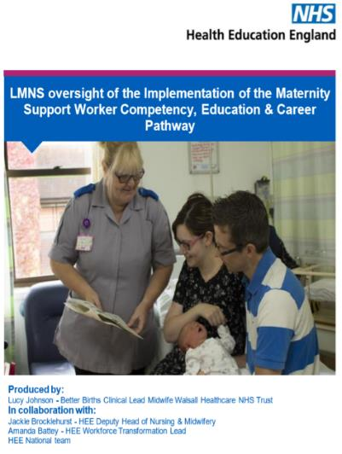
LMNS
LMNS oversight is required to ensure commitment for implementation of the MSW framework continues:
Ensuring that the training requirements identified are being implemented ideally through apprenticeships where required
That staff are trained and signed off against the framework within a specific timescale
Bank and agency MSW staff meet the framework requirements against the role for which they are employed.
(Recruitment and retention could be affected in Trusts who are not following implementation and there could be migration of the workforce into bordering areas and LMNS who are providing those opportunities).

Slide 31
LMNS Presentation:
DRIVERS
ACTIONS
CURRENT STATE

Slide 32
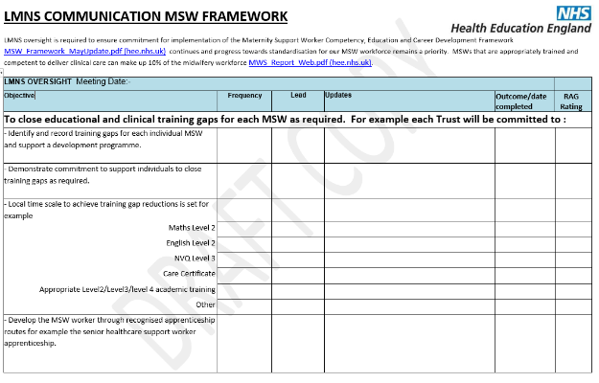
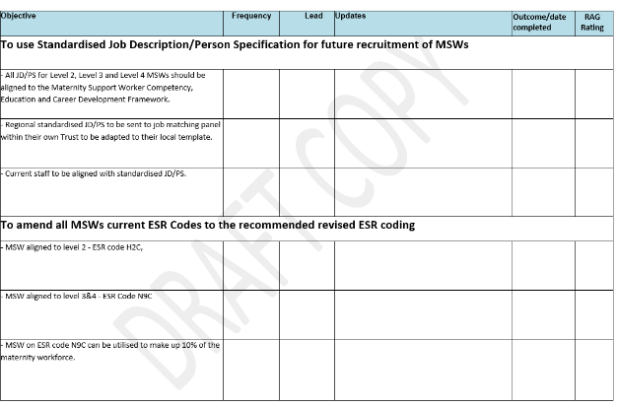
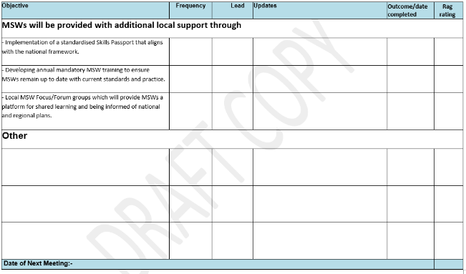
Midlands comms example

Slide 33
ESR codes
The MSW workforce that map at level 3/band 3 and above will be assigned to a redefined electronic staffing record (ESR) code from late summer which will identify them as being appropriately trained and competent to deliver clinical care and can be utilised to make up 10% of the midwifery workforce as recommended by Birthrate plus (NICE 2016).
Therefore, Trusts will look at what their mapping has shown, identify actions to up skill/ uplift bands/ calculate skill mix and know who can be coded as an MSW or MSW apprentice (those on the programme) in pipeline.

Slide 34
Raising the profile…
Celebration Webinar for Maternity Support Workers
Opportunity to celebrate the role of MSWs. The event was a new platform for MSWs and included:
Information from the Lead Midwife from Health Education England about priorities for Maternity Services and how MSWs can help support that delivery,
Hearing from several different MSWs about their role (what they like about it, how they got there, what’s challenging),
Hearing about different options for development in the role,
Identifying the challenges within their own role and how they may overcome them,
A chance to network with other MSWs. Plan to repeat quarterly at present.

Slide 35
Webinar
Distributing, sharing and promoting the Maternity Support Worker Competency, Education and Career Development Framework
Engaging with the senior workforce to ensure the standardisation of the MSW workforce is high on their agenda
Providing a catalogue of webinars for the MSWs

Slide 36
Webinar outcome
100 + attendees between Midlands and East of England (unable to identify specific MSW attendees)
To continue with MSW engagement through offering future MSW webinars/support
Definite interest for development opportunities – enquiries about level 3 and level 4 training
Presentations and recordings available on the HEE website

Slide 37
Implementing the Framework: the experience of North West London
Alison Smith
Senior Project Manager
HEE National Maternity Programme
Provided by
Richard Griffin, Professor of Healthcare Management, Kings College London
&
June Mensah, Practice Development Midwife, Hillingdon Hospital NHS Foundation Trust

Slide 38
Approach
System-wide (four NHS trusts and six maternity services)
Single band 2, band 3 and band 4 Job Descriptions mapped against Framework
Single approach to education via apprenticeships (started with band 3/Senior Healthcare Support Worker apprenticeship)
Apprenticeship co-delivered. PDMs taught clinical elements. Return of levy.
Looking at new entry-level supply routes via Technical Levels (FE colleges)
Enabling progression into midwifery degrees/degree apprenticeship
Framework delivers - consistency, standardisation, transferability, increased capacity and capability

Slide 39
What do NW London MSWs think of the HEE Framework?
All positive
“I think the framework is very clearly defined and easy to understand. The framework will help Maternity Support Workers to be more recognised and further understanding of how important their work is for maternity and patient care.
The far-reaching recognition of Maternity Support Workers within and around the UK will allow their skills to be transferable between trusts and different health care organisations which will be a great boost for the profession.”
(MSW)

Slide 40
What benefits do NW London HoMs think the Framework will deliver?
Releasing time for registered midwives.
Improved safety.
Improved functional skills.
A more diverse and inclusive workforce.
Service improvements such as increased rates of breast feeding, smoking cessation, vaccinations and improved observations.
Reduced turnover due to a more satisfied maternity support workforce.

Slide 41
What difference has the apprenticeship training made to MSW practice?
Greater clarity about tasks they can/cannot perform
Greater understanding of why they carry out tasks
Able to work more effectively
More confident
Able to improve care to women by taking on more tasks and responsibilities (capacity)
More likely to remain with their employer (keen also to develop their career further)

Slide 42
What difference has the apprenticeship training made to MSW practice?
“In terms of baby observation, before we had little or no knowledge on the subject which made us vulnerable to miss any critical signs of deterioration of the baby, but now we know the vital signs to look for when observing and can report back effectively to the midwife when needed.”
“As a result of training I will improve my task and responsibility. I am feeling more confident as a lead of a team.”

Slide 43
What difference has the apprenticeship training made to MSW practice?
“I have found new challenge and opportunity to improve my career. Understand and improve my development skills”.
“This training is designed to develop the MSWs. It is practically useful and it is work-based. It helps to enforce the understanding of roles and responsibilities of MSWs and service standards which in turns helps us develop and provide better services.”

Slide 44
Feedback from Practice Development Midwives
Working towards apprenticeship alongside undertaking Care Certificate and Functional Skills sometimes too much work for MSWs
Would recommend Care Certificate and Functional Skills are completed prior to recruitment to apprenticeship
Need to understand upfront amount of work set by course providers – little surprised at amount of work and reflective activities given
Pilot cohort did not have chance to rotate due to COVID, but would recommend rotation for exposure to different areas of care
MSWs felt better able to signpost, escalate and were more involved in activities such as screening

Slide 45
Where to find learning resources and support
Alison Smith
Senior Project Manager
HEE National Maternity Programme

Slide 46
Care Certificate
Care Certificate frequently cited as one of the main education gaps.
Jointly developed by HEE, Skills for Health and Skills for Care.
Made up of 15 minimum standards that those new to healthcare support roles should meet – all MSWs expected to hold the Care Certificate.
Care Certificate modules available on eLearning for Healthcare.
Materials to support learners and employers implementing the Care Certificate, including revised standards and guidance, are available to download from the Skills for Health and Skills for Care websites.

Slide 47
Public Health Initiatives
Competency 6 on public health initiatives was a commonly cited competency gap.
eLearning for Healthcare has wealth of modules related to public health and maternity.
All free to NHS organisations, including:
Maternity Support Worker (includes 4 modules necessary for framework)
Screening
Immunisation
Infant Feeding
Anatomy and Physiology
Legal and Ethical

Slide 48
MSW National Procurement Framework and Functional Skills Offer
Elaine Lancaster – Relationship Manager, Apprenticeships (South East). Talent for Care, HEE.

Slide 49
Learning Support for Functional Skills
Online self-study learning for numeracy, literacy and digital skills provided through the basic key skills builder platform (Bksb)
Free
Available to any level of learner & all types of employer
Easy and simple sign up process
Learners study using any type of device
Can be paired with other types of learning, available on HASO: https://haso.skillsforhealth.org.uk/free-online-learning-tools/
Employers can run reports on the progress of cohorts or individual learners
Can help prepare learners for functional skills exams
Includes extras like help for dyslexia, dyscalculia, IELTs and more

Slide 50
Access to Functional Skills Exams
Free
Available to all types of employer
Online invigilation and other options too (including paper based)
Employer & awarding body (Open Awards) work together to assess learner exam readiness. Bksb resources can also be used to help.
https://haso.skillsforhealth.org.uk/free-online-learning-tools/#functional-skills-support-with-open-awards

Slide 51
UK ENIC (formally UK NARIC)
HEE Talent for Care have funded access to the UK ENIC database
We can offer information and advice on the comparability of international and UK qualifications
Individuals seeking comparability information on international and UK qualifications
In this way it promotes individual progress towards:
further study in the UK
registration with professional bodies employment in the UK

Slide 52
Purpose
Apprenticeship Education Provision - Facilitating a robust quality exercise in MSW workforce apprenticeship education provision in order to secure the development of a strong and well-adapted provider market which meets quality ambitions for apprenticeships applicable to the development of the MSW workforce which will:
Maximise opportunities to work with wider stakeholders to jointly procure apprenticeship education provision
Develop an inclusive and participative approach to the implementation of apprenticeship education at a local system level through supported partnership working across the regions in designing and delivering apprenticeship programmes applicable to the development of the MSW workforce, particularly progression, on the job learning, and the identification of regional challenges and solutions
Ensure the development of local educational infrastructures to accommodate apprenticeships and their delivery models
Maximising opportunities and ensuring efficiency in placement rotations within the system

Slide 53
Apprentice purpose cont.
Workforce - Supporting the workforce pipeline which will:
Ensure stability and sustainability of the MSW workforce supply
Increase equity of access and apprenticeship experience for MSW workforce apprentices
Demand - A facilitated strengthening of engagement with local systems around maximising the opportunities presented by the apprenticeship levy which will:
Support the creation of development for the MSW workforce, from MSW staff to registered practitioners, which satisfies local workforce demand projections
Promote how apprenticeships can support an effective 'grow your own' approach to MSW workforce supply and development
Support the development of local and National maternity apprenticeship strategies
Support the accelerated uptake of apprenticeships applicable to the development of the MSW workforce across the country

Slide 54
Apprenticeship Procurement
Apprenticeship provision must be procured as per public sector procurement rules
Apprenticeship DPS & Procurement Frameworks have been established nationally
Use of a framework or DPS ensures procurement compliance and can reduce timescales
Each Trust has different requirements under their Standing Financial Instructions (SFI)’s so if you are unsure please contact your internal procurement team
Can stimulate the provider market
Delivery models – work based, block release, day release
HEE can support with scoping viable cohorts regionally and nationally

Slide 55
Advantages of National Procurement
The advantages of working collaboratively are:
Only one set of mini competition documents needs to be produced
The greater combined volume of apprentices required may be more attractive to training providers and HEIs
One tender response per provider means less “mini competition fatigue”, resulting in more and potentially better quality bids
Evaluation of the bids can be split between employers and can therefore be quicker
Opportunity to co-produce/bespoke programmes with providers, including subcontracting delivery
Open to all public sector bodies

Slide 56
Considerations
Workforce Planning at employer level is essential when collating numbers for possible starts will the apprentices be:
Existing workforce
New entrants
Or a mix of both
Involve subject matter experts at the start of the process, through to the end evaluation, and on to creation of bespoke apprenticeships which are employer led
From the start, set clear responsibilities and roles for HEE, Trust Apprenticeship Leads, subject matter experts and Lead Procurement system
Set realistic dates for the timetable of dates
When evaluating consider:
Programme length
Delivery methods and locations
20% off the job training
What does the programme/timetable/content look like?
HEE Regional Leads can support with this

Slide 57
Procurement
Purpose of a robust competitive procurement activity
Process

Slide 58
Approx. Timescales – Guide – Once SHCW L3 Revised/Published
ITT | Allow provider market opportunity to respond to requirements | Feb/March 2022
Bid Submission Deadline |  | April/May 2022
Bid Submission Assessment | Assess the quality of the bids received and award to appropriate provider(s)
Stage 1 - Bid Shortlisting | Initial assessment (criteria to be agreed / provided) – shortlist of providers to take forward to bid score stage | May 2022
Stage 2 – Bid Scoring | Bid scoring to produce a shortlist of providers - remove sub-standard / inadequate providers from remaining process
Stage 3 – Bid Showcases | Showcases of shortlisted providers (showcase requirements to be agreed / provided at the bid scoring stage)
Clarification Questions | Time for review groups to request clarification | June 2022
Award | Providers notified of outcome. Successful providers awarded | June/July 2022
Confirm Apprenticeship Starts | Planned starts (Nationally and Region specific) in order to track utilisation and ultimate outcome of the apprenticeship

Slide 59
Getting in touch Jennifer.stone@hee.nhs.uk Talent for Care talentforcare@hee.nhs.uk Healthcare Apprenticeships Standards Online https://haso.skillsforhealth.org.uk

Slide 60
Q&A Thank you for listening.

